Slide 1
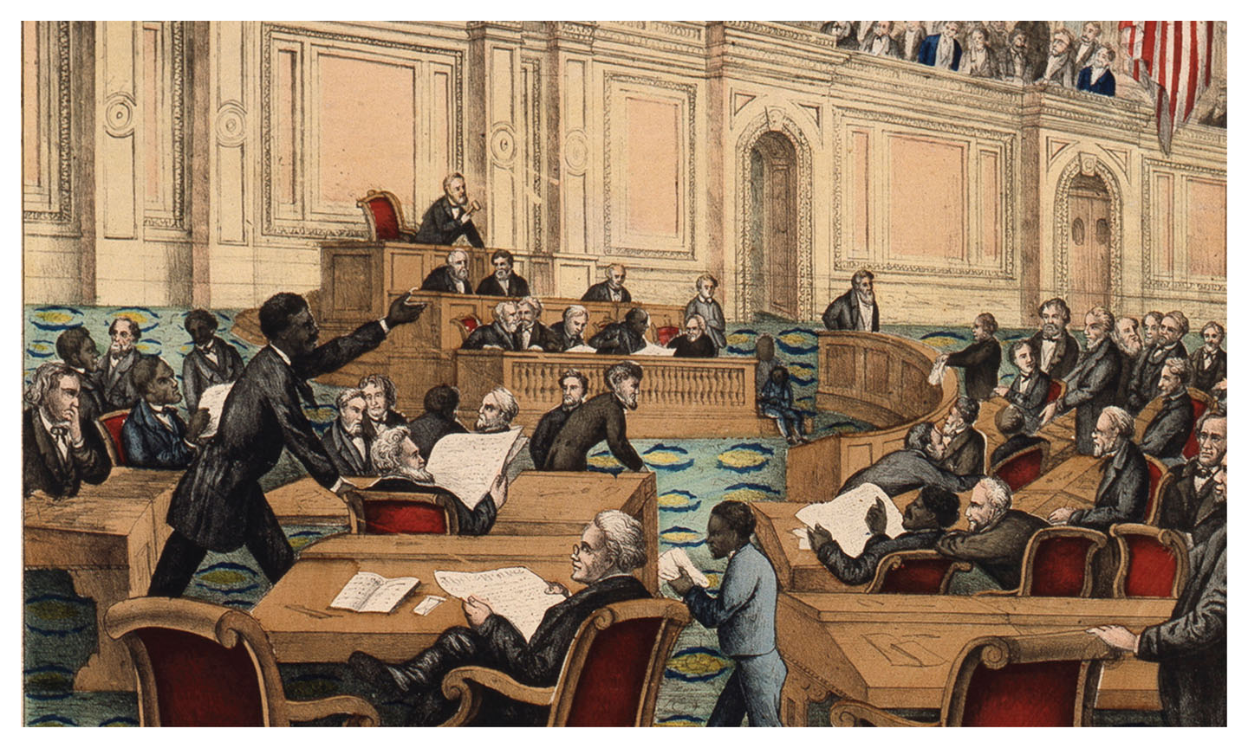
RECONSTRUCTION
Aftermath of the U.S. Civil War, 1863-1877
U.S. History Since 1865

Slide 2
What is the question of this lecture?
Was Reconstruction a failure, a success, or a defeat?*
* Did it fall down, or was it pushed?

Slide 3
but first let’s pick up where we left off...
What is Total War?

Slide 4
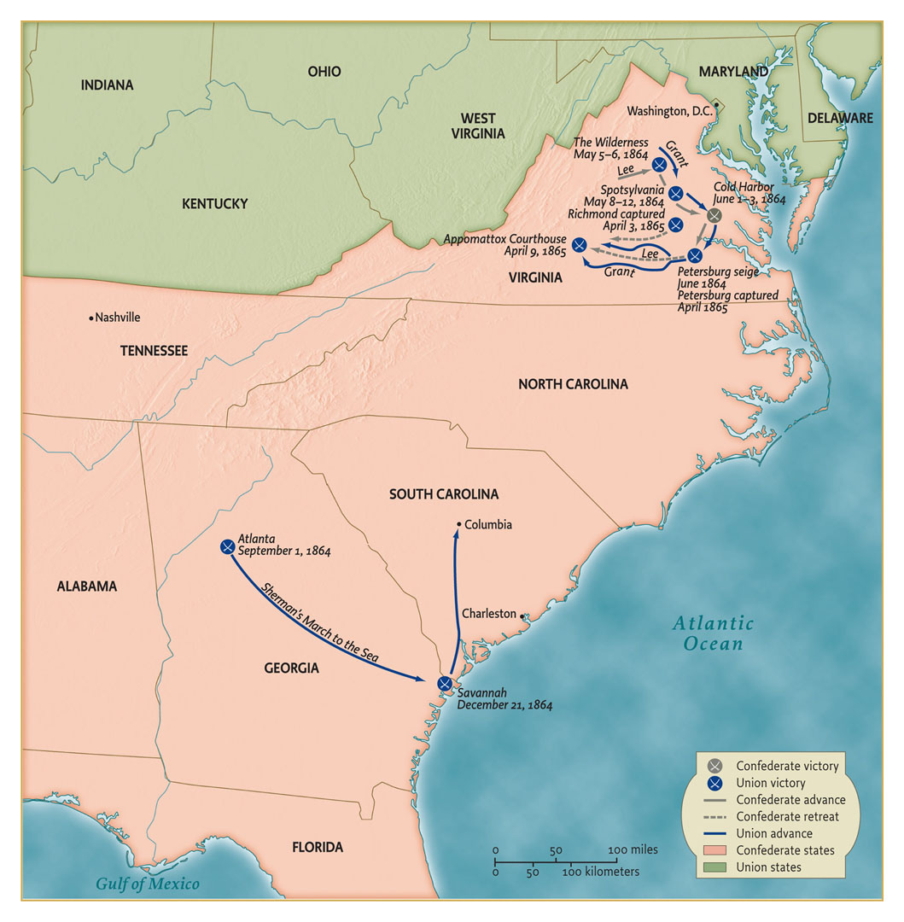

Slide 5
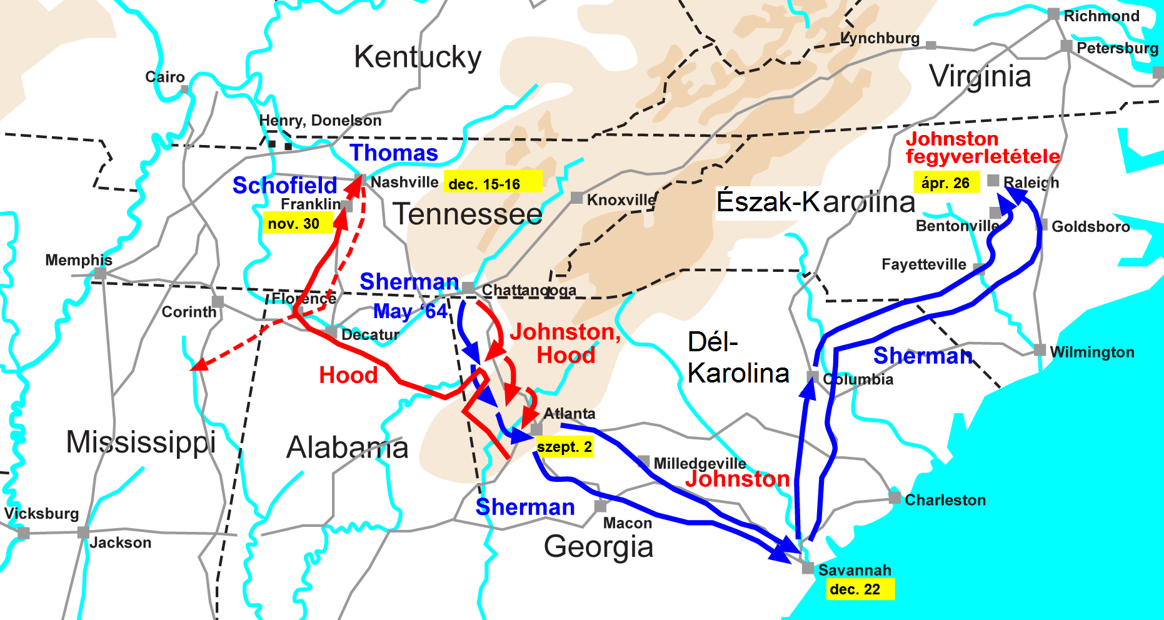
Sherman’s Campaign, May 1864 to April 1865
Map (in Hungarian language) shows Sherman’s army defeating Confederate forces under Hood and Johnston, clearing the way for the capture of Atlanta and a march through the industrial-agricultural heartland of Georgia... (continued next page)

Slide 6
Map on preceding page (in Hungarian) shows Sherman’s army invading Georgia out of Tennessee starting in May 1864. In the summer they won a series of battles against Confederate forces under Hood and Johnston, clearing the way for the capture of Atlanta in September.
Much of the city burned down. News of the Union victory assured Lincoln’s reelection against George McClellan, the former Union commander turned peace candidate. In the course of Sherman’s ‘March to the Sea’ the industrial-agricultural heartland of Georgia was subjected to scorched-earth destruction. Union forces plundered farms for supplies, burned factories and destroyed railway lines. With thousands of now freed slaves following his train, Sherman issued General Order No. 15, granting lands in Georgia and South Carolina to the freedmen. (This would be reversed by President Johnson.)
Hood regrouped his diminished forces, launched a desperate counterattack into Tennessee, and met with complete defeat against the Union defenders in December – a week before Sherman reached the sea at Savannah.
Militarily, the Confederacy was finished. Sherman turned north to continue the campaign through South and North Carolina, aiming to attack Lee’s Army of Virginia from the south, until the Confederate surrender in April 1865.

Slide 7
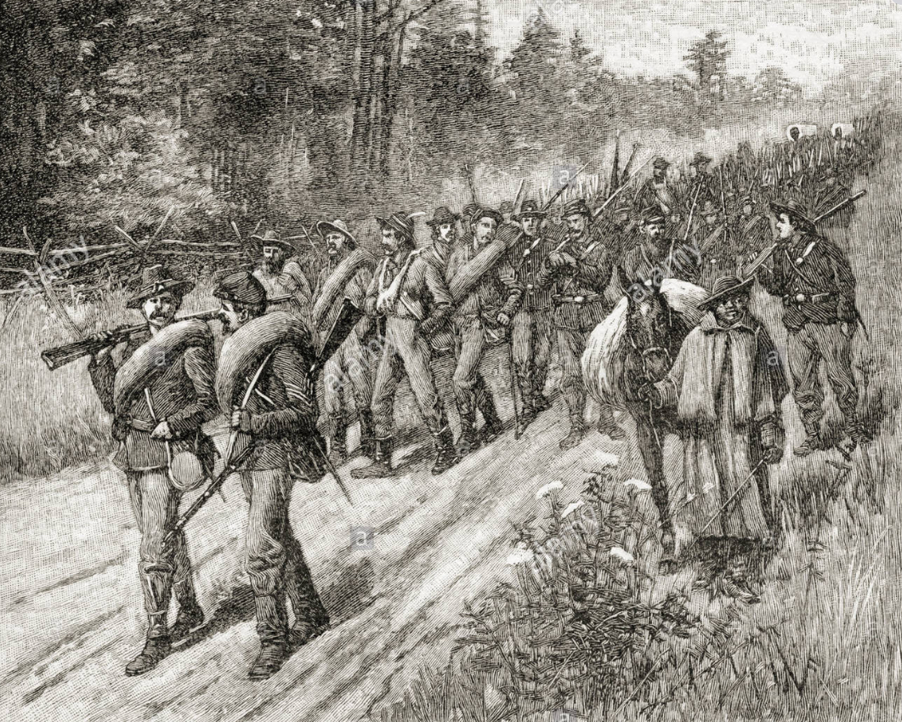

Slide 8
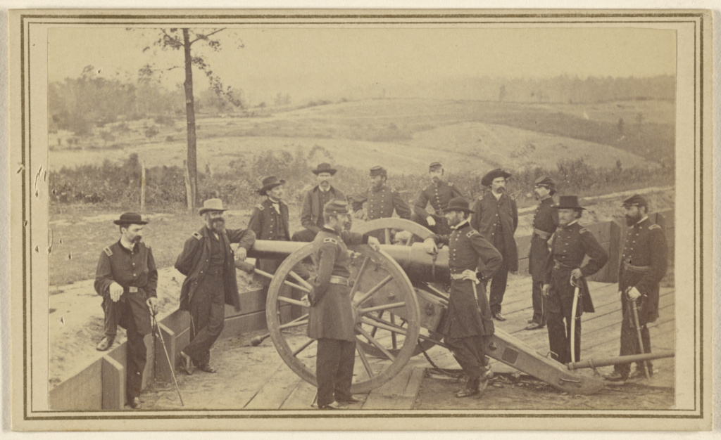

Slide 9
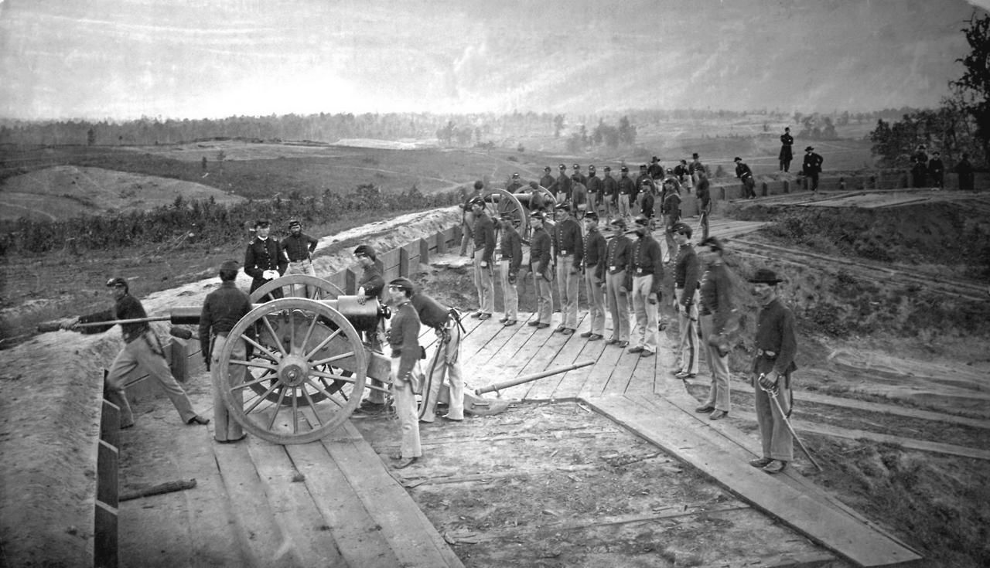

Slide 10
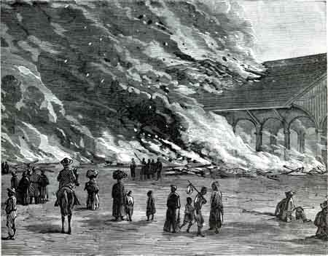
Atlanta, September 1864

Slide 11
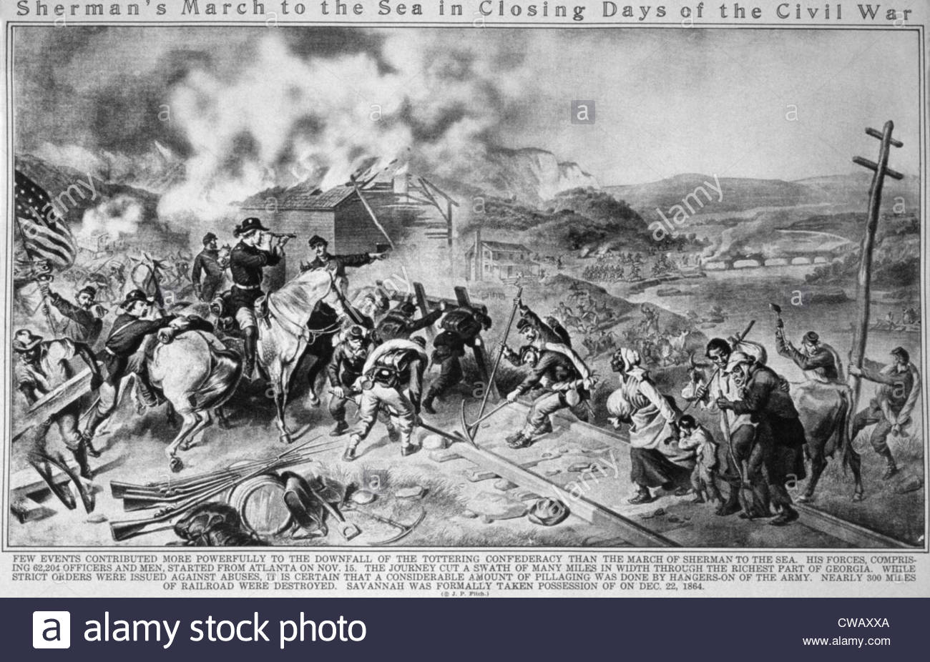

Slide 12
War Becomes Increasingly Total (I)
What is total war? Everything is viewed in terms of its resource value. Militaries reorganize and rationalize on national scales.
Through emotion, persuasion, mobilization and force, the state at war attempts to enlist the maximum conceivable and possible homefront commitment. Economic planning aims to maximize production. No money limits, only resource limits.
Loss of distinction between military and civilian targets as all enemy capacity is targeted: “Sherman’s March to the Sea.”
Promises and incentives to subaltern (lower) classes and castes.

Slide 13
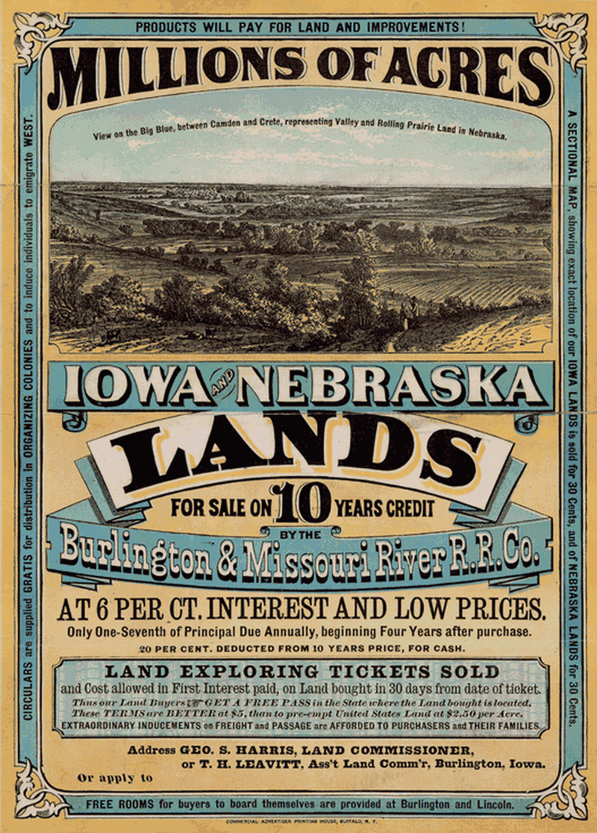
1862 POSTWAR
PLANNING MEASURES
Homestead Act
Land Grant Colleges
Union-Pacific Railway
Poster shows postwar offer of lands in Iowa and Nebraska, with a 10-year credit plan. Buyers could buy tickets allowing them to explore and stake a claim. These lands were originally granted to a railway company and later sold off as excess after the railway construction.

Slide 15
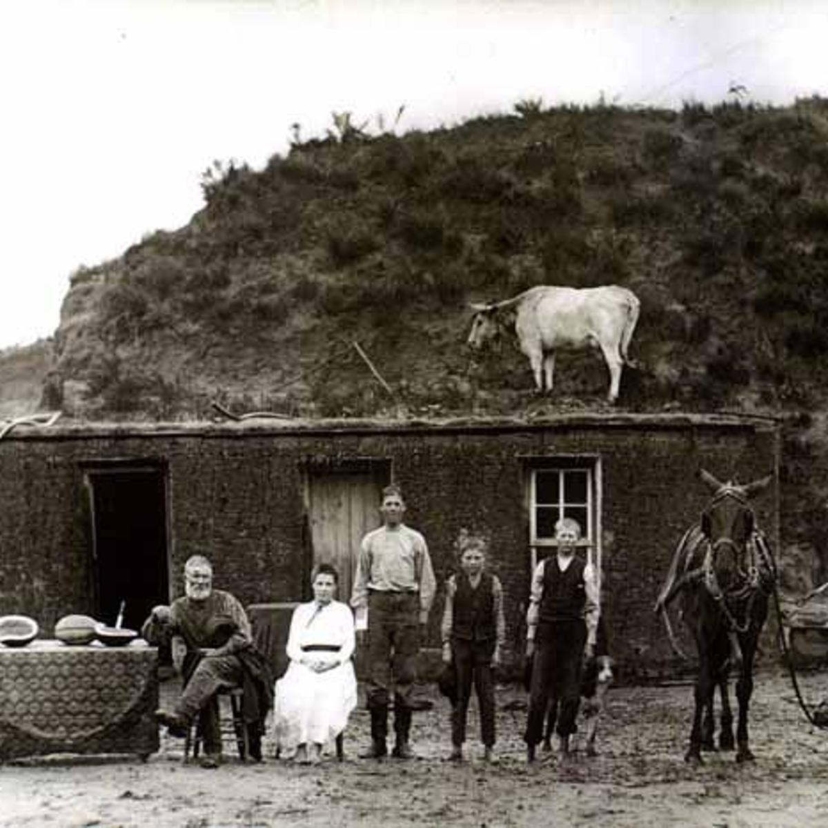
Library of Congress writes:
‘Signed into law by President Abraham Lincoln on May 20, 1862, the Homestead Act encouraged Western migration by providing settlers 160 acres of public [federally-owned] land. In exchange, homesteaders paid a small filing fee and were required to complete five years of continuous residence before receiving ownership of the land. After six months of residency, homesteaders also had the option of purchasing the land from the government for $1.25 per acre. The Homestead Act led to the distribution of 80 million acres of public land by 1900.
Text source, more photos: https://guides.loc.gov/homestead-act

Slide 16
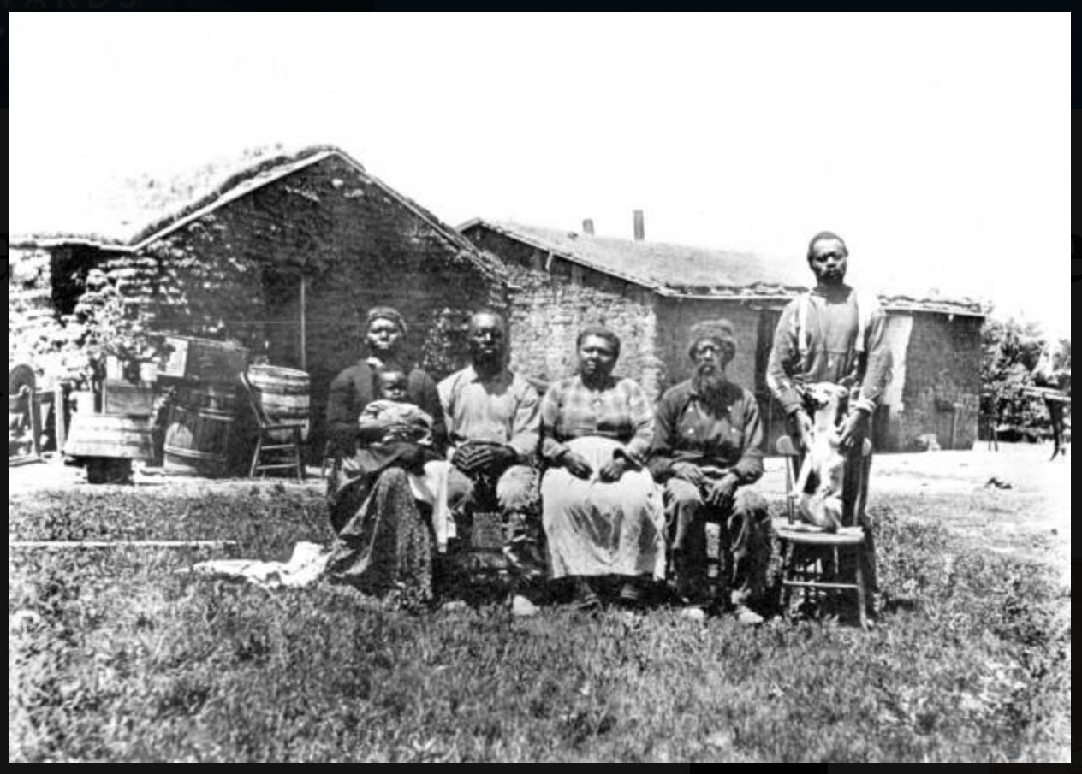
Lack of cash and obstacles to getting credit made it much harder for African-Americans such as this family in Kansas, to gain Western lands under the Homestead Act.

Slide 17
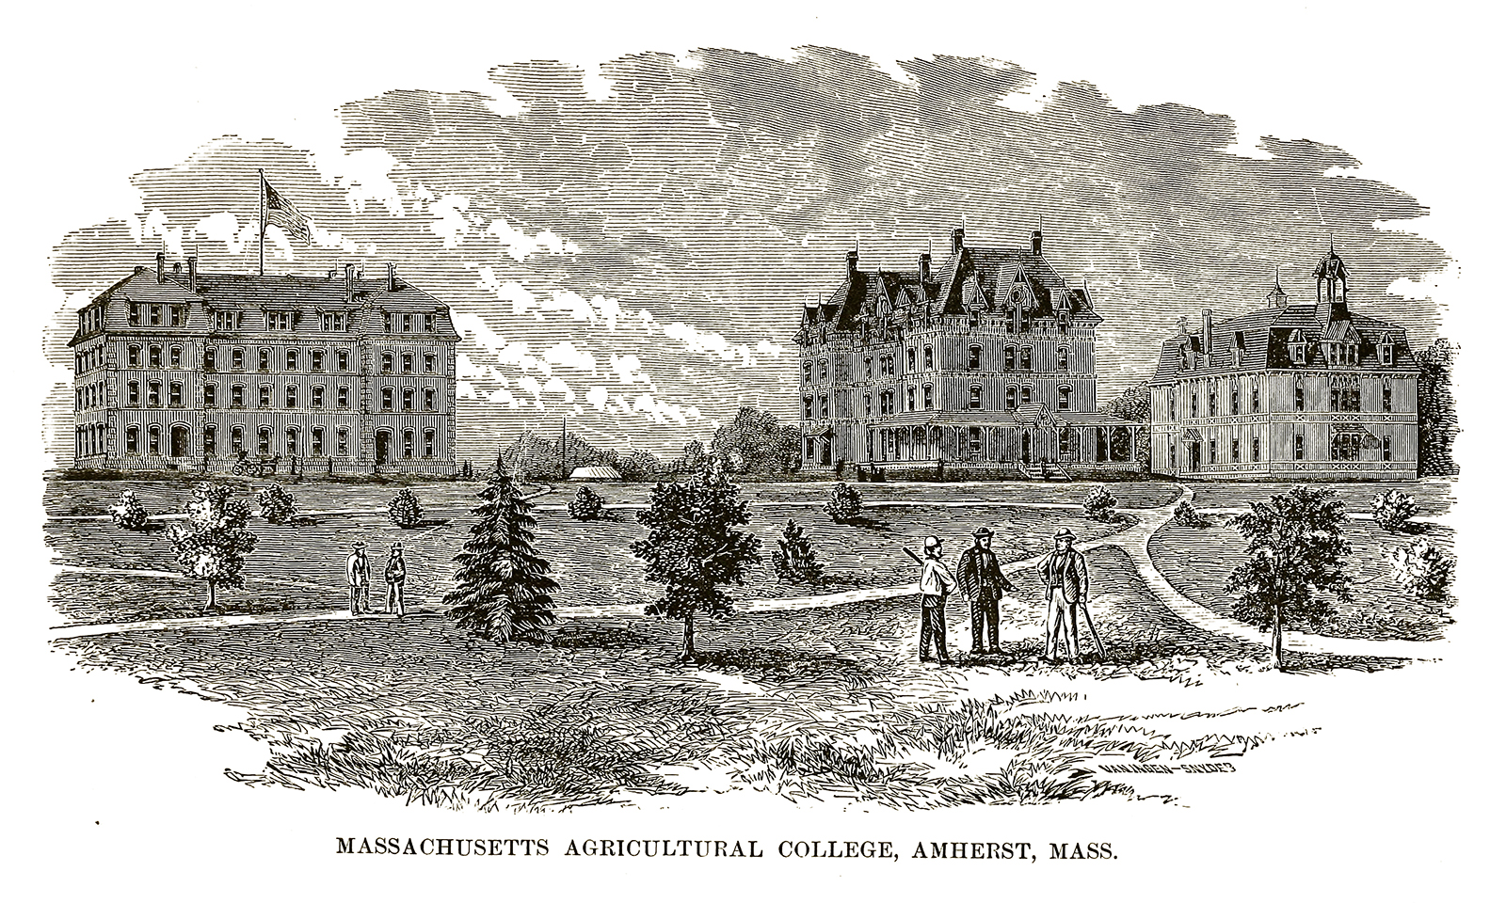
The Land Grant College Act provided federal lands and funds to create a state agricultural college in every state of the Union, so that there are 50 of these colleges today. The aim as with the Homestead Act was to encourage agricultural development and create good conditions for settlers to establish farms in the West as the promise of postwar opportunity. (The Cornell agricultural school was established in the town of Ithaca, New York, and later joined with private colleges to create Cornell University.)

Slide 18
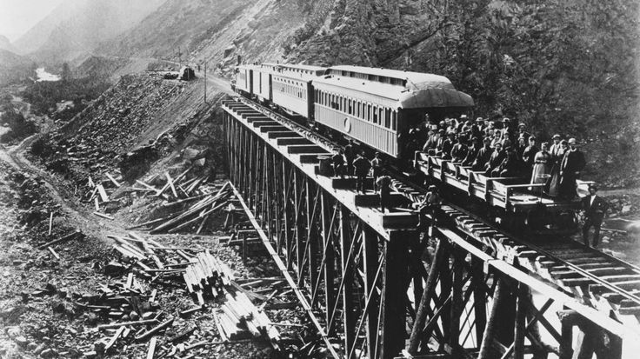
Building the Transpacific Railroad (1862-1867)

Slide 19
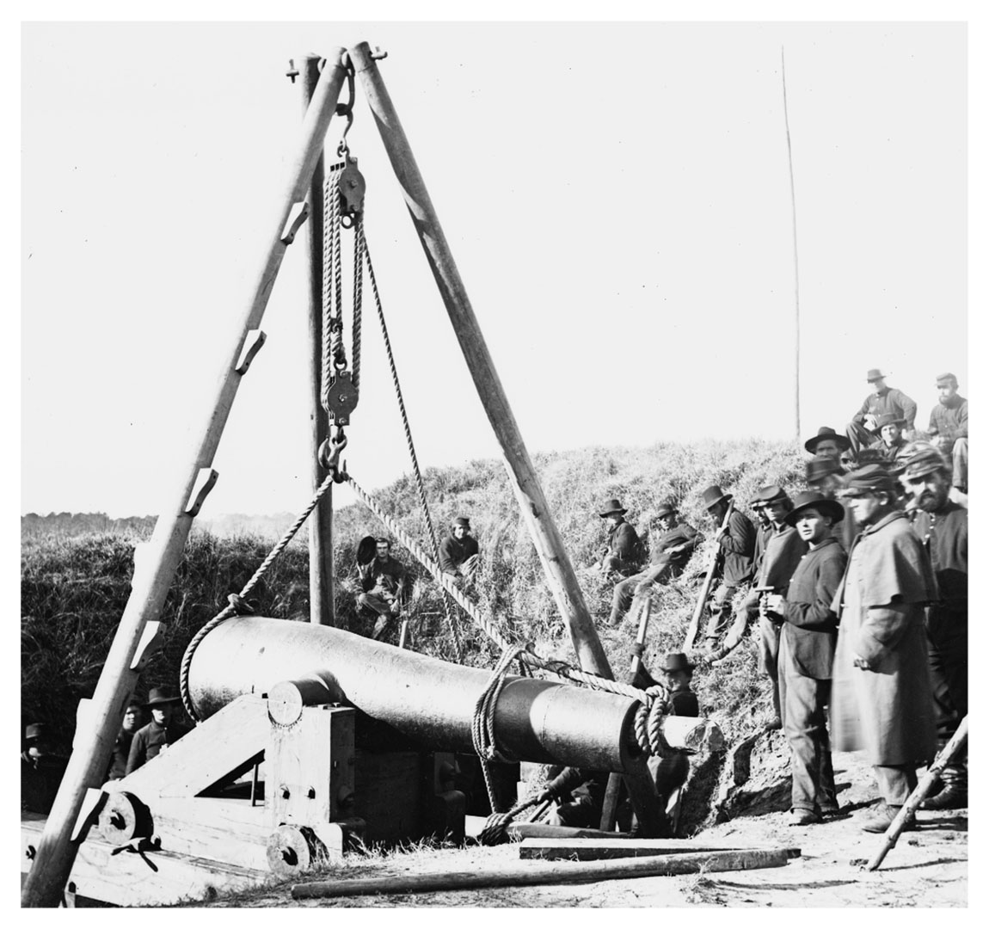
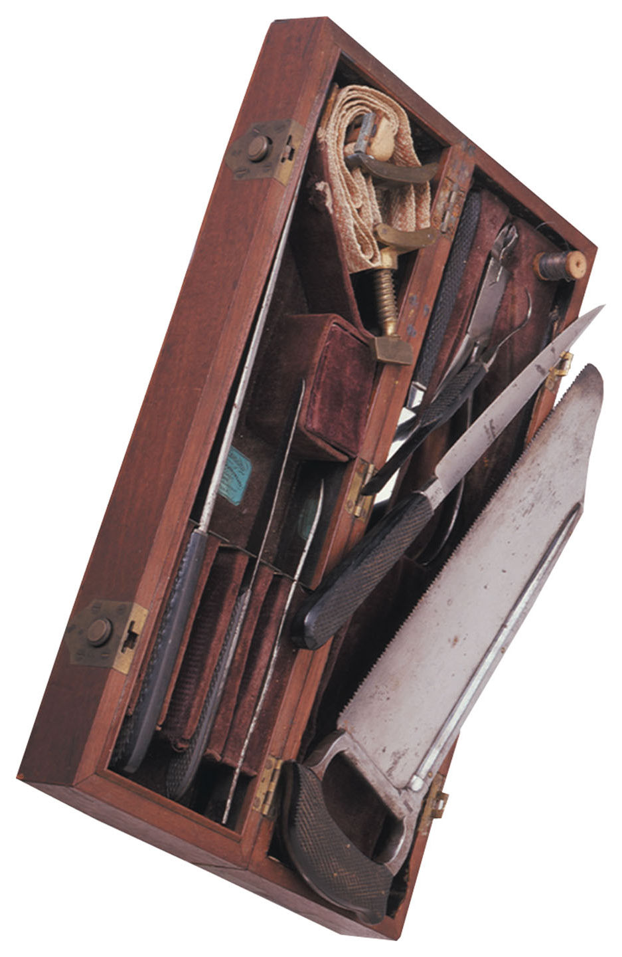

Slide 20
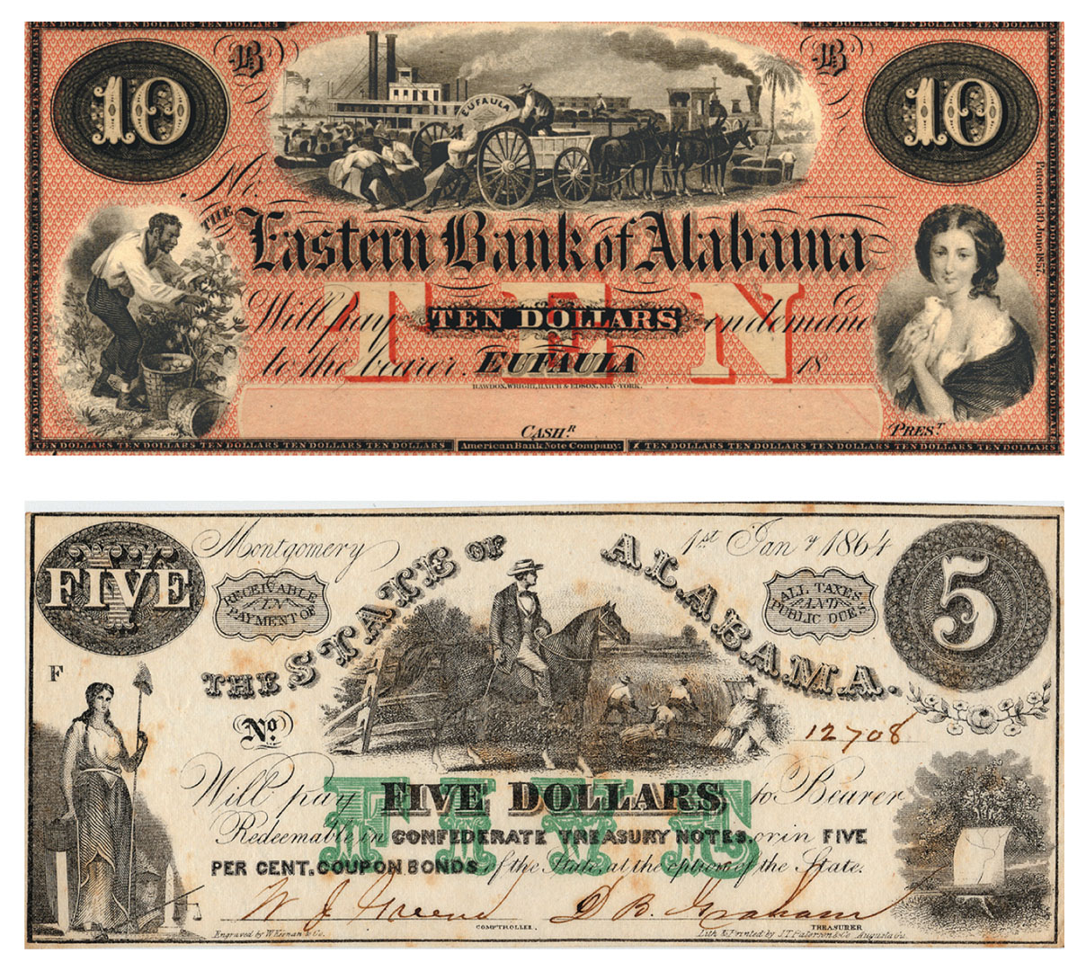
The centrality of slavery to the Confederacy is illustrated by the paper money issued by state governments and private banks, which frequently juxtaposed scenes of slaves at work with other revered images. The ten-dollar note of the Eastern Bank of Alabama depicts slaves working in the field and at a port, along with an idealized portrait of southern white womanhood. Alabama’s five-dollar bill includes an overseer directing slaves in the field, and a symbol of liberty.

Slide 21
Thoughts on Total War, II
- Increasing cruelty, also in treatment of prisoners of war
(Andersonville, Liber Code)
- Women at war: Hospitals, cooks, support personnel.
- Espionage and traitors (Pinkertons).
- Epidemic and war become indistinguishable.
- Harsher treatment of Indian resistance: mass executions.
- ‘Excesses’ such as the Sand Creek massacre of Cheyenne and
Arapaho, Nov 1864.
Next slide: Lithograph depicts the hanging of thirty-eight Sioux Dakotas in December 1862, the largest mass execution in American history.

Slide 22
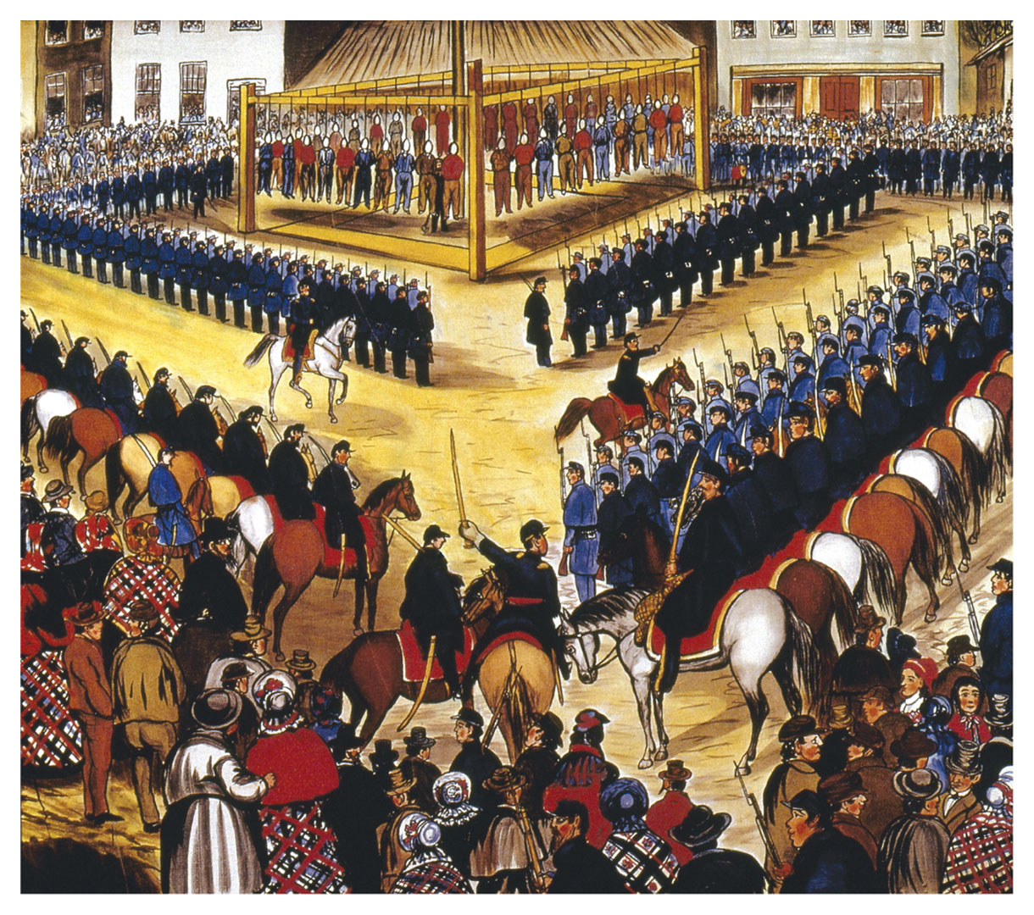
(Source: Foner)

Slide 23
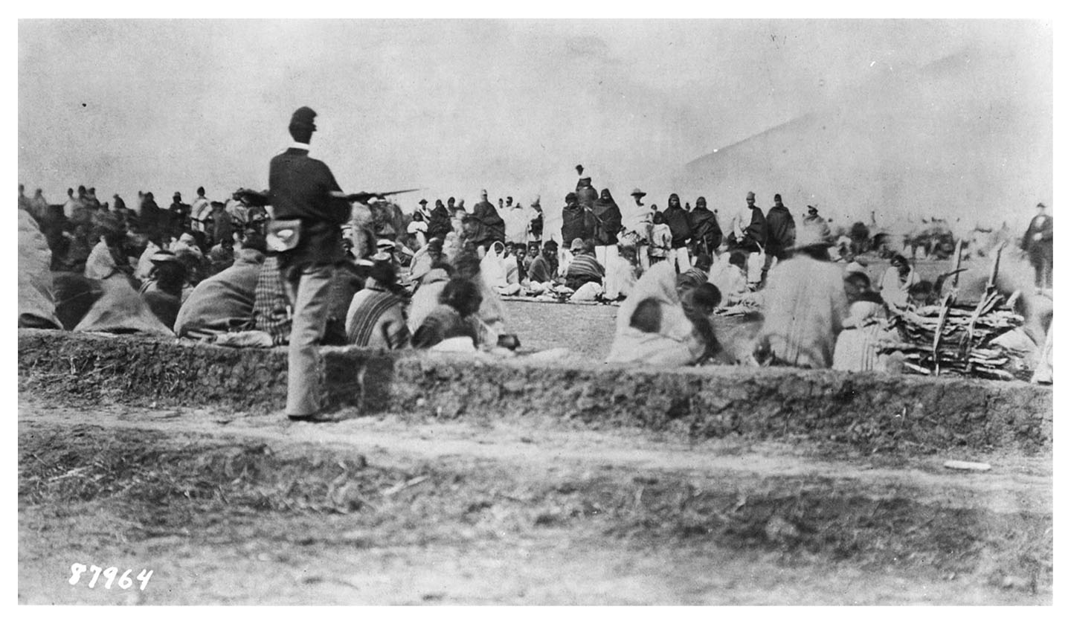
A Union soldier stands guard over a group of Indians during the Navajo’s Long Walk, in which the army removed them from their New Mexico homeland to a reservation hundreds of miles away.

Slide 24
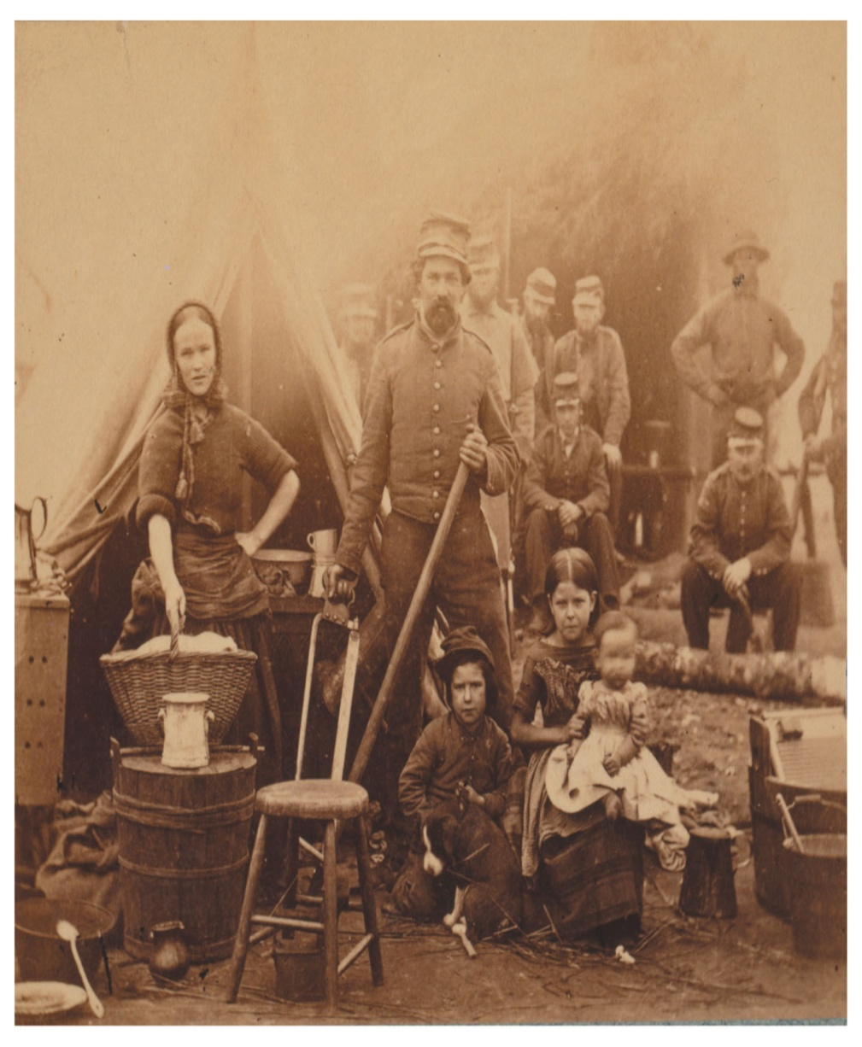
Camp of Thirty-first Pennsylvania Infantry, Near Washington, D.C., an 1862 photograph by the Mathew Brady studio.
Many women worked for the army as laundresses. Some accompanied their husbands and even brought their children.

Slide 25
Total War, III
- Massive expansion of Northern industrial base – second industrial revolution begins.
- New fortunes accumulate in the North.
- Destruction of Southern infrastructure and industry.
- Financial loss of most Southern ‘property’ (freeing of the enslaved)
- Ruptures of war encourage creation of new national mythologies. Example: Thanksgiving made official holiday in 1863.

Slide 26
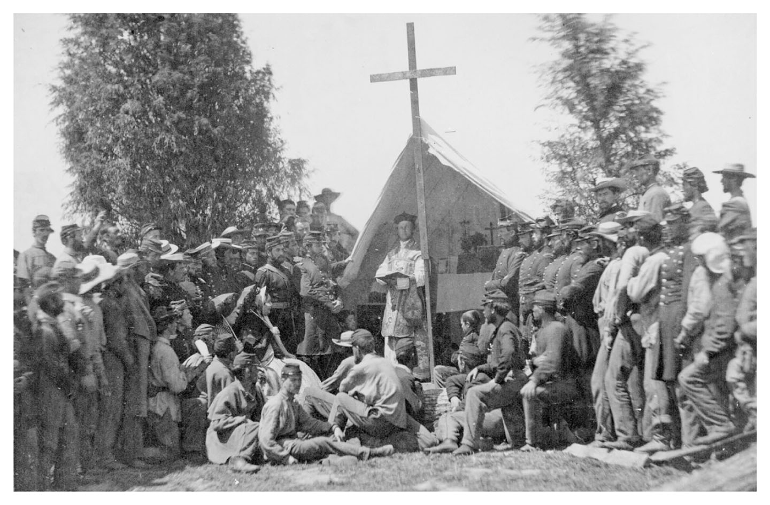
Priest conducts mass for Sixty-Ninth New York State militia, stationed in Washington, D.C., in June 1861. Photo (by Mathew Brady) illustrates how the war mitigated the anti-Catholic bias so prominent in the 1850s.

Slide 27


Slide 28
Postwar Crisis and Opportunity
- Can anything happen?
- All Southern society in some sense refugee and on the move.
- Appearances can deceive.

Slide 29
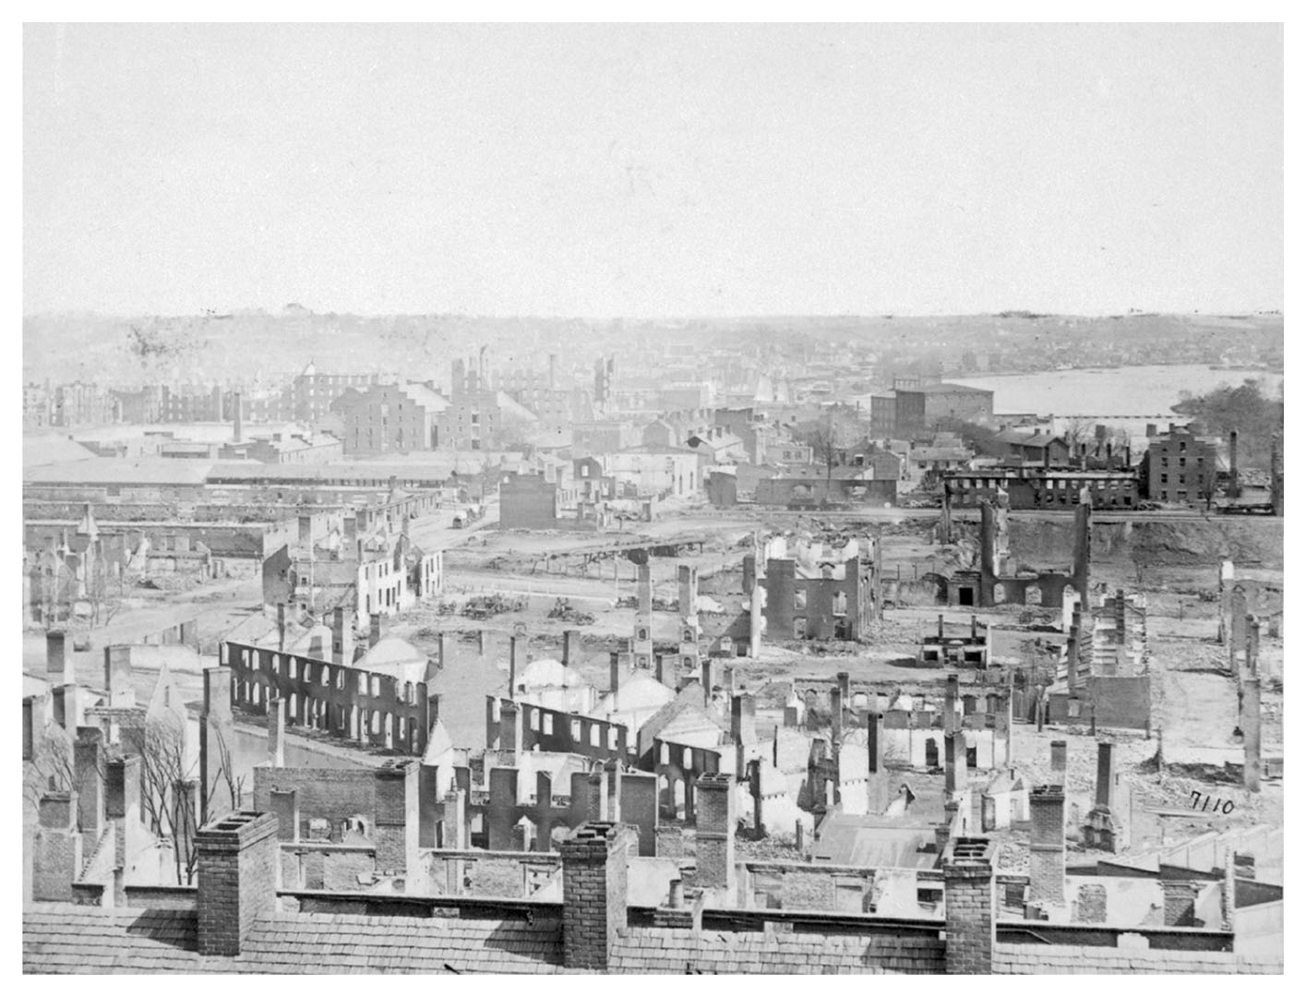
1865 – Victory, assassination,
“Presidential Reconstruction”

Slide 30
1865: Immediate Effort to Reverse the War
- ‘Presidential Reconstruction’ is near-immediate restoration.
- Johnson enacts mass pardons of Confederate officers and officials.
- Restoration of lands given to freedmen under General Order No. 15.
- Land property not challenged. Possibly single most important factor.
- Beginnings of the sharecropping model.
- Defeated Confederate states pass Black Codes, elect Confederates to legislatures and Congress.
- Ku Klux Klan forms.
- Myth of the ‘Noble Cause’ is born.

Slide 31
The Barrow Plantation
On the next page, see the two maps given in Foner, Give Me Liberty!, of the Barrow Plantation, Oglethorpe Country, Georgia, in 1860 and 1881.
The caption in Give Me Liberty! reads as follows:
Two maps of the Barrow plantation illustrate the effects of emancipation on rural life in the South. In 1860, slaves lived in communal quarters near the owner’s house. Twenty years later, former slaves working as sharecroppers lived scattered across the plantation and had their own church and school.
Now look at the maps. What visually obvious fact does the caption not mention?

Slide 32
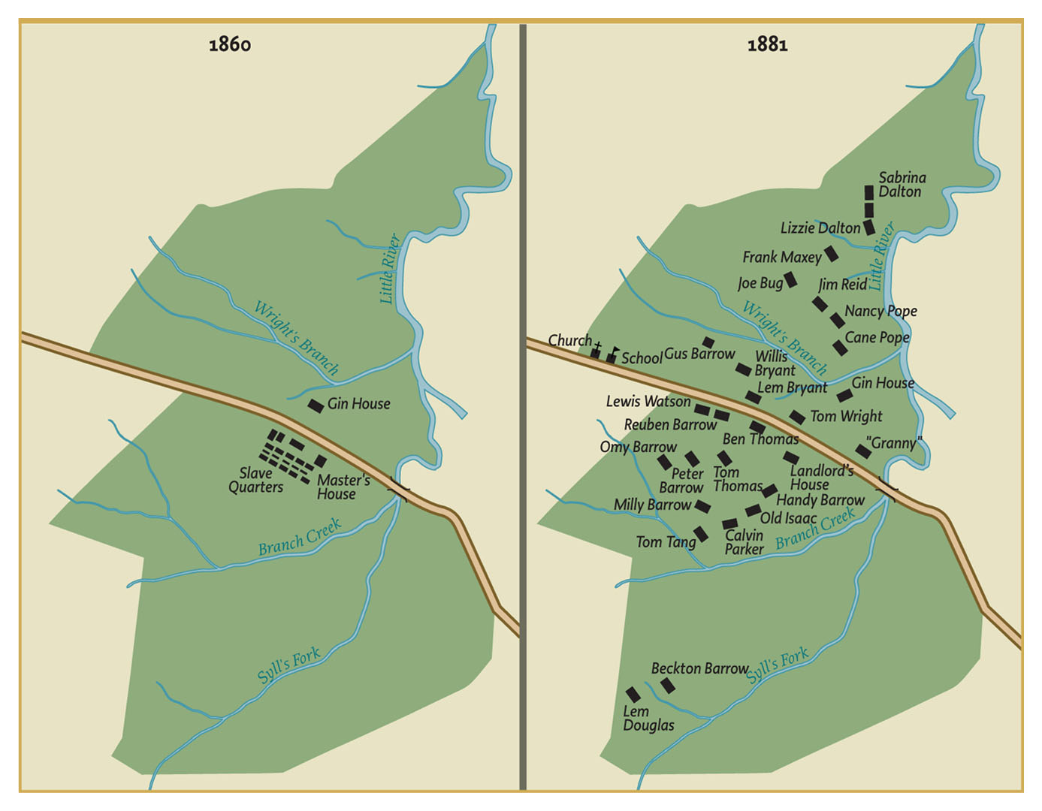

Slide 33
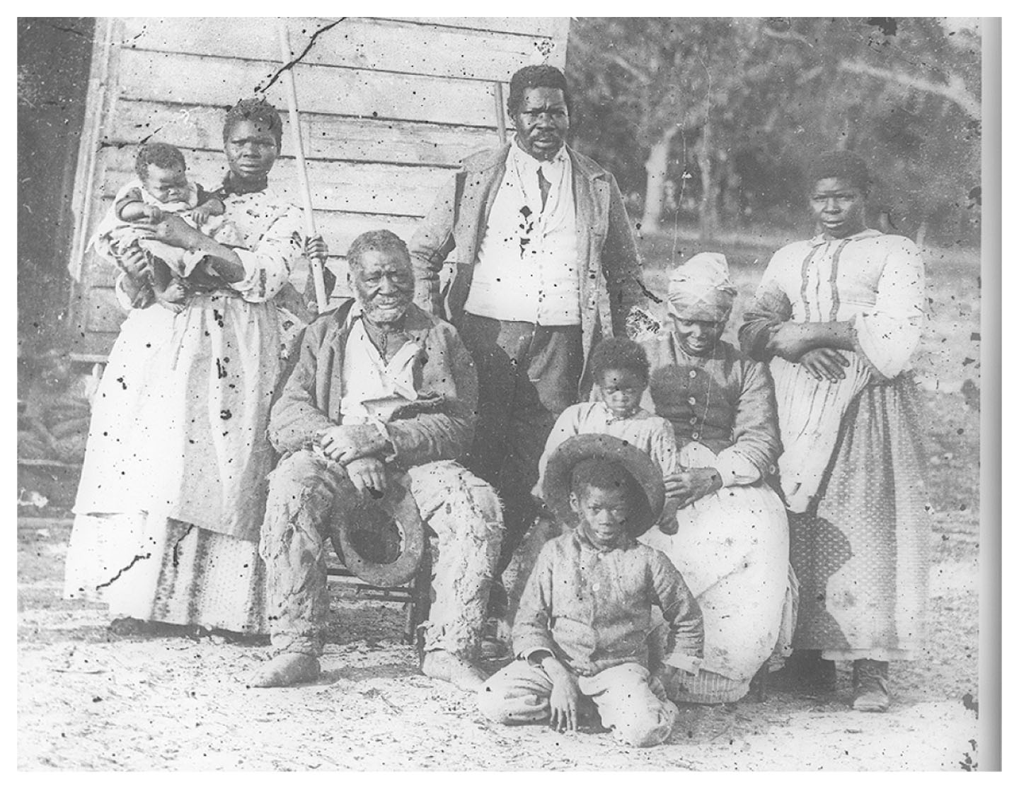
Undated photograph, ca. 1850s-1870s

Slide 34
Radical Republicans Take Charge
- Dec. 1865, Congress reconvenes. Northern Republican majority blocks reentry of southern Democrats. Radical Republicans move to end Andrew Johnson’s ‘Presidential Reconstruction’.
- Reconstruction Acts, passed against presidential veto in 1867, formalize military occupation of Southern zones.
- Conditions are set for readmission of Southern states to the Union: Must pass 13th and 14th amendments and protect the black vote.
- Impeachment of Johnson over his attempts to fire Lincoln cabinet members. Conviction fails by single vote.

Slide 35
Freedom?
- Radical Republicans pass 14th and 15th Amendments, Civil Rights Act.
- Starting in 1867, federally supervised elections assure black vote.
- Majority black and ally legislatures in Southern states in most of the time from 1868-1876. Republican governments come to power and black men are elected to Congress and Senate.
- Suppression of KKK under President Grant starting in 1870-71.
- Freedman’s Bureau works to protect civil rights although against severe resistance.
- Desegregation of schools and transportation in South Carolina and Lousiana (most radical states).
- Black militias
- Hope

Slide 36
South Carolina Legislature

Slide 37
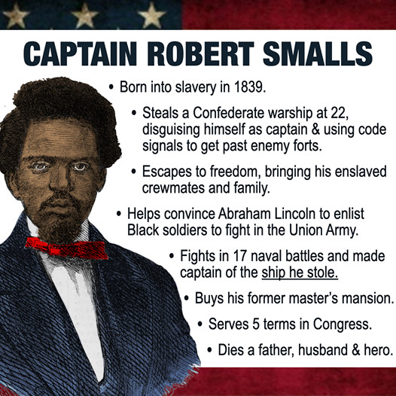
The mixed history and legacy of Reconstruction also allows for optimistic readings, as in this infographic about Robert Smalls.

Slide 38
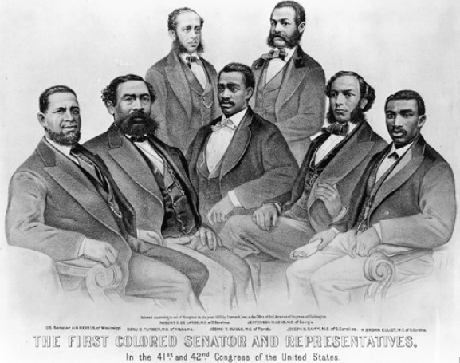

Slide 39
preceding page: ‘First Colored Senator and Representatives in the 41st and 42nd Congress of the United States.’
Print by the Currier and Ives firm, 1872. The era of Reconstruction witnessed moments of true progress. One of those was the election of African Americans to local, state, and national offices, including both houses of Congress. Left to right: Sen. Hiram Revels of Mississippi, Representatives Benjamin Turner of Alabama, Robert DeLarge of South Carolina, Josiah Walls of Florida, Jefferson Long of Georgia, Joseph Rainey and Robert B. Elliot of South Carolina. (National Archives)

Slide 40
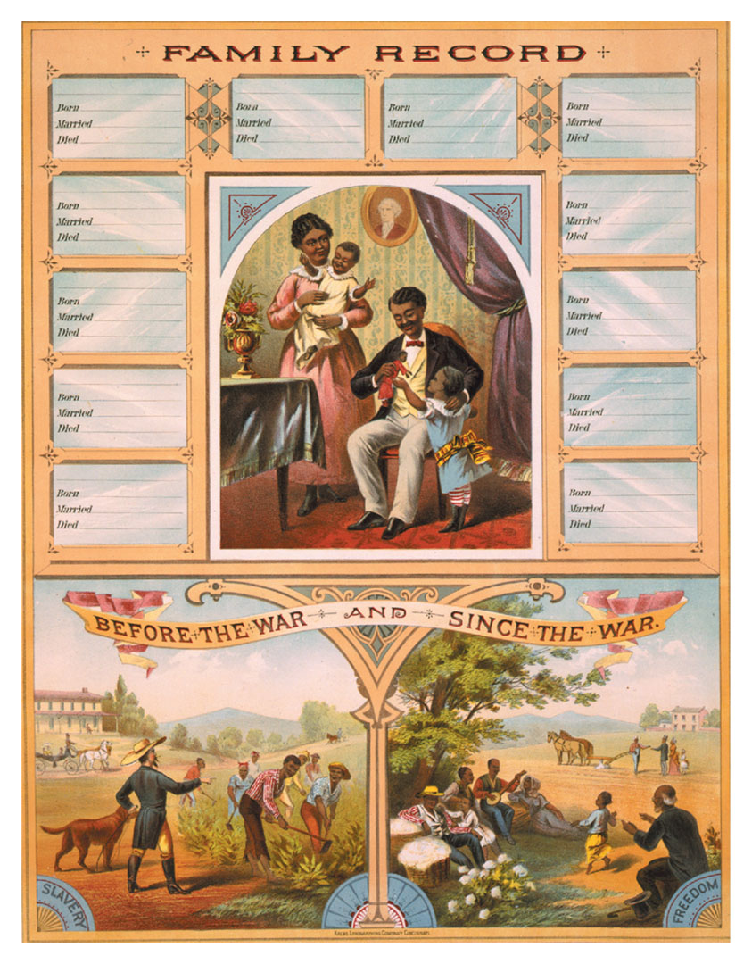
Family Record book made for black families.

Slide 41
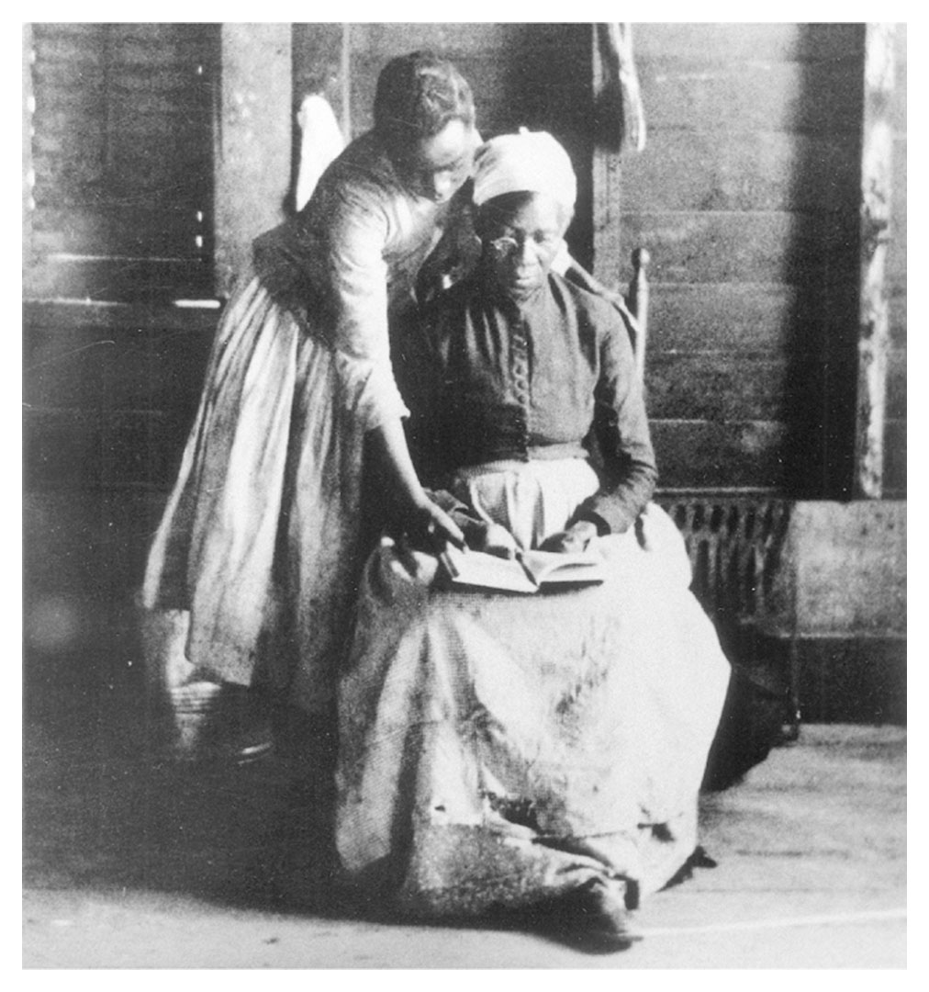
Learning to read.

Slide 42
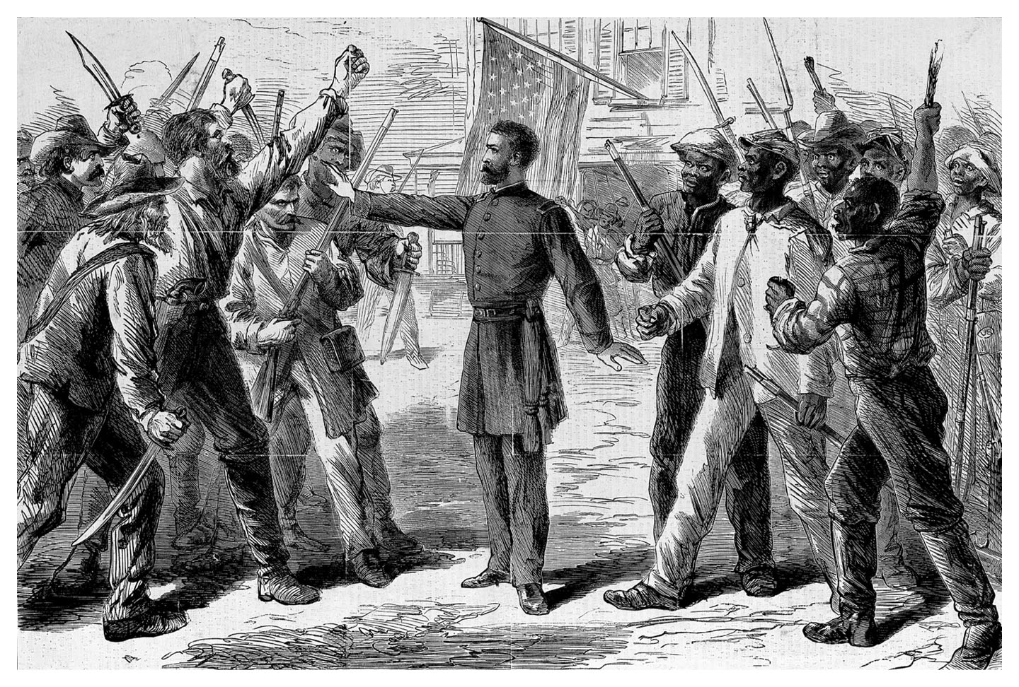
The Freedmen’s Bureau, an engraving from Harper’s Weekly, July 25, 1868, depicts the Bureau agent as a promoter of racial peace in the violent postwar South.

Slide 43
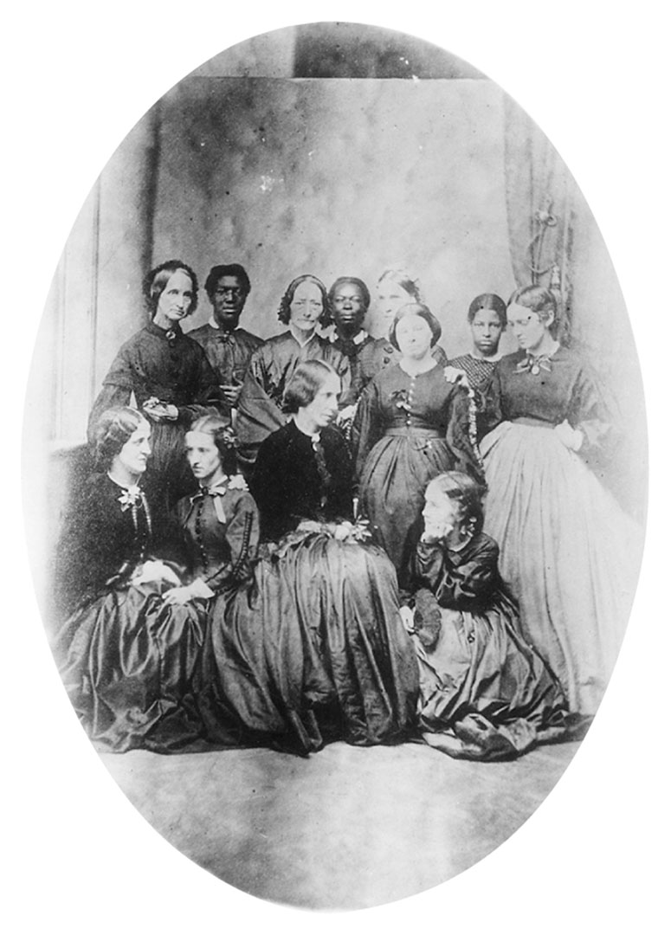
Teachers in the Freedmen’s Schools in Norfolk, 1863, a photograph of a group of black and white teachers who brought education to former slaves in a Unionoccupied part of Virginia.

Slide 44
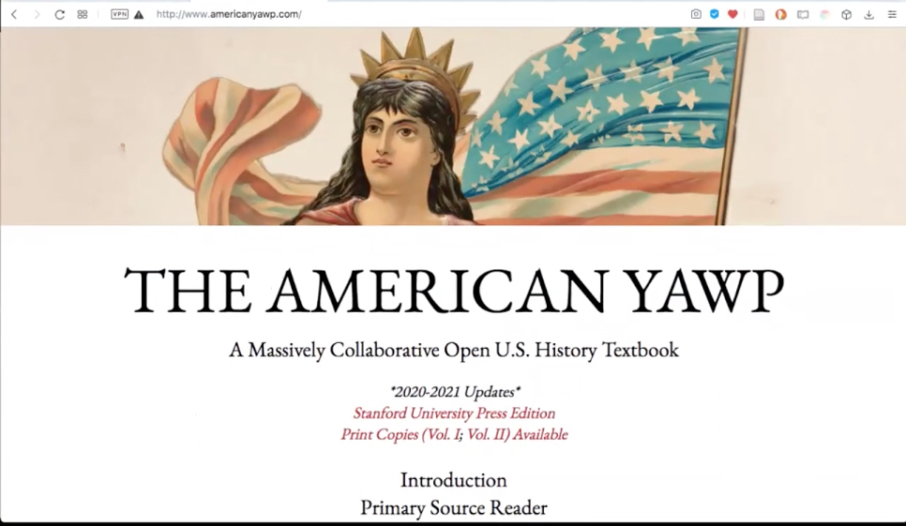
Excerpts from American Yawp, ch. 15
Primary Source Reader

Slide 45
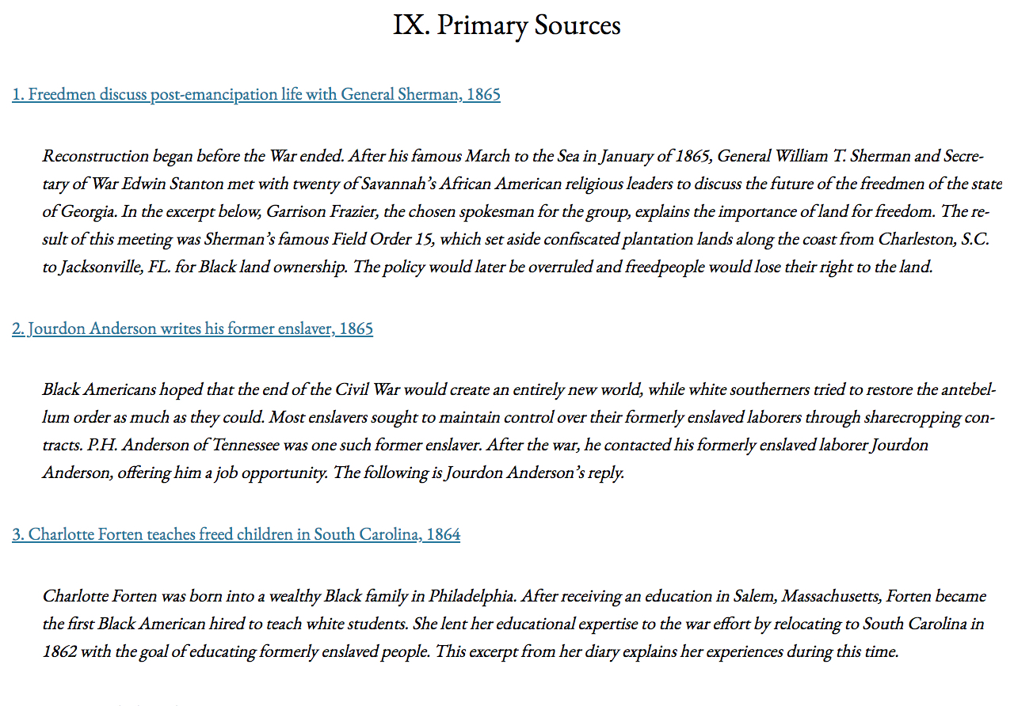

Slide 46
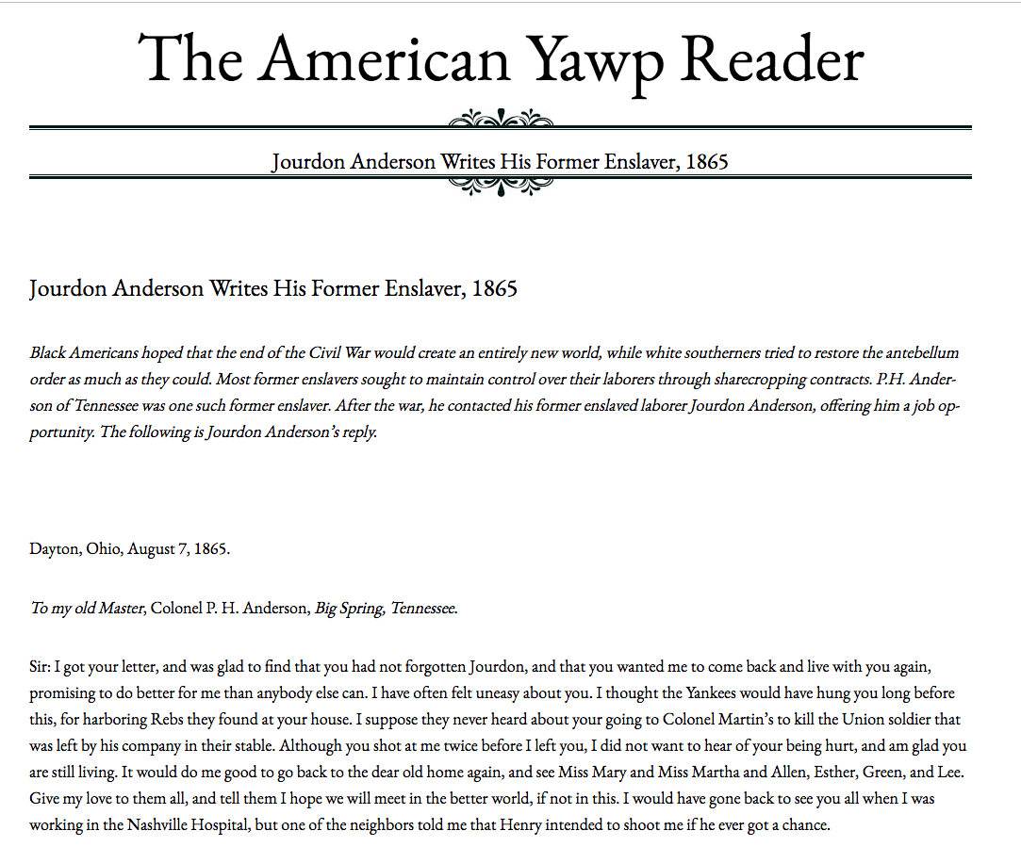

Slide 47
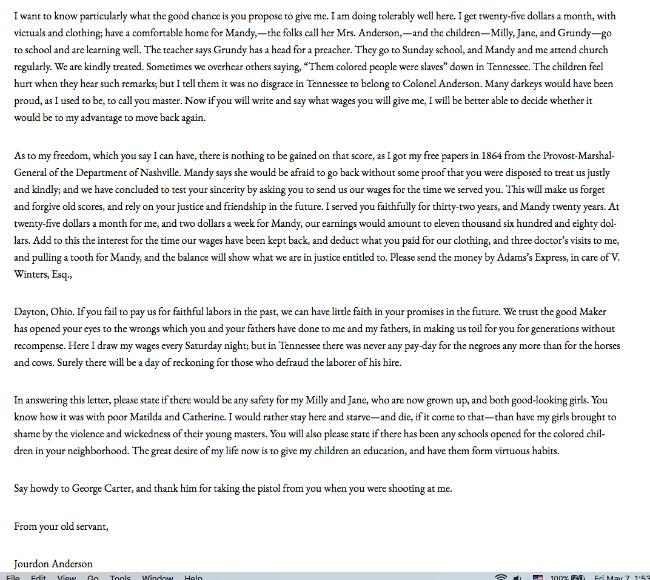

Slide 48
Backlash and ‘Redemption’
- Continued escalation of violence against black defense efforts, including lynchings and a number of major massacres (Colfax, 1875)
- Attacks on ‘carpet-baggers’ and ‘scalawags’.
- Loss of Northern support accelerates after start of Great Depression in 1873.
- Retaking of Southern legislatures by Democrats in 1870-1876. Back in power, Democrats act to suppress black vote by law and violence.
- “Compromise of 1877,” to allow Republican victory in 1876 presidential election, means removal of Union forces from South and end of Reconstruction.

Slide 49
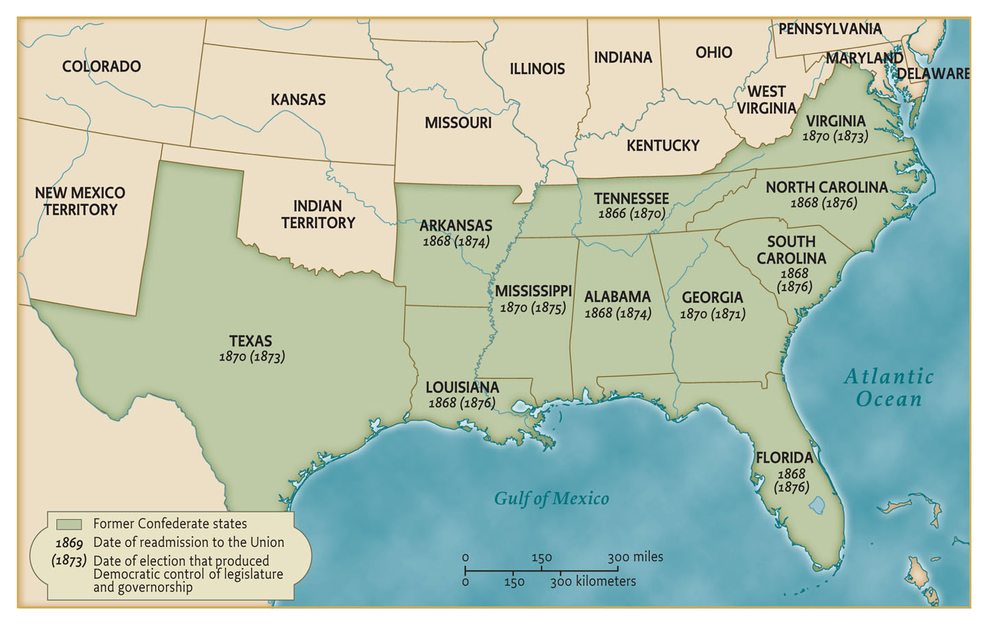
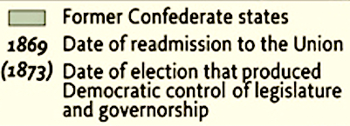
The Defeat of Reconstruction

Slide 50
Under the Reconstruction Act of 1867 (passed against Johnson’s veto), the former seceding states could apply for readmission to the Union only after (1) approval of a new state constitution by a majority vote of the people, with the African American assured; and (2) ratification of the 13th and 14th Amendments.
This initiated a period of Republican rule and Reconstruction policy in most of the Southern states. One by one, however, each state eventually reelected (or was otherwise taken over) by a Democratic government that would (1) immediately end Reconstruction policy and (2) take measures to suppress the black vote and assure permanent Democratic government.

Slide 51
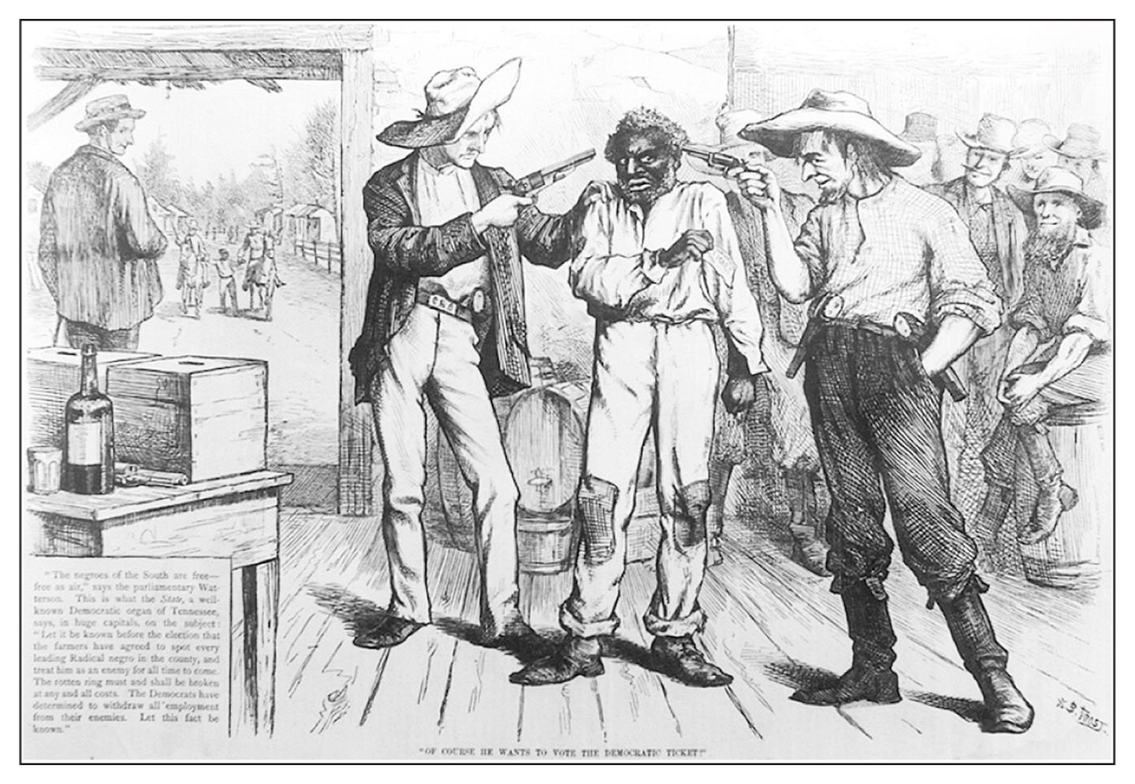
Of Course He Wants to Vote the Democratic Ticket, a cartoon from Harper’s Weekly, October 21, 1876, comments on the campaign of terror launched by South Carolina Democrats in an attempt to carry the election of 1876.

Slide 52
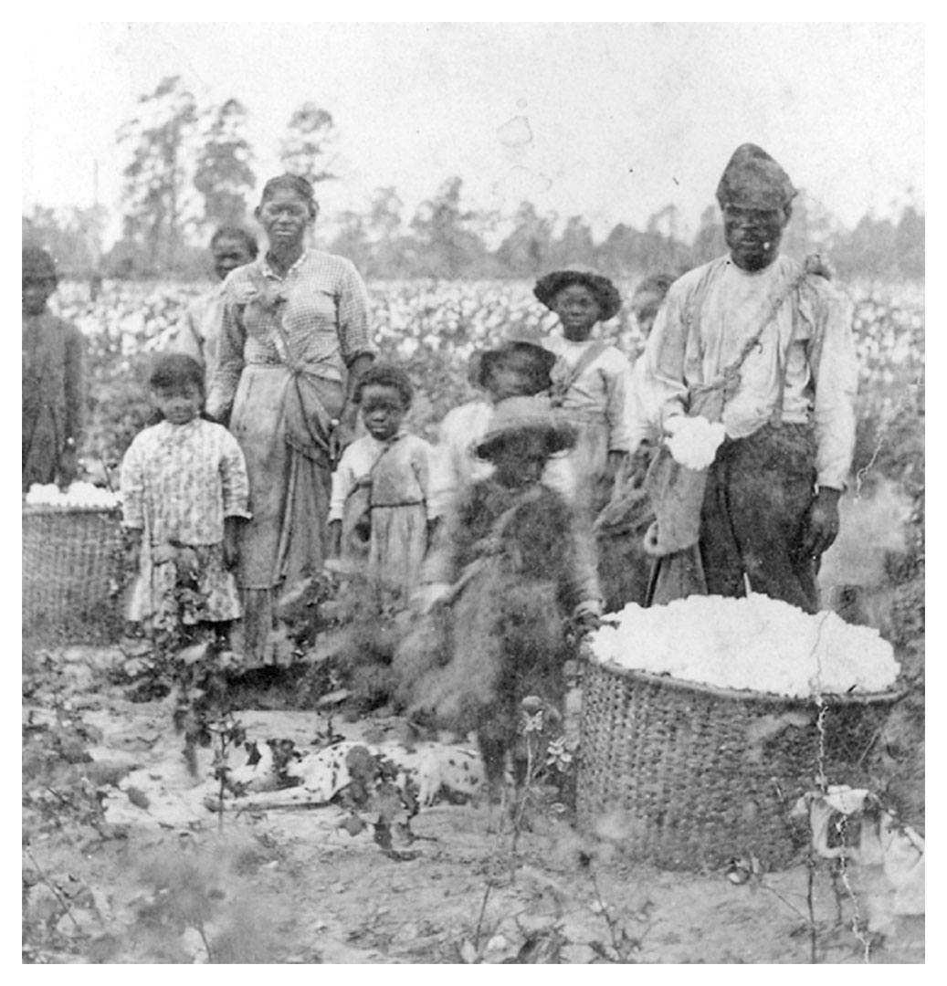
1867

Slide 53
Memory: Historical and political narratives
- Late 19th century historians and pundits posed Reconstruction posed as a failure, not a defeat. The ‘war of emancipation’ receded as narratives of the ‘Noble Cause’ or ‘Lost Cause’ and the tragedy of ‘Brother against Brother’ came to the fore. (Dunning School).
- General nostalgia for idyllic slave society.
- ‘Scientific racism’ and Social Darwinism.
- Contrast: the Pledge of Allegiance. Socialist Francis Bellamy seeks to foster unified national feeling: "I pledge allegiance to my Flag and the Republic for which it stands, one nation, indivisible, with liberty and justice for all.” (1892)

Slide 54
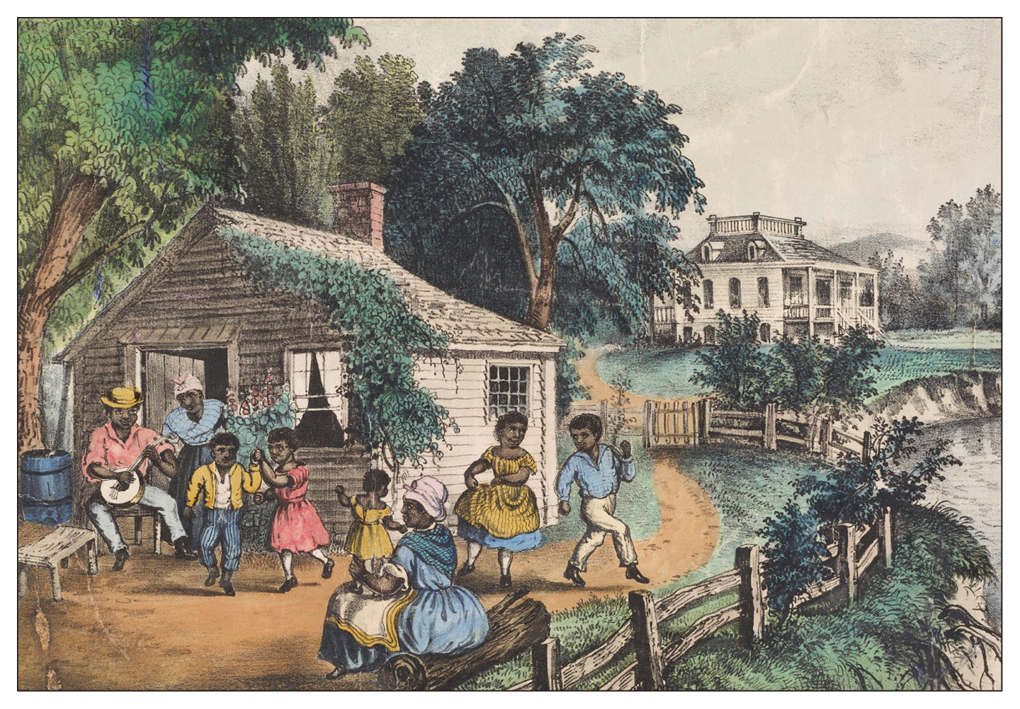
The Old Plantation Home, an 1872 lithograph produced by the prominent firm of Currier and Ives in New York, illustrates how a nostalgic image of slavery as a time of carefree happiness for African-Americans was being promoted even as Reconstruction took place.

Slide 55
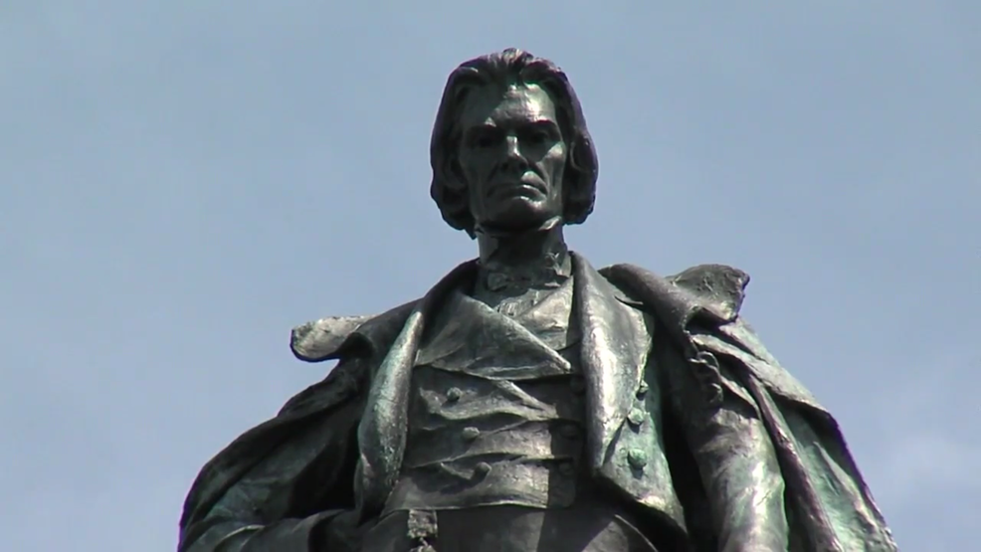
John Calhoun monument
Charleston, South Carolina

Slide 56
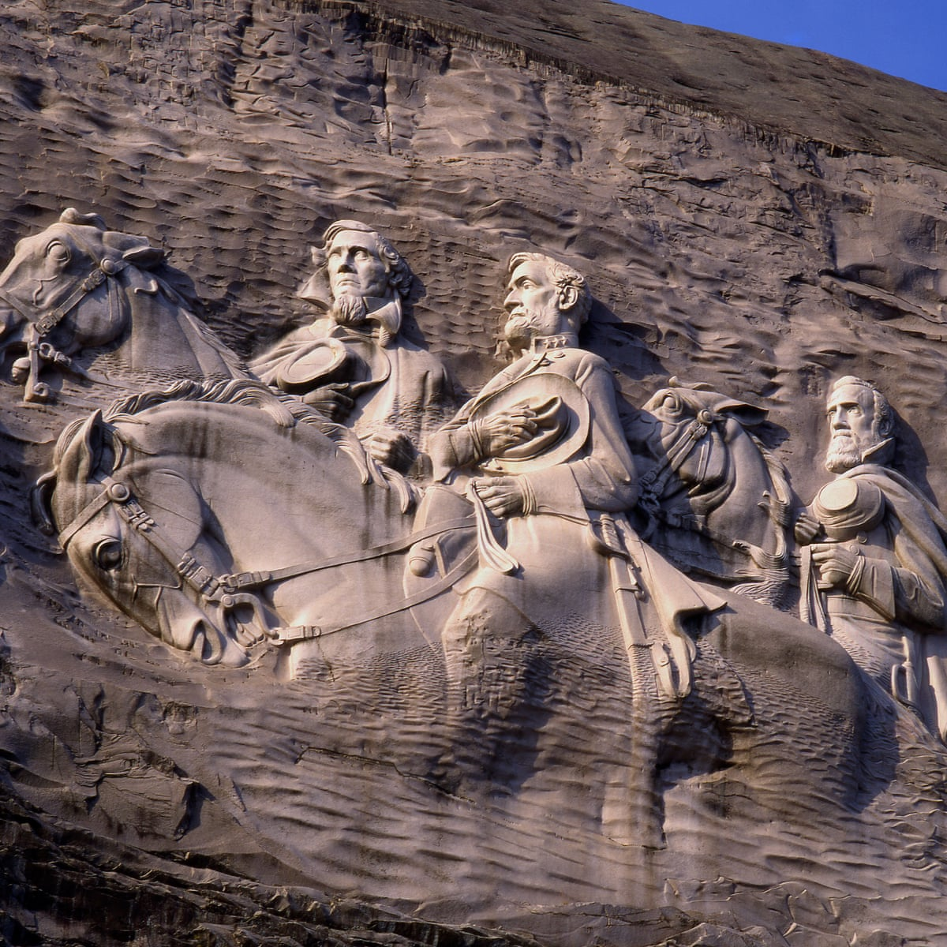
Lee and Stonewall Jackson
Rock carving at Stone Mountain, Georgia

Slide 57
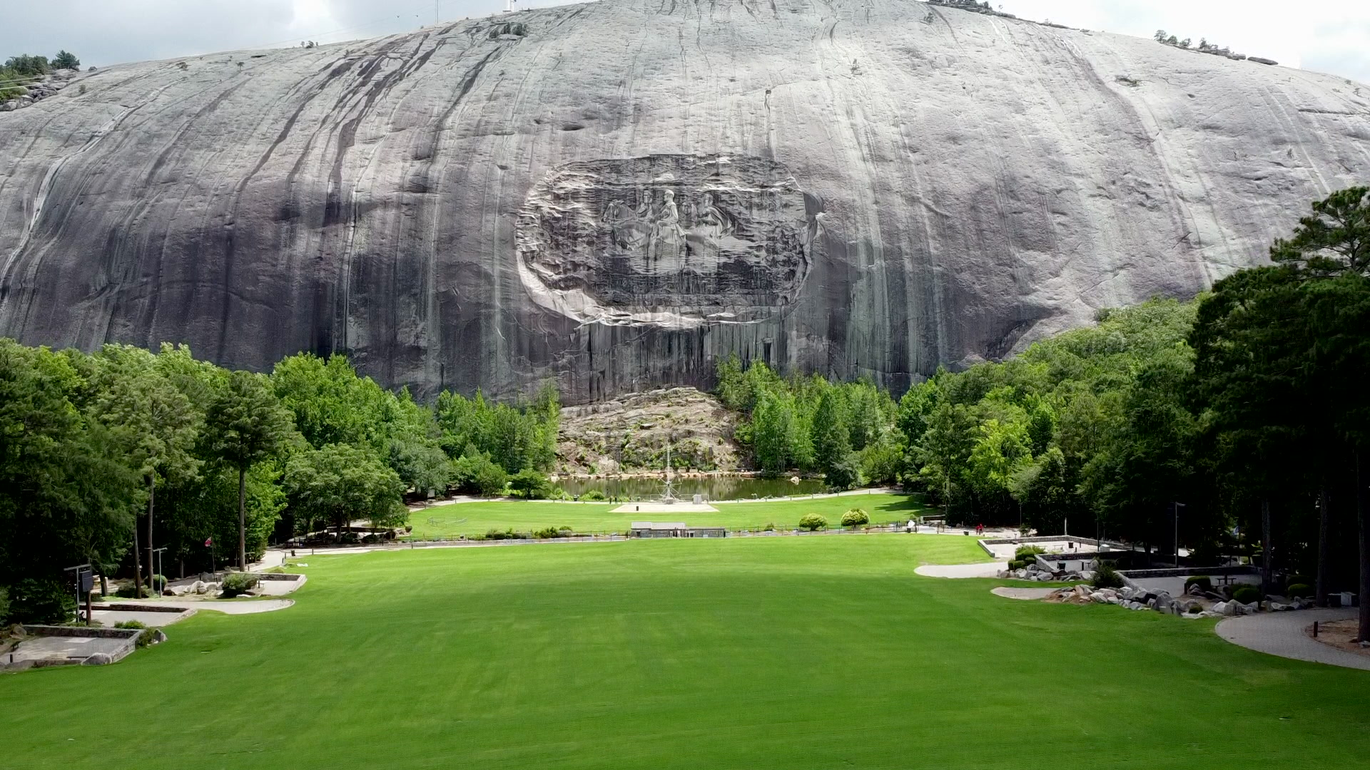

Slide 58
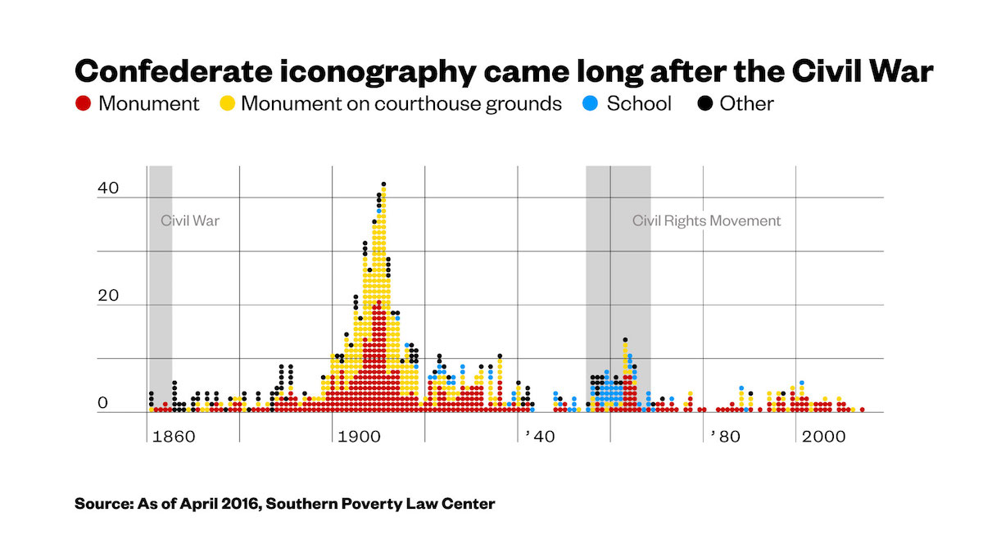

Slide 59
Long-Term Legacies
- Powerful industrial North with Republican majorities
- Economically underdeveloped, agrarian South with sharecropping model under Jim Crow segregation and the ‘Solid South’ rule of Democratic machines (Dixiecrats).
- Republican ‘American System’ -- Tarriffs, corporate personhood, gold standard, free labor.
- Labor and Capital, boom and bust, mass immigration.

Slide 60
The New West ( ‘Old West’ or ‘Wild West’ to us)
- Permanent crisis of farmers, decline of the yeomanry. Populism.
- Military after the Civil War turns to the final Indian Wars.
A ‘closing of the domestic frontier’ announced in 1890.
- Black cowboys as first Great Migration?
- Ranchers and mine-owners as political powers.
- West as entertainment show: Buffalo Bill tour with Indians already in 1880s.
- Chinese Exclusion (1882)

Slide 61
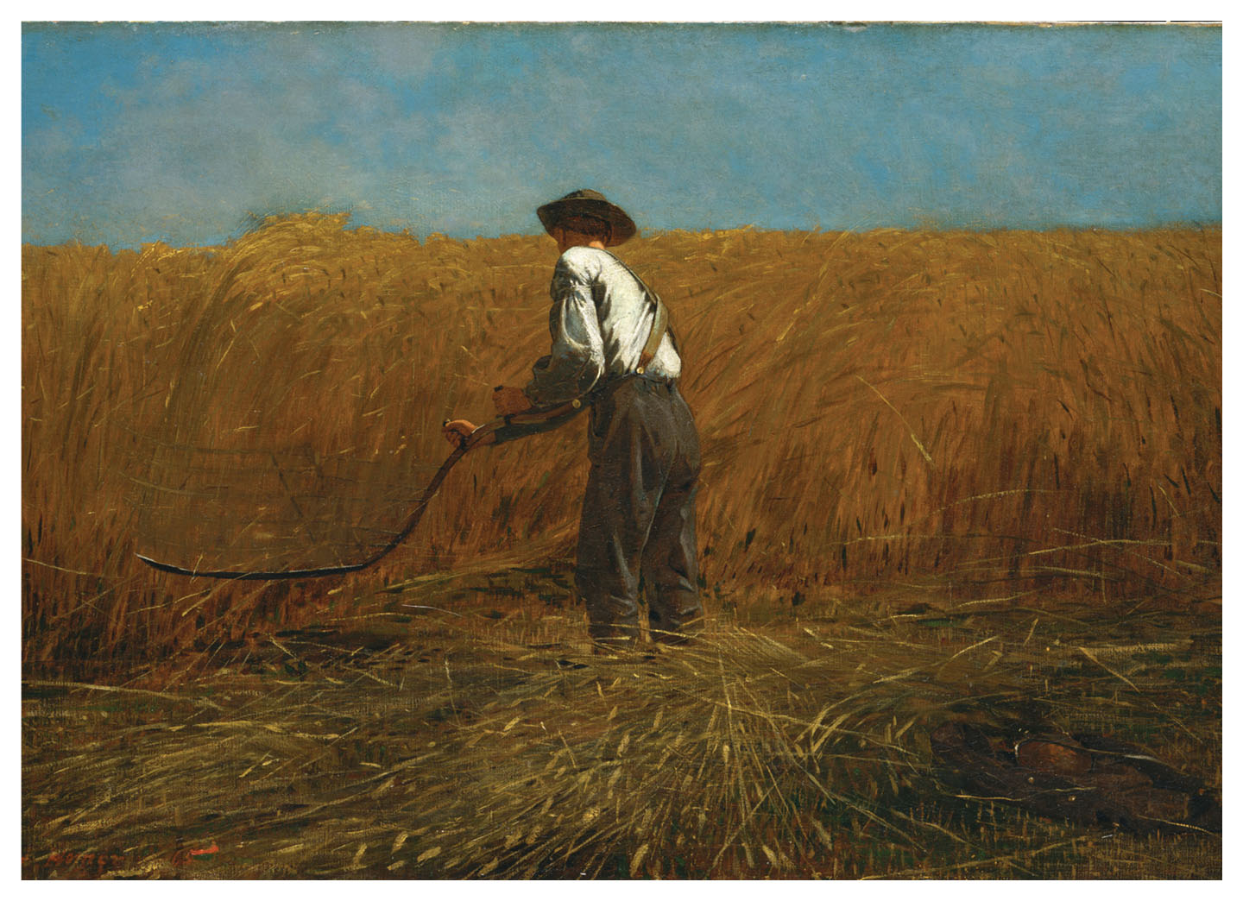

Slide 62
Caption in Foner for painting on the prior page:
Winslow Homer’s painting The Veteran in a New Field, completed in the fall of 1865, offers a reflection on the Civil War and its legacy. The one-armed former Union soldier, whose army jacket lies in the right corner, is at work cutting wheat. The scythe brings to mind the grim reaper, a symbol of death, perhaps a reference to not only war casualties but also Lincoln’s assassination. But the bountiful field suggests national regeneration.
To me, this work seems much sadder and instead prefigures the decline of the yeomanry.

Slide 63
FARMERS
Homestead Act (1862) and Land Grant Colleges
Bonanza Farms vs. Family Farms
‘Three crops: corn, freight charges, interest payments’
Victims of own productivity, prices low
Gold standard deflationary

Slide 64
FARMERS (II)
Rise of Grange and Populist movements
Modern in many ways – education and technology
Attempts to make alliances with Northern proletariat and Southern farmers meet with trouble.
Falls in 1896 with Bryan (‘Cross of Gold’)
BEST COVERAGE: POSTEL

Slide 65
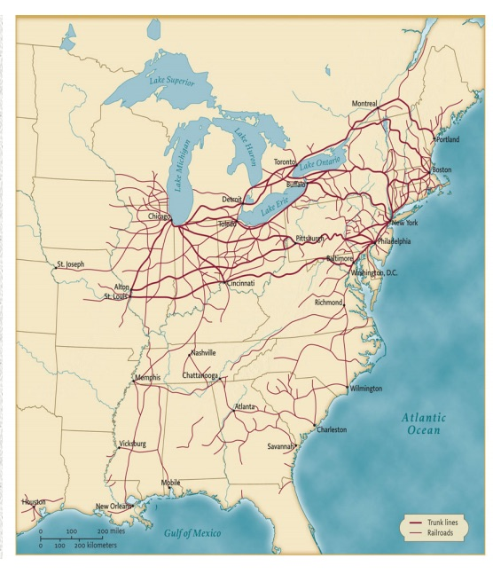
1860

Slide 66
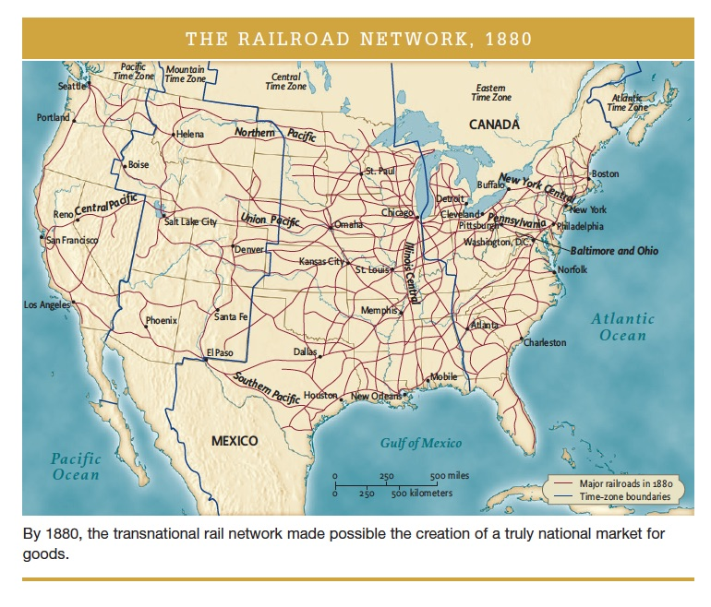
1880!

Slide 67
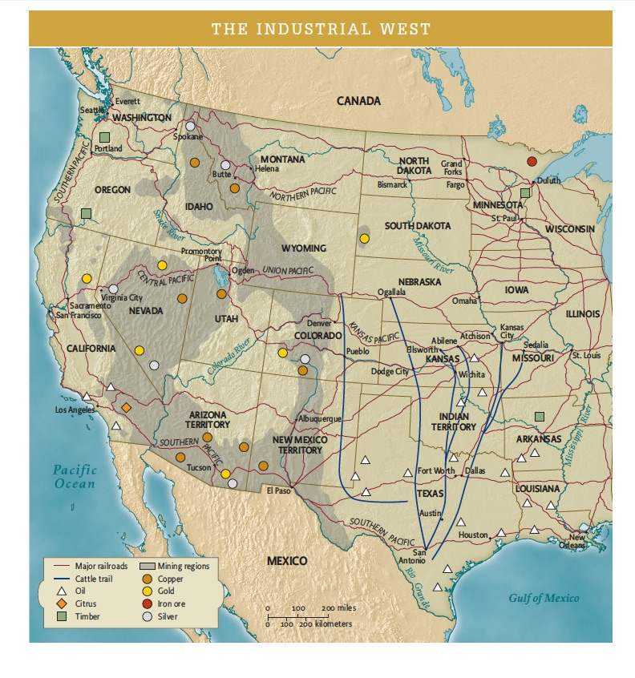

Slide 68
TO BE CONCLUDED NEXT WEEK WITH
Course Review from
Indian Nations’ Perspective
(Meantime, best coverage can be found in American Yawp, Chapter 17 on ‘The West’)

Slide 69
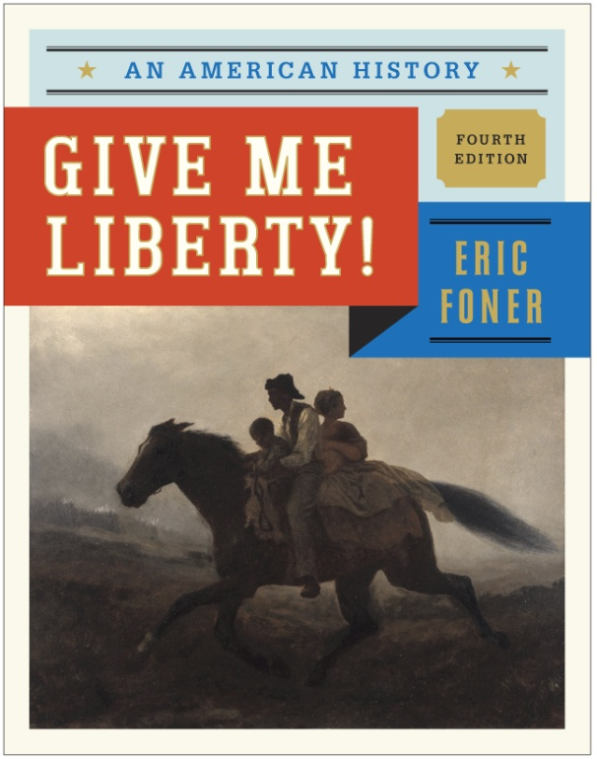
Many of the art slides used here are found in the textbook by Eric Foner
ERIC FONER
Give Me Liberty!
An American History
FOURTH EDITION

Slide 70
End of Presentation (48 pt)
28 pt.
32 pt.
36 pt.
52 pt.
Source: 24 pt, Times New Roman

