Slide 1
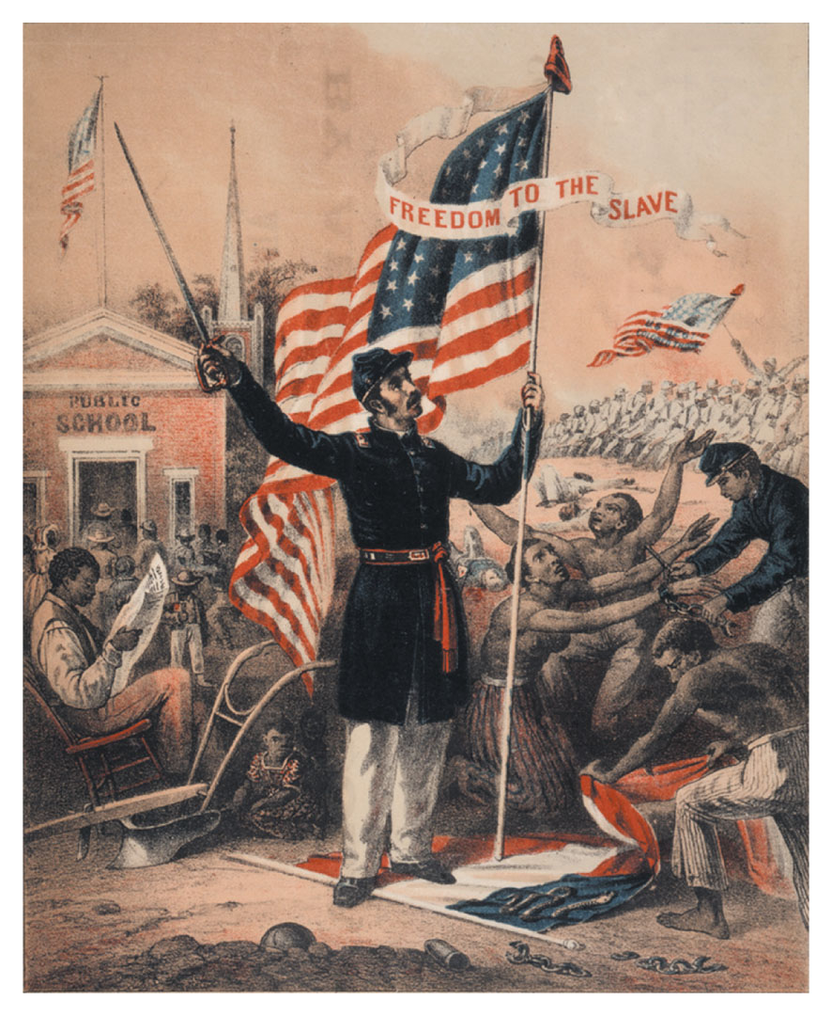
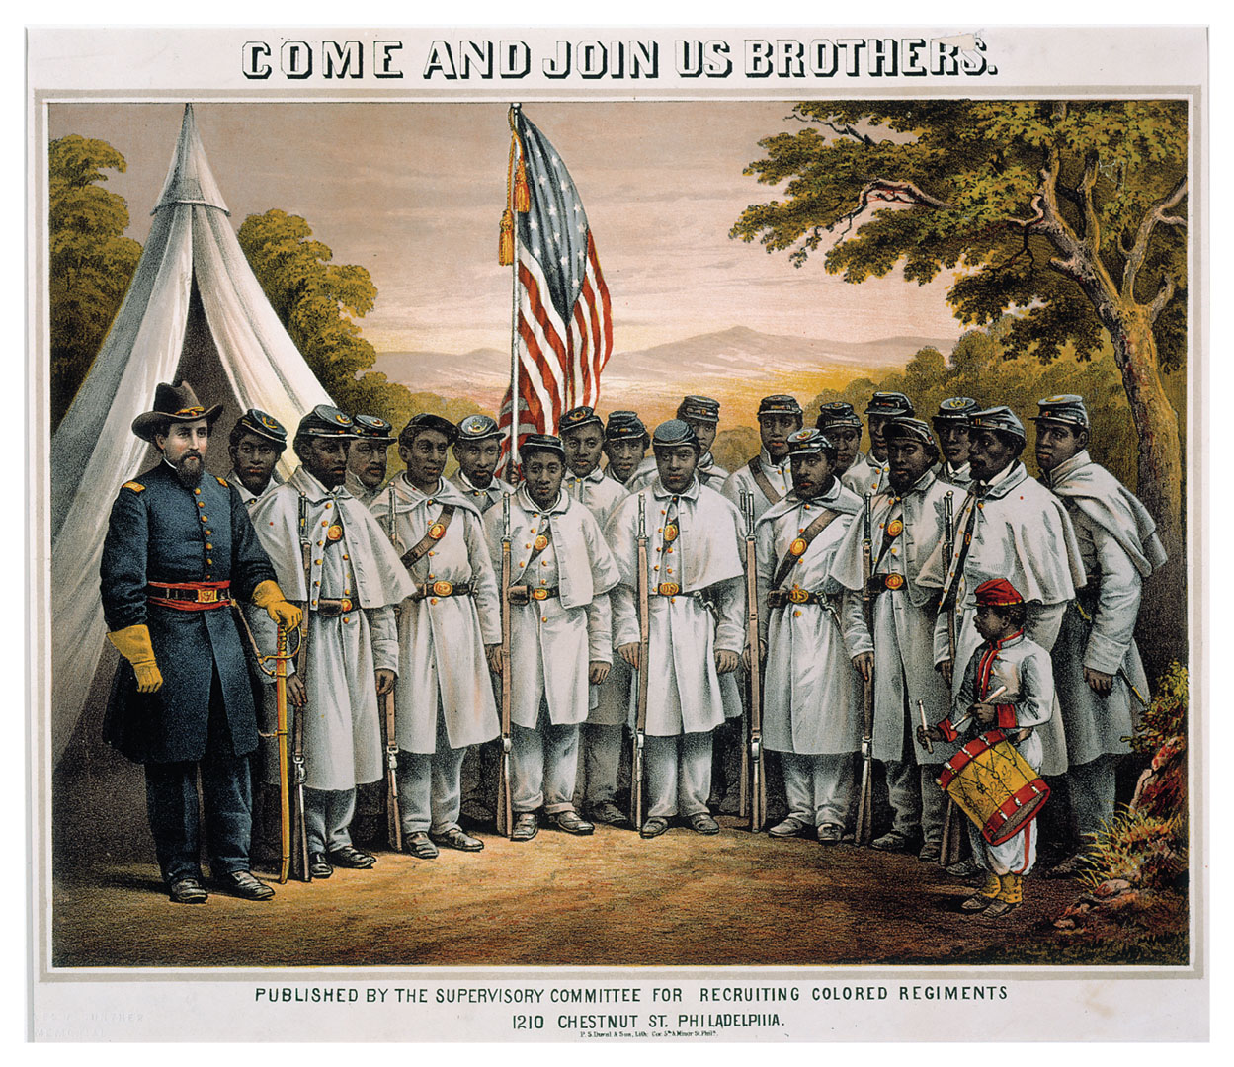
The U.S. Civil War
1861-1865
Intro to American History, I
History 103 w/NEL - Spring 2021 @ QC
American Colonial & U.S. History to 1877
Week X: lecture recorded X
See Video Recording

Slide 2
What is the secret of this lecture?
It’s about revolutions.*
* The 1860 election was a political revolution
– actually two, North and South.
* The Civil War became a social revolution.

Slide 3
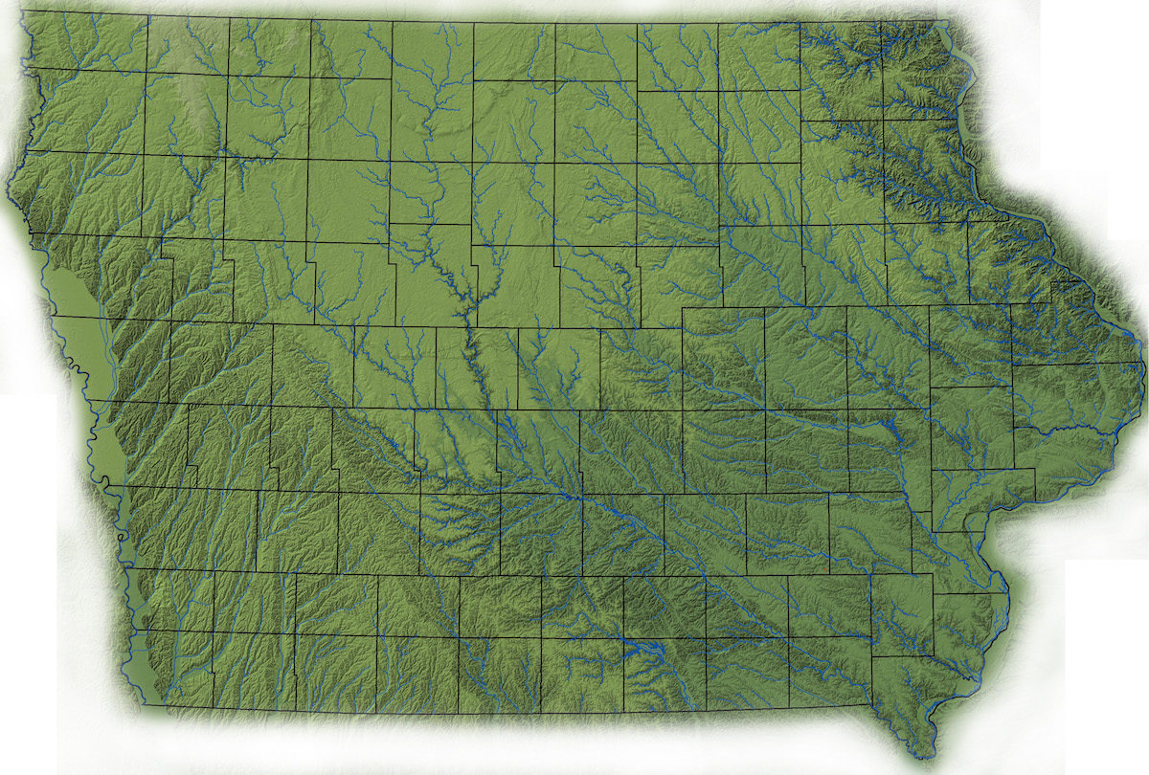
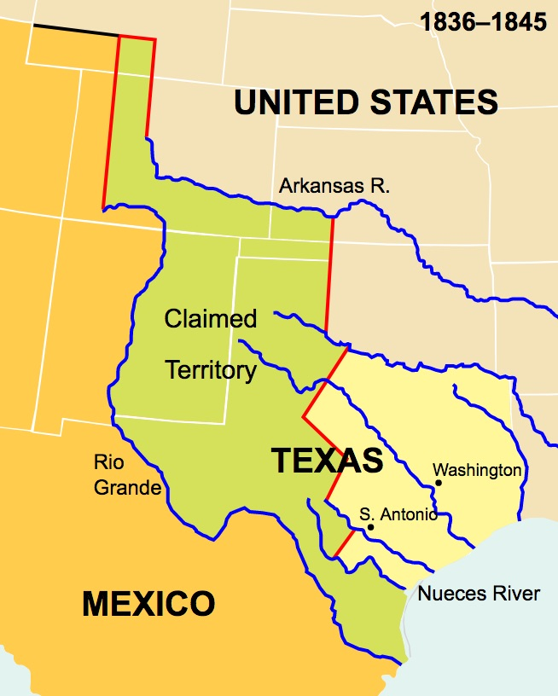
Dec. 1845: TEXAS
Last slave state admitted...
Dec. 1846: IOWA
1848-1859
Wisconsin
California Minnesota
Oregon
5 new free states = 10 senators

Slide 4
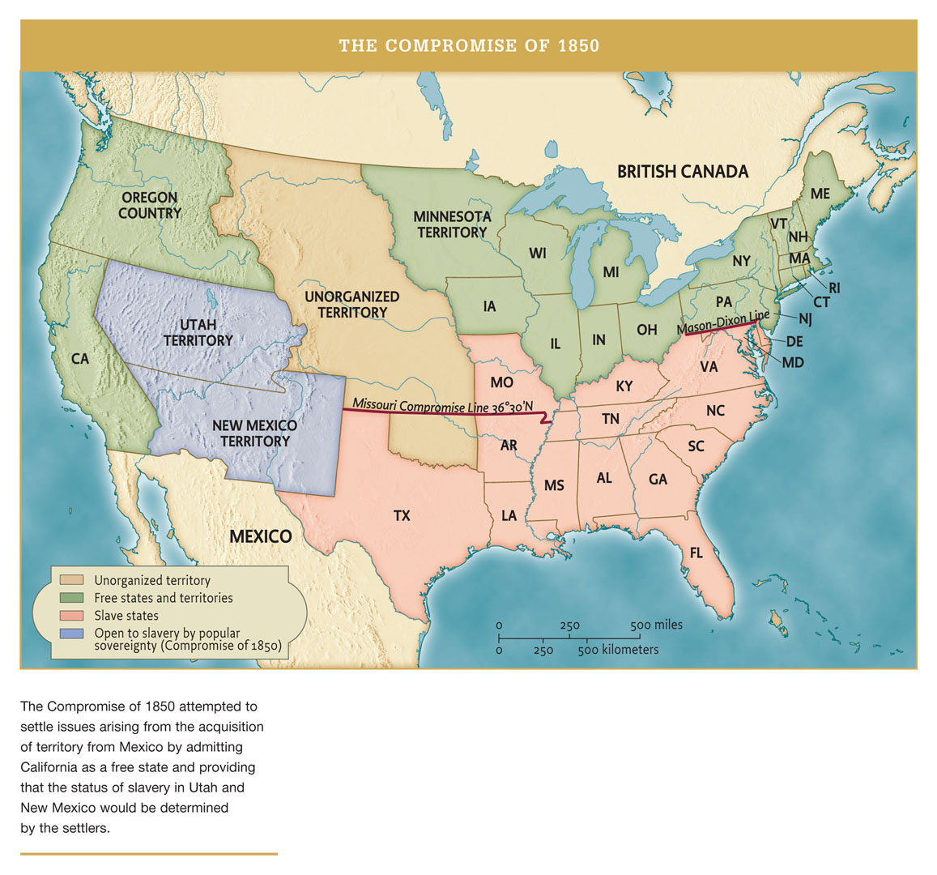

Slide 5
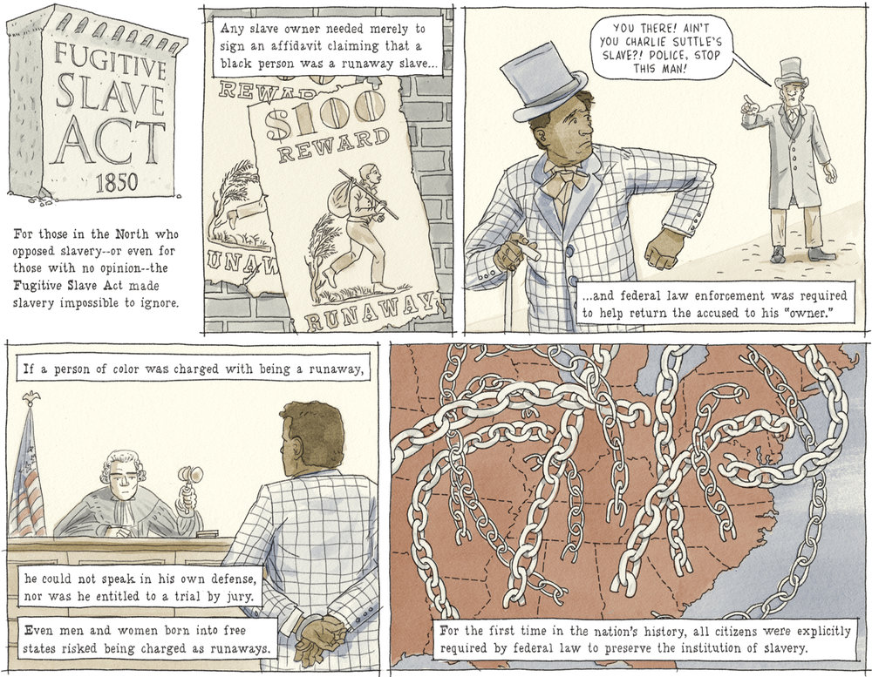
Source: J. Fetter-Vorm and A. Kelman, Battle Lines: A Graphic History of the Civil War (Hill & Wang, 2015)

Slide 6
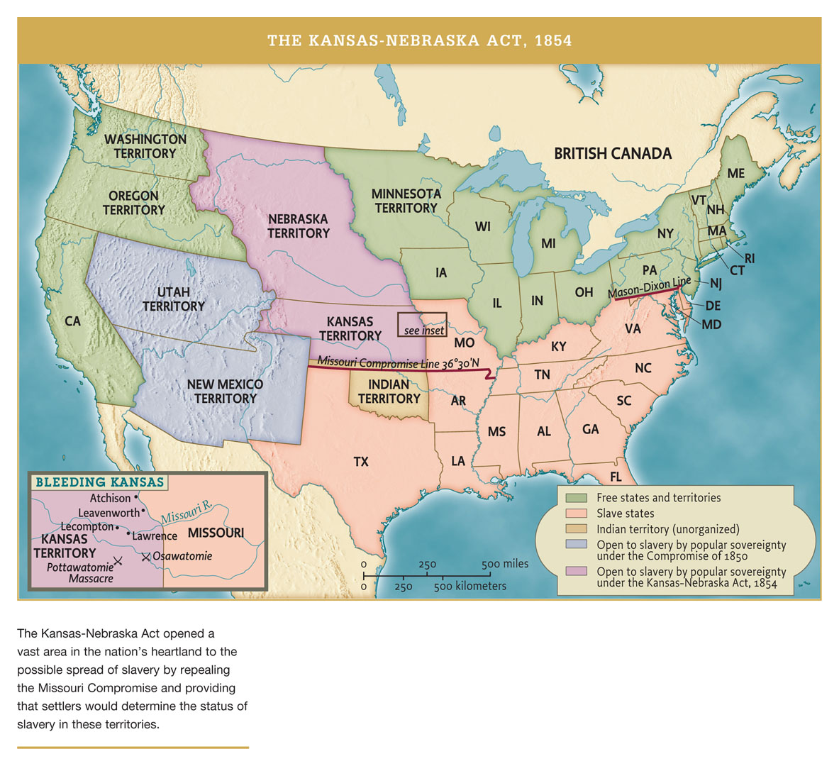

Slide 7
From Course ‘Outline of U.S. History’
The 1854 Act also sets off an exodus of elected politicians who have had enough of the ever-compromising Whig leadership. 108 "Nebraska Party" representatives are elected to the House in the fall of 1854. They reorganize as the Republican Party, who are able to run Fremont as presidential candidate in 1856, and win the northernmost tier of northern states. The Republican program is like that of the Whigs, but it is anti-slavery. (Anti-Slavery plus Free Labor plus Lots More Railroads, and a railway lawyer shall lead them.)
The Slave Power is enraged by the rise of anti-slavery. Traditional Democratic leaders like Stephen Douglas (Senator of Illinois, Lincoln's nemesis in 1858) find it difficult to hold Southern loyalty in the party, no matter how much they bend over backwards. Then the Supreme Court hands down Dred Scot decision. Its argument denies any rights to black people, free or enslaved, North or South. Its unanimous ruling effectively allows slave-owners to travel with their slaves throughout the North, to establish businesses with slave labor in the North, and to expect the full enforcement of slave law by Northern courts and Northern police. Its logic makes clear that in a single country under modern conditions, Slave cannot be separated from Free: either it will be all Slave, or slavery will be extinguished. Then, in 1859, John Brown leads the raid on Harper's Ferry, and is defeated, and executed with his sons. The shockwaves are enormous in the South, and to many in the North, he is a hero....

Slide 8
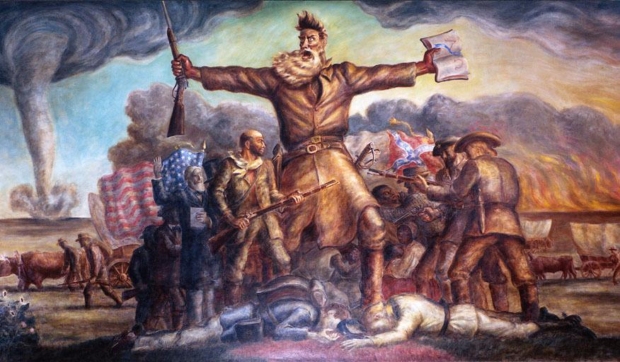
John Brown memorial
Kansas State House
RAID ON HARPER’S FERRY, VIRGINIA: OCTOBER 1859

Slide 9
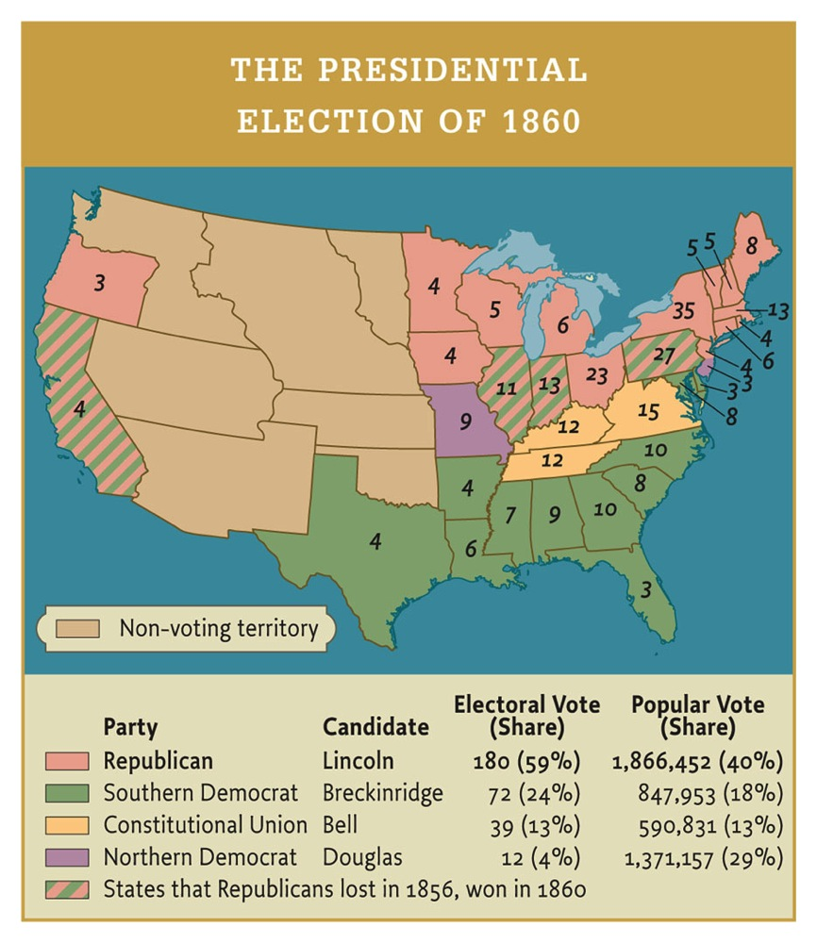

Slide 10
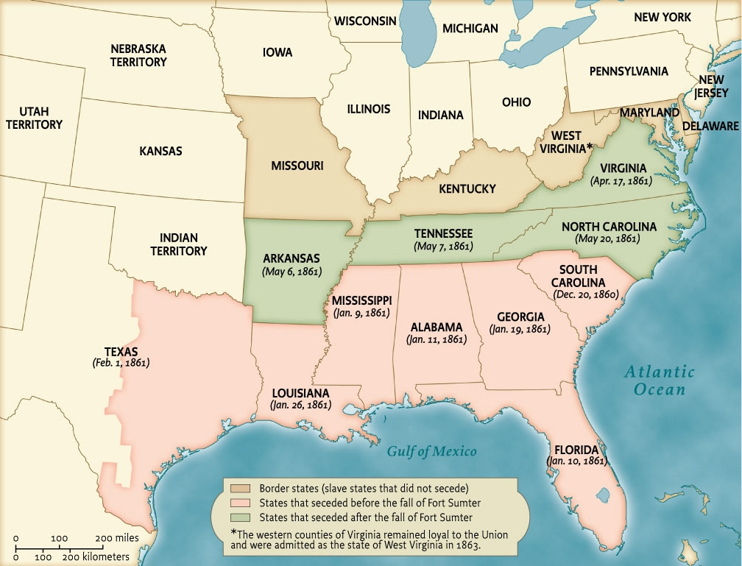

Slide 11
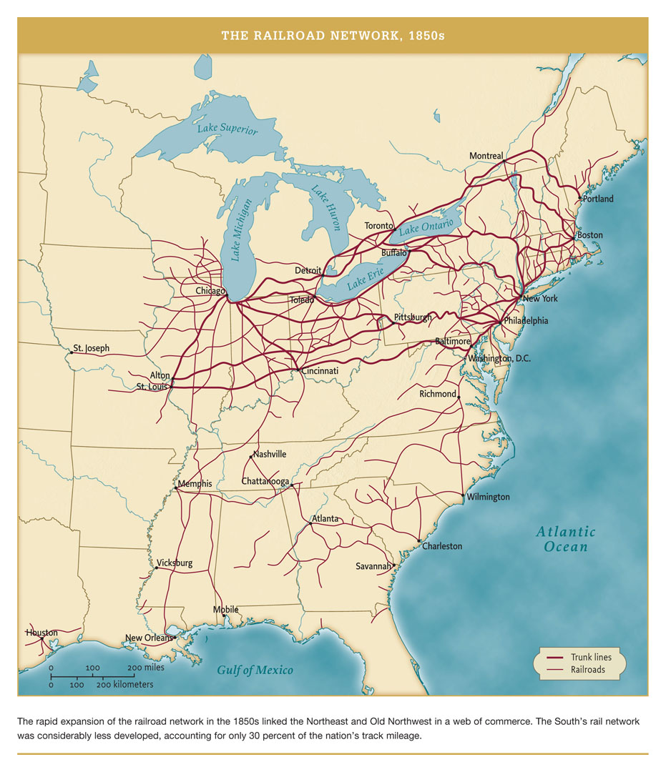
Railway networks show relative industrial/ infrastructural density, South and North.
North in 1860: 22 million people.
South: 11 million, 4 million of them slaves.

Slide 12
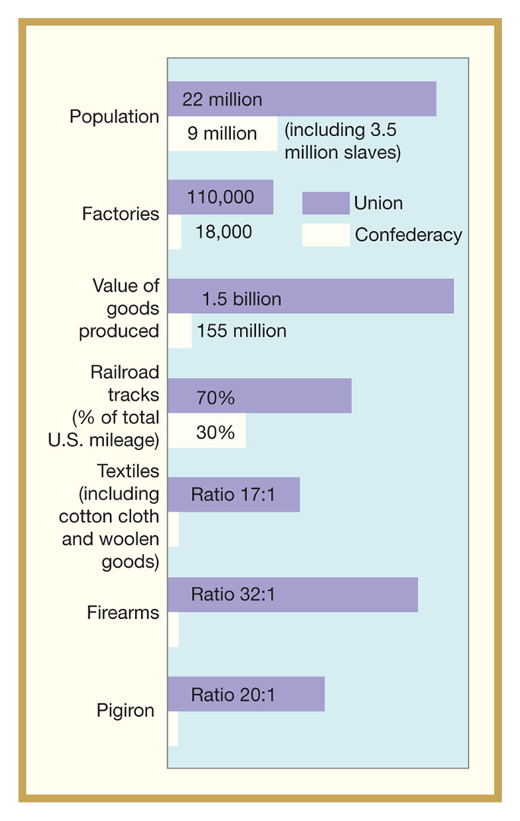

Slide 13
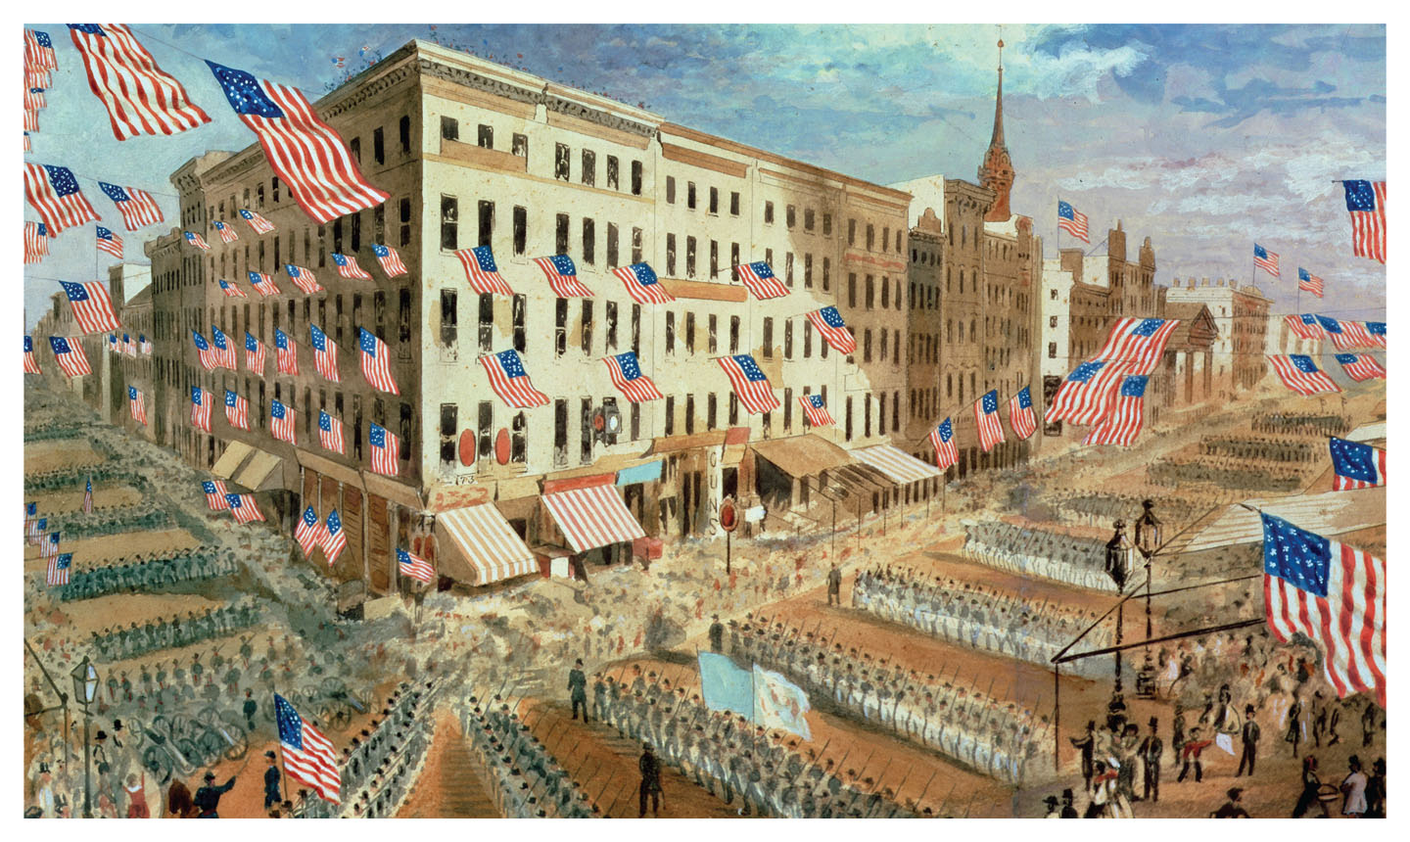

Slide 14
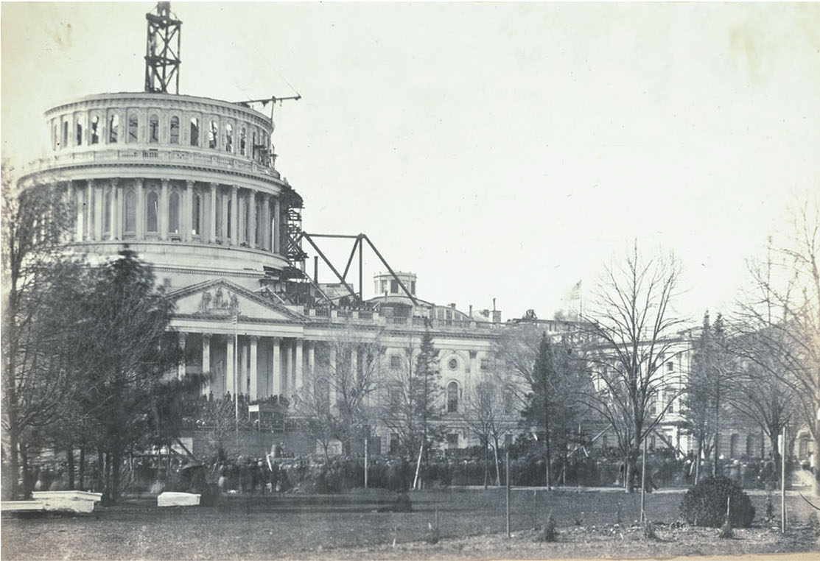

Slide 15
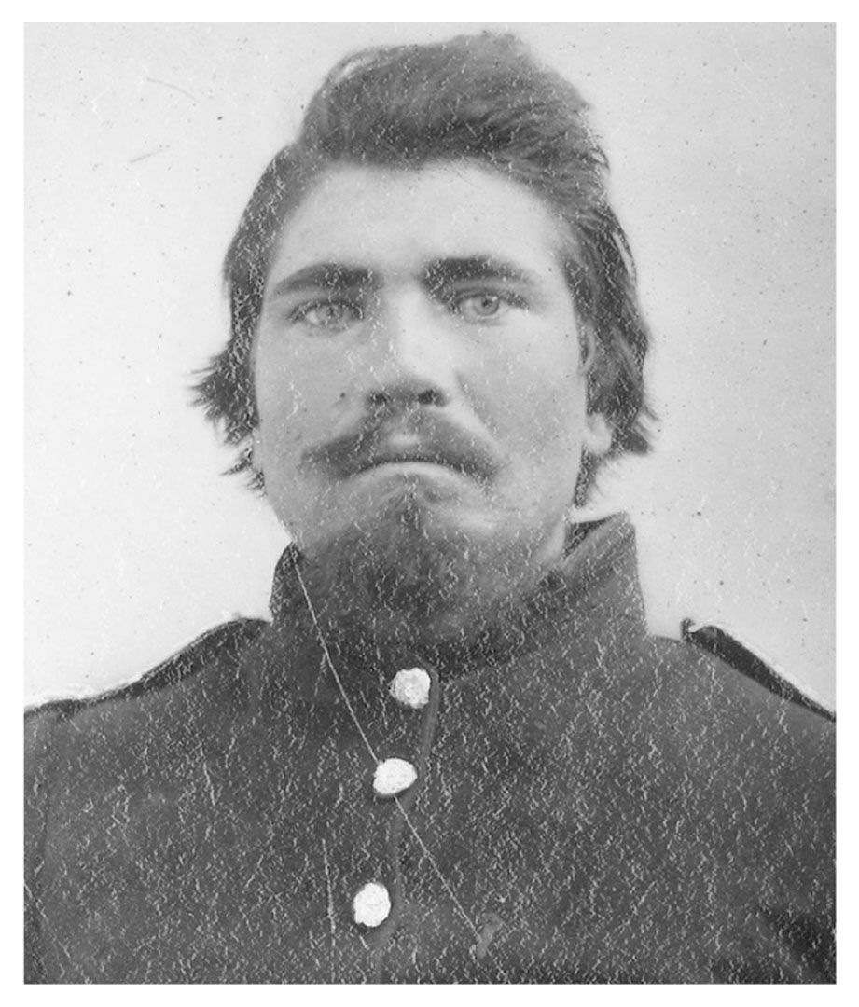
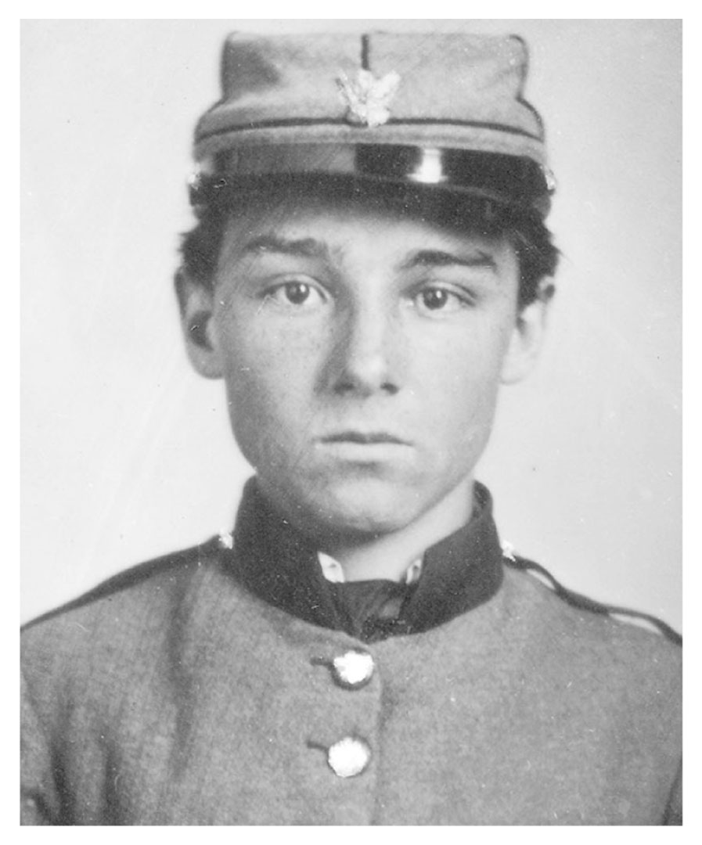

Slide 16
Civil War is Political War
- Opposition in the North (“Copperheads”)
- Opposition in the South (“Scalawags”)
- West Virginia secedes from Virginia
- Fears about provoking border states
- Tendencies to martial law and extraconstitutionality
- Reluctance to impose a draft, on both sides
- ‘Contraband’ and fears of arming freedmen

Slide 17
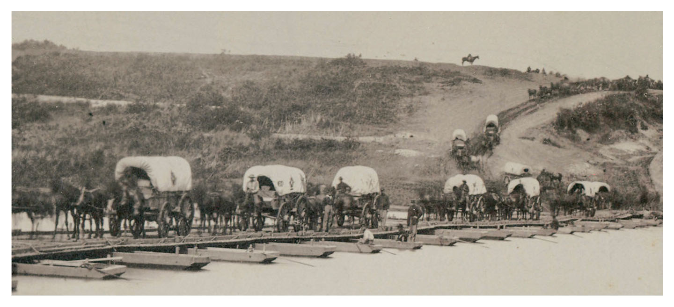
Every year there comes a point when
it seems the South might win
1861 - Bull Run, stalemate, realization war will be long, panic:
Reorganization and expansion of government ensues.
- Greenbacks
- Secret Service and expansion of the Treasury Department
- McClellan is supposed to fix this (bad move).
- Logistics. Reorganization of Army begins.
Crossing into Virginia

Slide 18
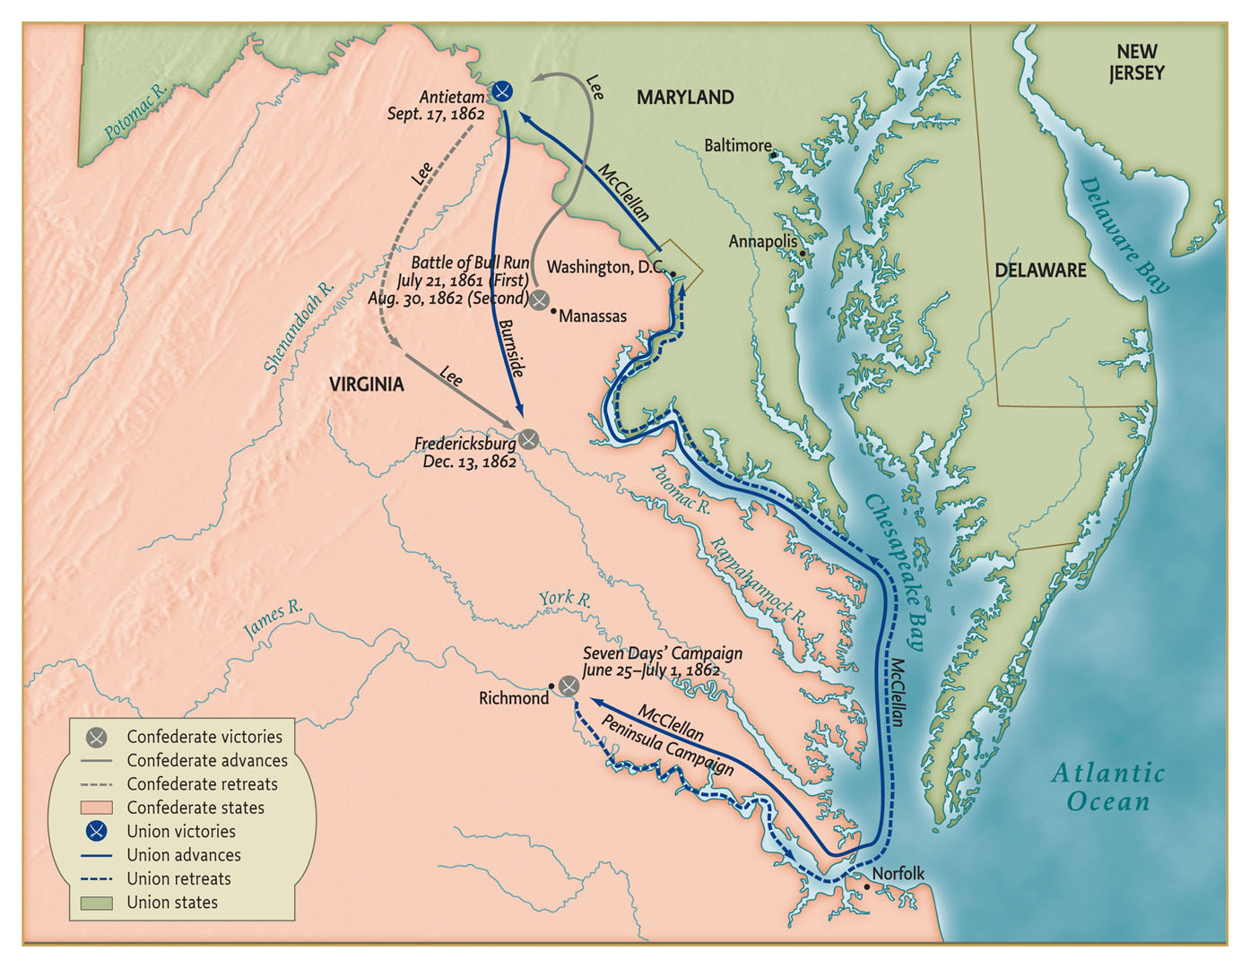
1862 - McClellan’s losses. Lee’s first invasion of Maryland, stopped at Antietam. Incredibly bloody.

Slide 19
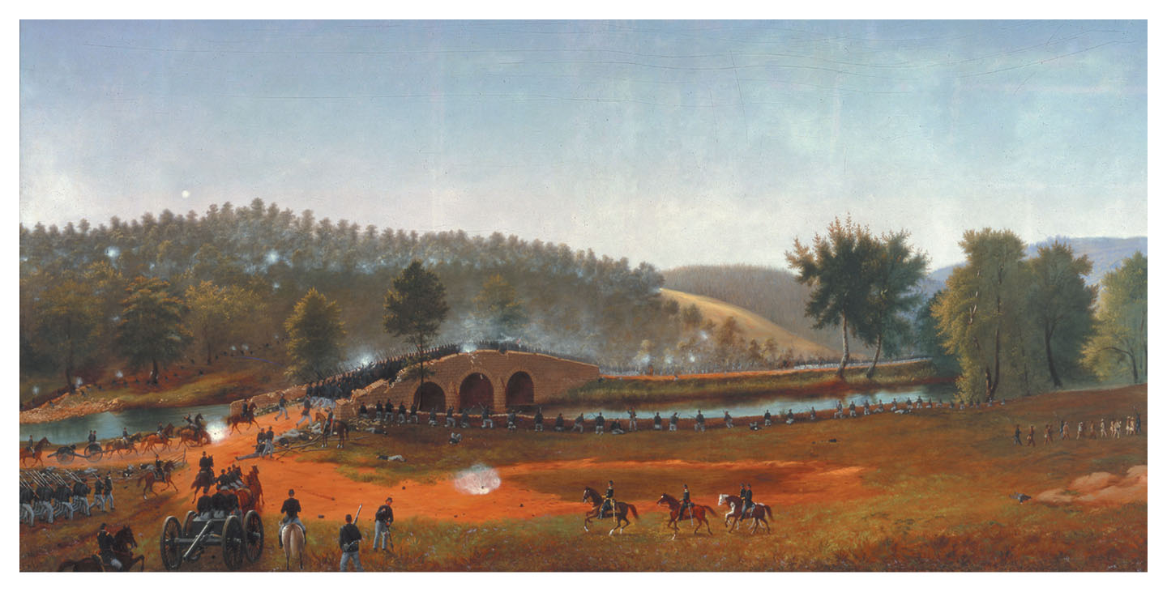
51st Pennsylvania Volunteers rush Burnside’s Bridge at battle of Antietam Sept. 17, 1862
Sketched by James Hope, who was present as a soldier and later made this painting.

Slide 20
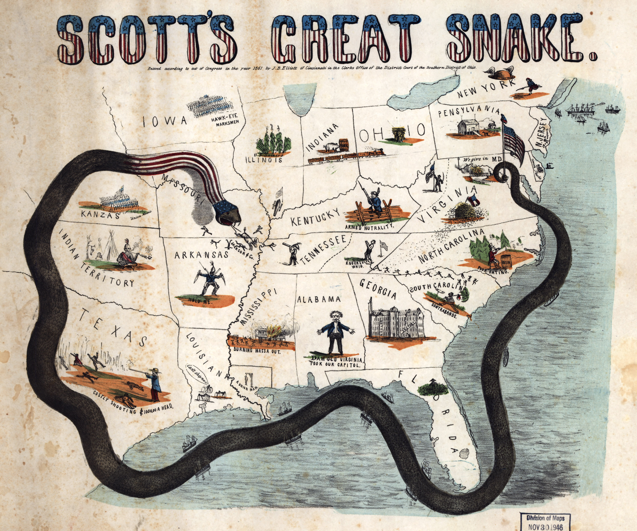

Slide 21
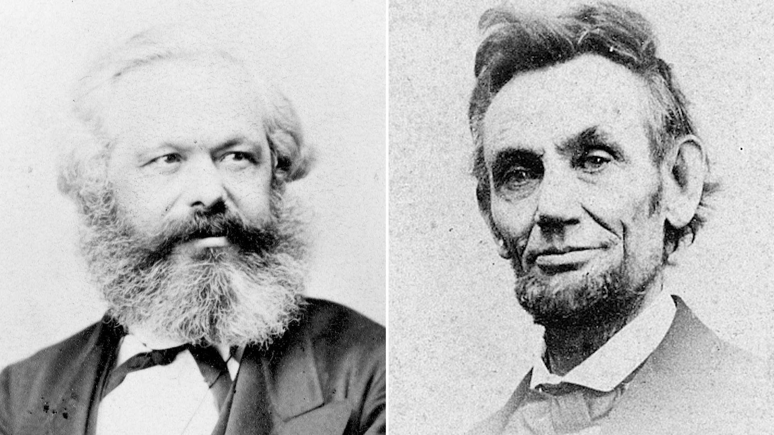
Civil War & Europe

Slide 22
1863 – Emancipation Proclamation goes into effect – military emancipation as war strategy.
July - Lee’s invasion of Pennsylvania turned back by decisive Union victory at Gettysburg, bloodiest battle of all.
Next day, July 4:
Grant captures massive fort at Vicksburg, finally securing all of the Mississippi River.
Military situation now near hopeless for South.

Slide 23
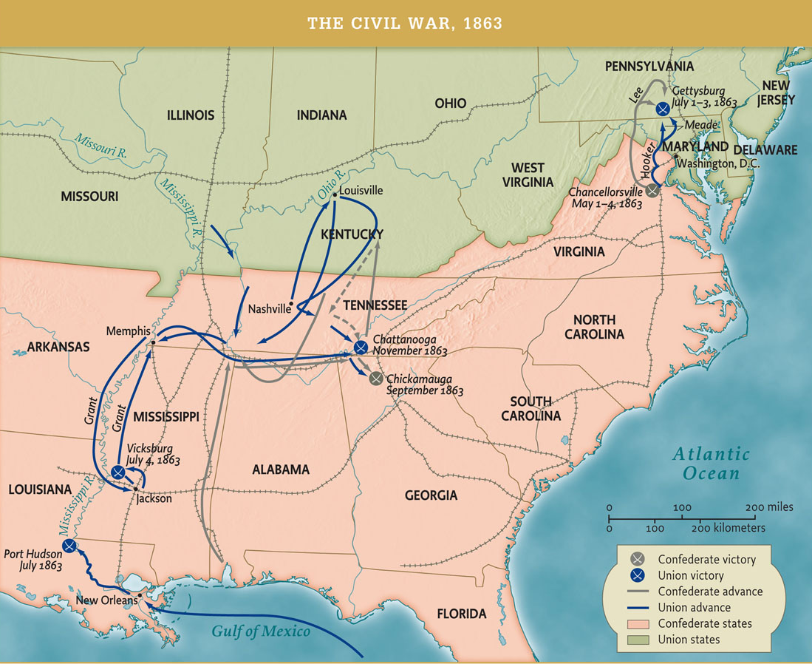

Slide 24
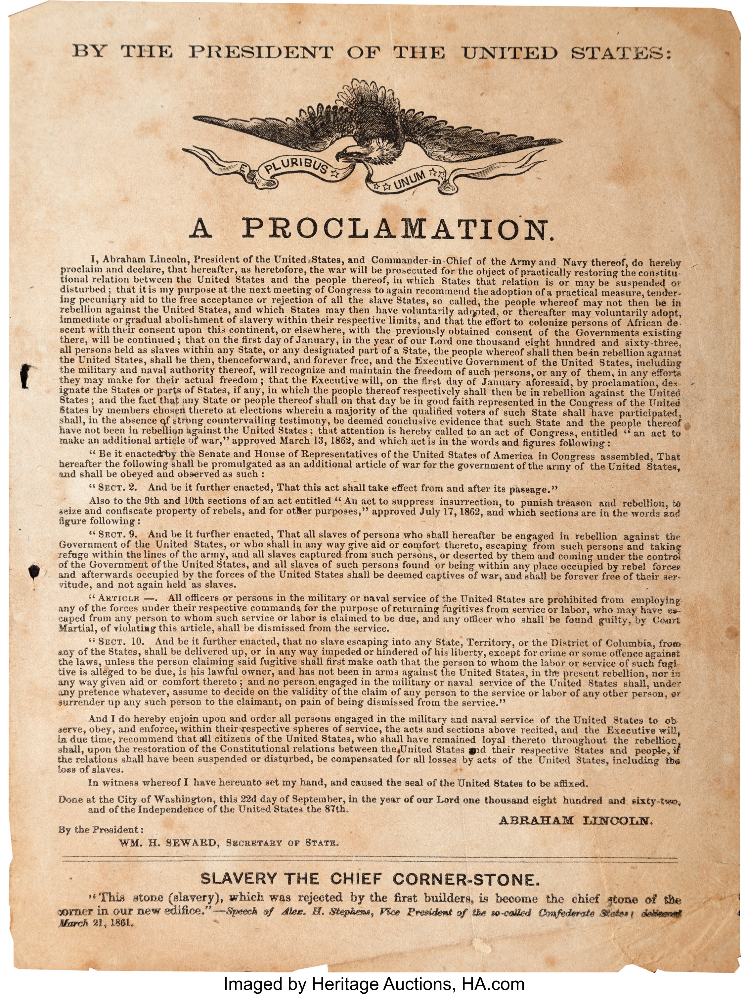

Slide 27
THE EMANCIPATION PROCLAMATION
With the exception of a few areas, the Emancipation Proclamation applied only to slaves in parts of the Confederacy not under Union control on January 1, 1863.
Lincoln did not “free the slaves” with a stroke of his pen, but the Proclamation did change the nature of the Civil War.

Slide 28
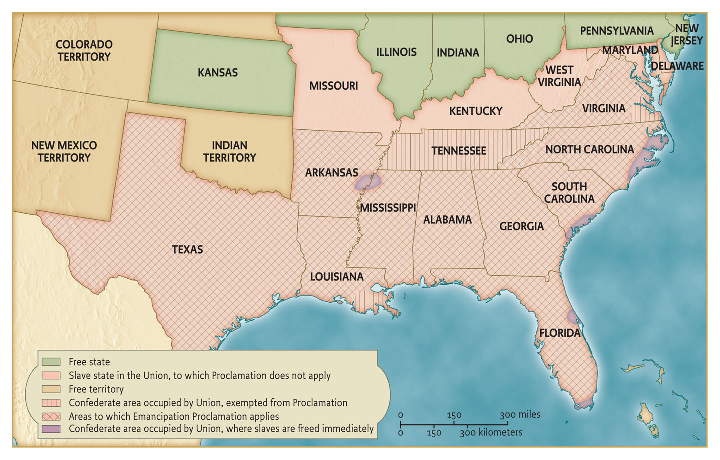

Slide 29
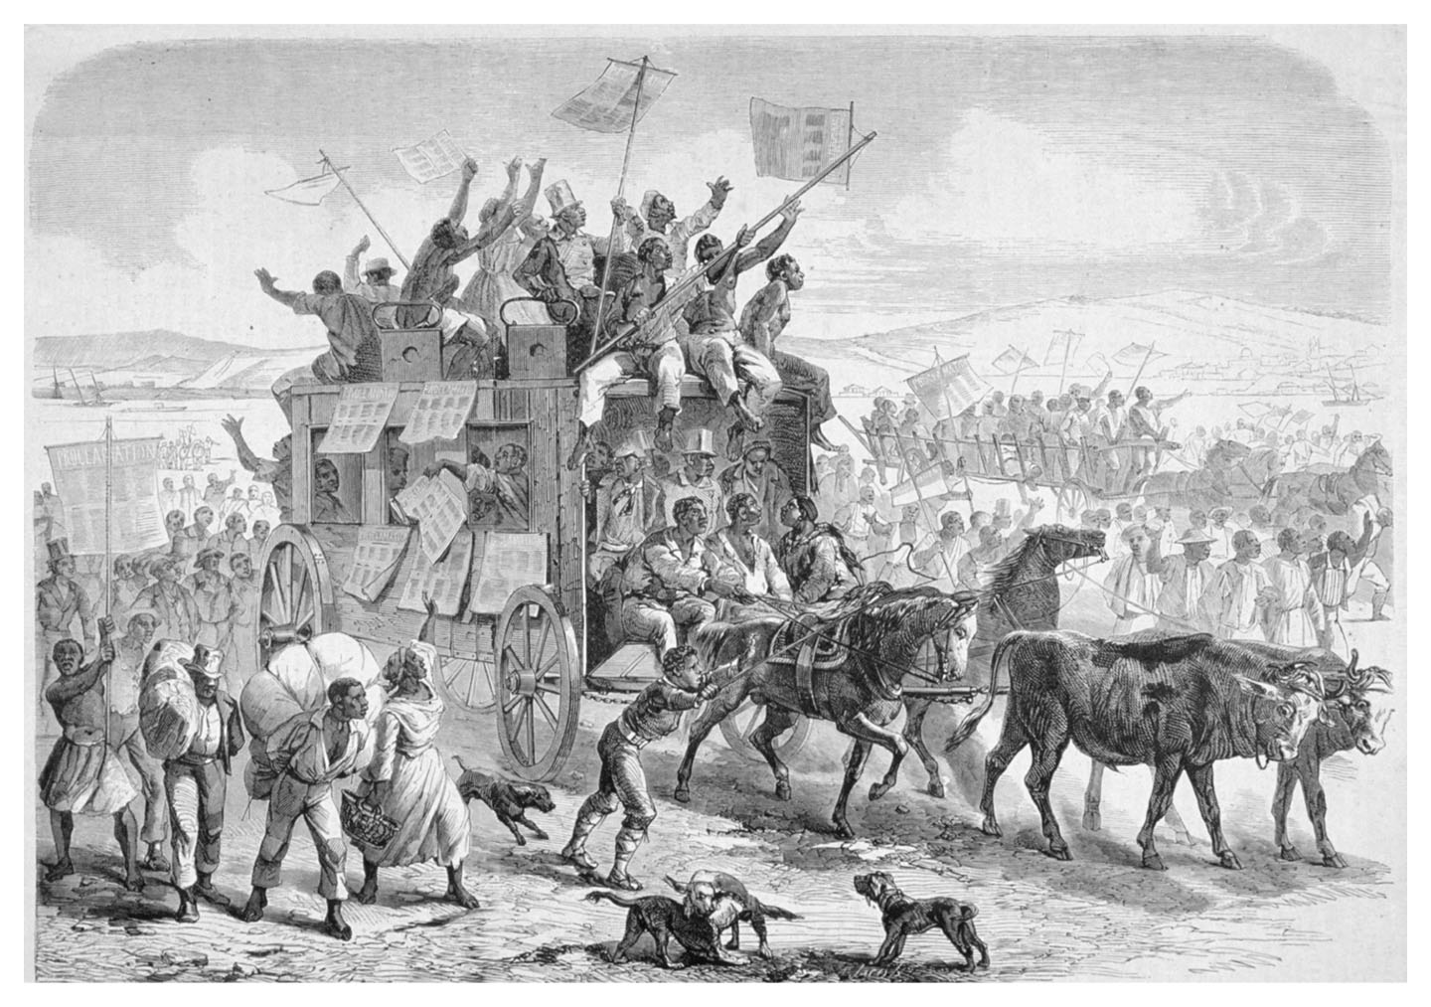
Freed Negroes Celebrating President Lincoln’s Decree of Emancipation, a fanciful engraving from the French periodical Le Monde Illustré, March 21, 1863.
THIS SCENE IS IMAGINARY. IT IS ABSURD. IT DID NOT HAPPEN.

Slide 30
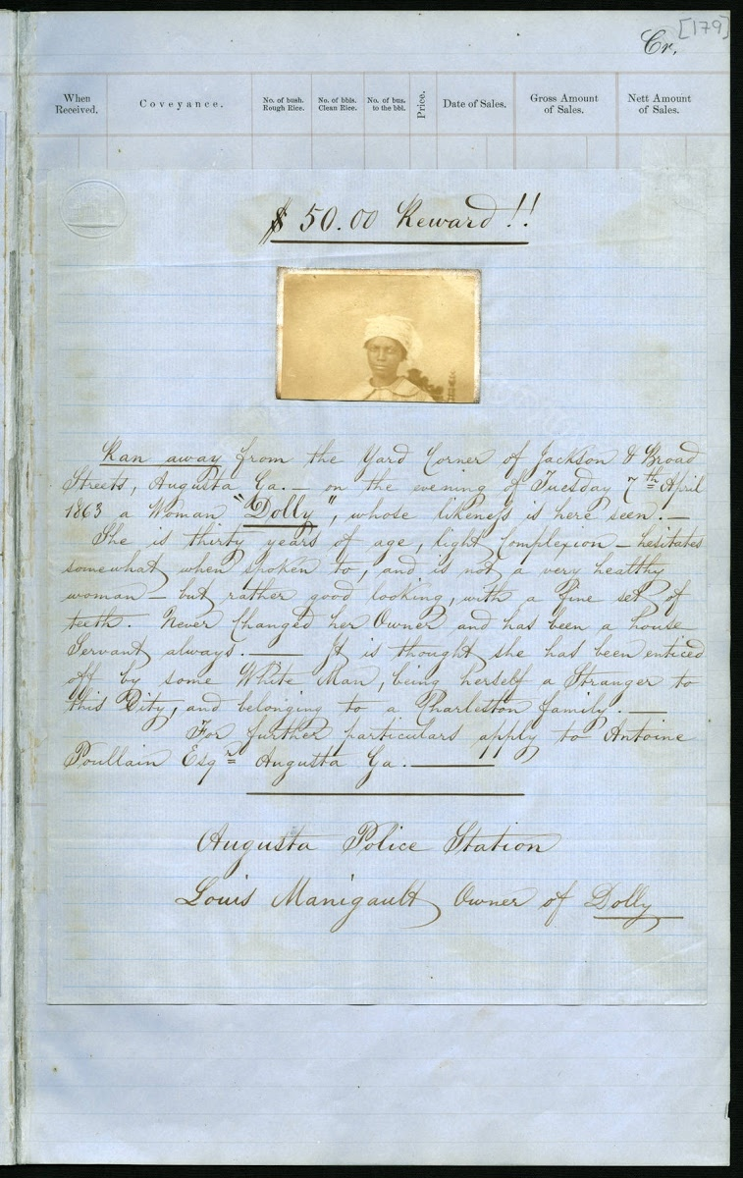
An 1863 advertisement asking for the capture and return of a runaway domestic slave, Dolly, circulated by Louis Manigault, a member of a prominent Georgia and South Carolina planter family. Manigault blamed an unknown white man for enticing her away, but she most likely escaped with a male slave who had begun to court her. Slaves fled to Union lines from the first days of the Civil War.

Slide 31
Emancipation was a Military Strategy,
Abolition the Eventual Outcome
1861 - ‘Contraband’ policy
1862 - Emancipation announced as threat
1863 - Emancipation initially frees no one; ‘contraband’ policy is maintained
1863-1864 - Enlistment of ‘contraband’ and freedmen.
1864-65 - Mass exodus and refusal to work of the enslaved. General Order No. 15
1865 - 13th Amendment, end of war
Foner: Reconstruction should be dated to 1863.

Slide 34
...John Brown’s Body...
(video) https://teachinghistory.org/best-practices/examples-of-historical-thinking/25095

Slide 35
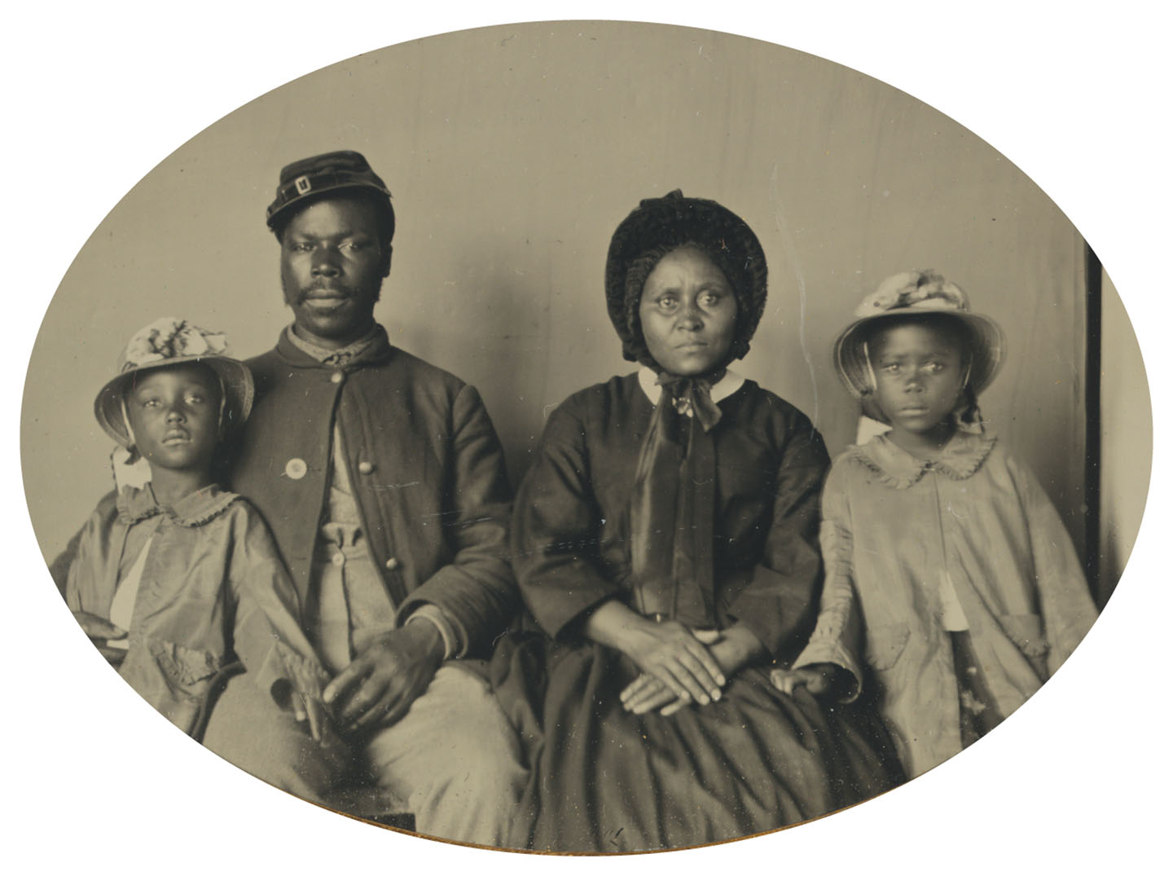

Slide 36
Draft riots in New York City, July 13-16, 1863.
Mostly Irish immigrant workers target and lynch black people and Union supporters.
Suppressed by Union troops. 120-400 dead.

Slide 37
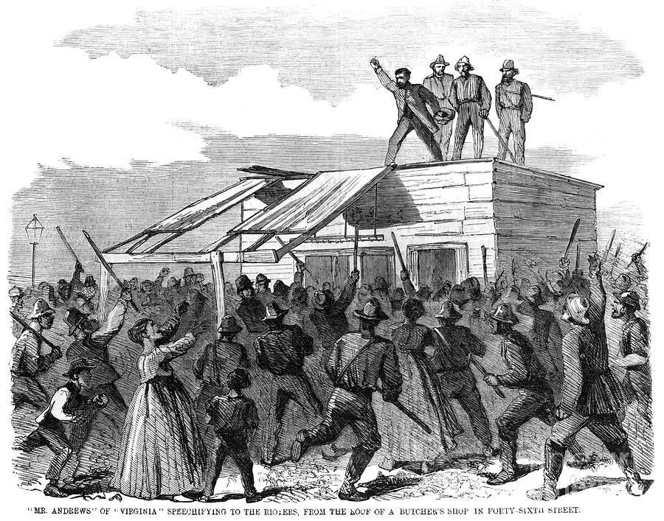

Slide 38
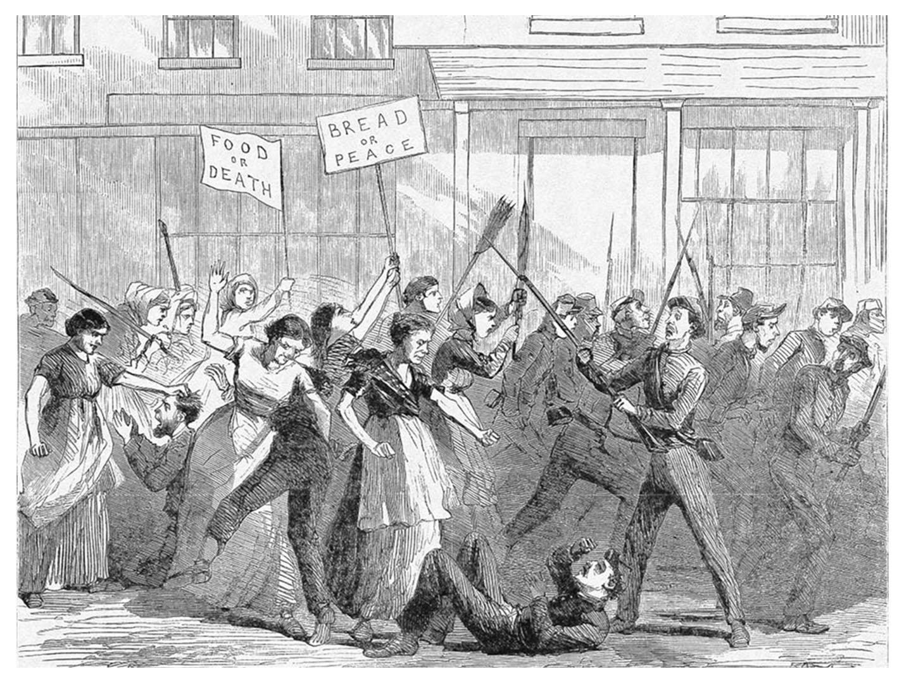
Hunger in Confederacy: An engraving in the New York Illustrated News depicts bread riot that took place in Mobile, Alabama, in the fall of 1863.

Slide 39
Every year there comes a point when
it seems the South might win
1864 – Lincoln fears that he will lose the presidential election to McClellan who is running on peace (or capitulation) platform.
Sept: Sherman’s “March to the Sea” leaves no remaining doubt of Union victory. Thousands of enslaved form a train behind Sherman’s advance.
General Order No. 15.

Slide 40
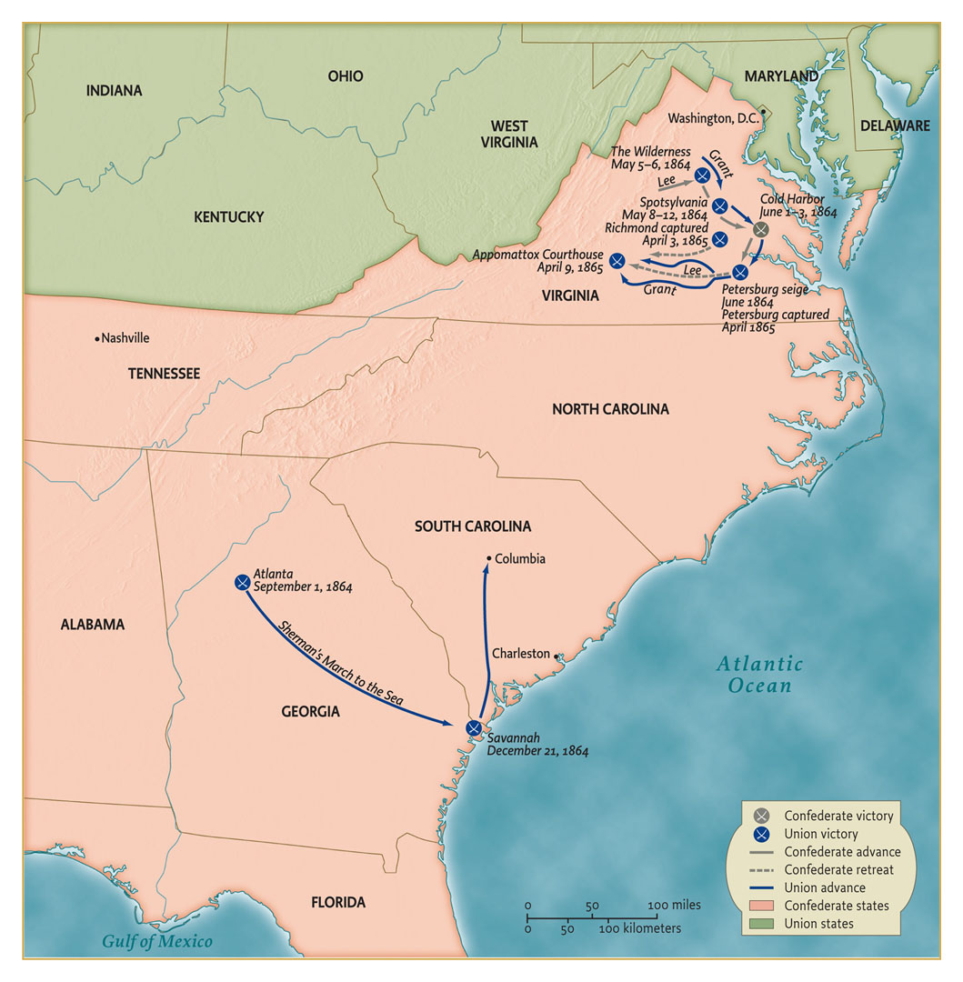

Slide 41
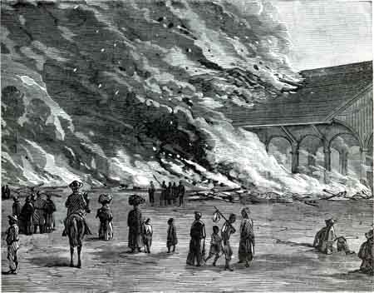
Atlanta, September 1864

Slide 42
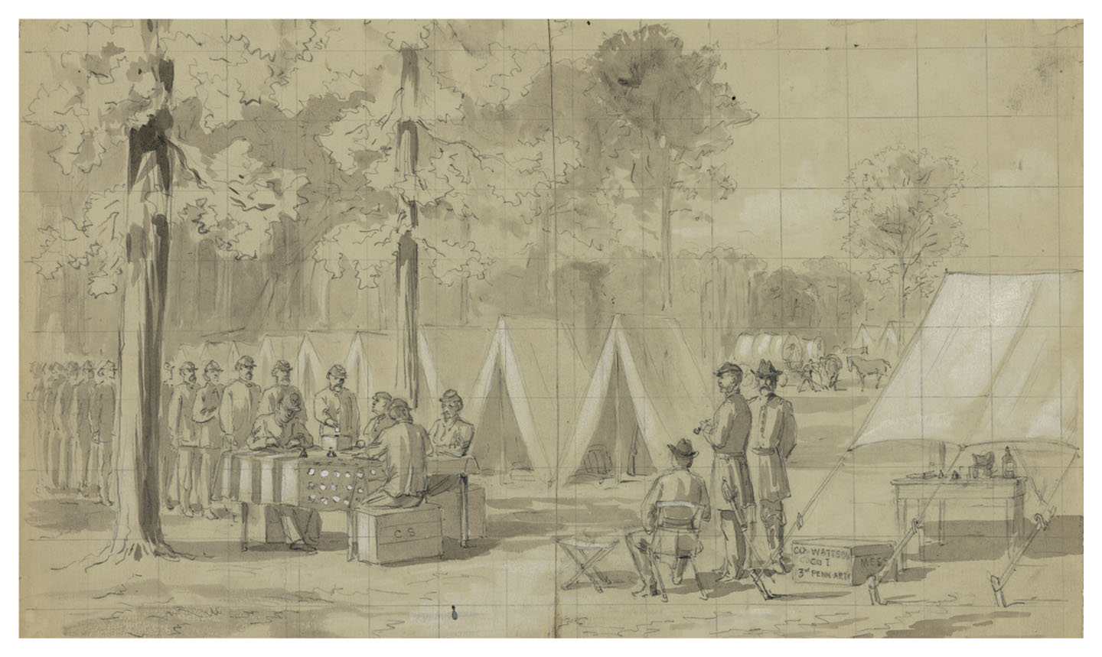
A sketch by William Waud, an artist who covered the war for Harper’s Weekly, depicts Pennsylvania soldiers voting in their army camp in the 1864 election.

Slide 43
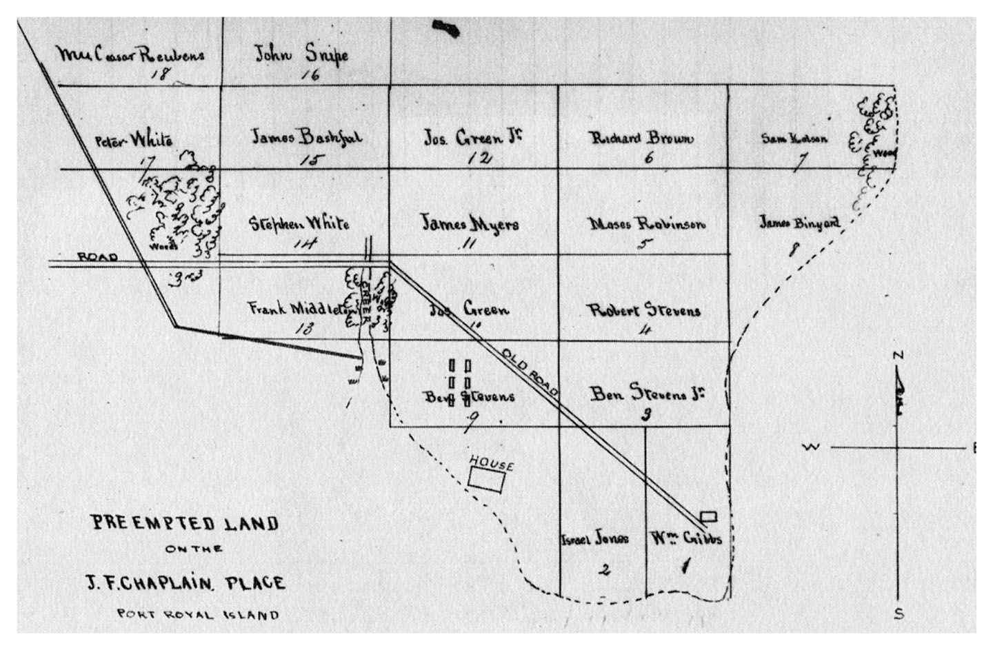
Diagram of plots selected by former slaves on Port Royal Island, South Carolina, January 25, 1864. Taking advantage of a sale of abandoned property, eighteen blacks (seventeen men and one woman) selected plots on a Sea Island plantation for purchase. (Sea Islands were seized by Union navy in 1861.)

Slide 44
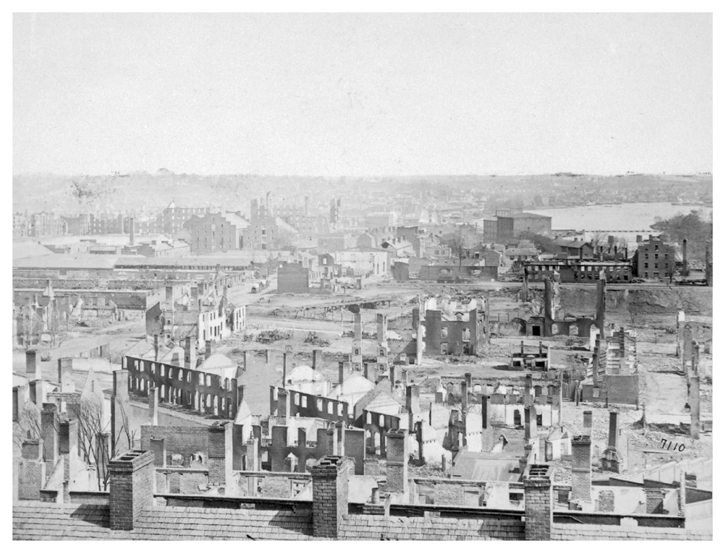
1865 – Victory, assassination,
“Presidential Reconstruction”

Slide 45
Picture: Richmond in Ruins.
Jan. 31: House passes 13th Amendement, abolition of slavery.
March 4: Second inauguration, Lincoln speaks of reconstruction.
April 8: Senate passes 13th Amendment.
April 9: Lee surrenders to Grant at Appomatox.
WAR ENDS
April 14: Lincoln assassinated.
Johnson issues pardons for officers and politicians of Confederacy. South holds elections for Congress as if nothing happened.

Slide 46
What is Total War?
...to be continued next week
when we turn to
Reconstruction
1863-1877
Also coming next week:
GROUPS G & H !!!
& GETTING READY FOR THE FINAL

Slide 47
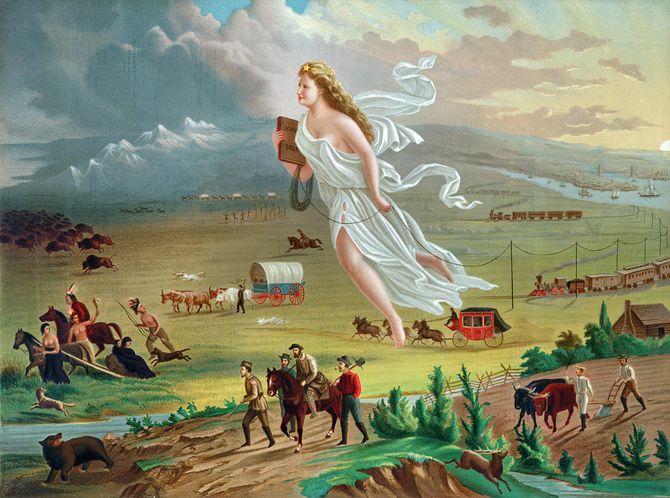
Art of Manifest Destiny
(Painting by John Gast, American Progress, 1872)

Slide 48
(next 2 slides: after-class presentation)
‘How to Succeed at Plagiarism’

Slide 49
How to Succeed at Plagiarism (1)
DON’T copy-paste pages from one source. It will be obvious. Even if you alter the text, instructors are trained to detect if you use only one. They are hard to fool.
Stealing from commercial/popular sites is also risky. You want it to look as if you did the work and read scholarship.
Gather at least five scholarly, secondary sources of quality. Find through QC Library or Google Scholar by library proxy.
Read abstracts and intros before choosing. Your plagiarism needs to look like an actual paper. When you have chosen your targets, read the texts carefully, so you have an alibi.
Steal passages from all five. Paste them, but mix them up, take turns. Plan how to arrange them logically.

Slide 50
How to Succeed at Plagiarism (2)
Cover it up by rewriting the stolen passages in paraphrase. Add a few of your own sentences to bridge between the passages. Fill it out with comments on the stolen parts.
Why not add citations for each source you are stealing from? Then no one will be able to accuse you of anything!
Write an intro paragraph summarizing the issue the texts cover. Write a conclusion drawing comparisons between the different articles, their perspectives, conclusions, use of facts. Give one or two of your own conclusions.
Devise your own title for the result.
Excellent! Your plagiarism is now indistinguishable from your own original paper. The perfect crime!

Slide 51
End of Recording (48 pt)
28 pt.
32 pt.
36 pt.
52 pt.
Source: 24 pt, Times New Roman

Slide 52
Class of 28 April – Extras
Film: Recreation of trench warfare in 1864 (American Battlefield Trust – watched at start)
Public History assignment
(due next week)
Papers: How to Succeed at Plagiarism
(done at end of class)
Nima Lama: American Visions
(postponed to next week)

