Slide 1
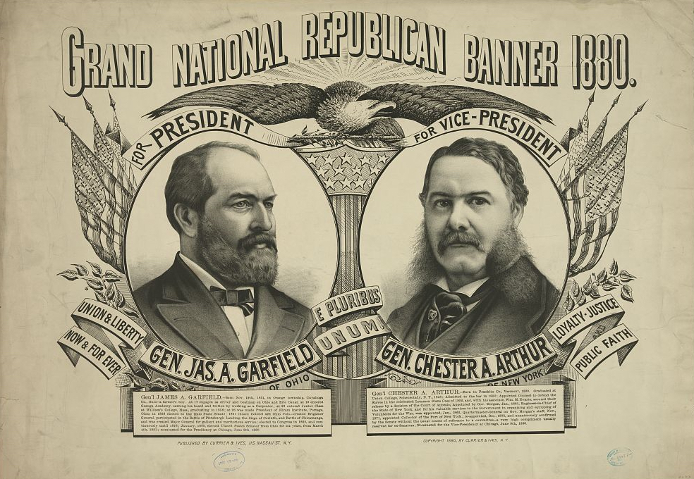
Presidential Assassination – 1881

Slide 2
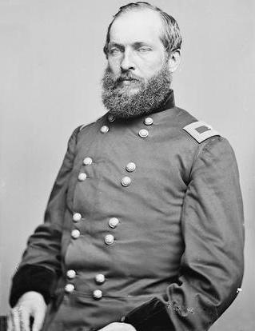
James Garfield
Civil War general from Ohio
(perfect qualification for president)
Reform Republican
Supported Reconstruction
Impeccable reputation

Slide 3
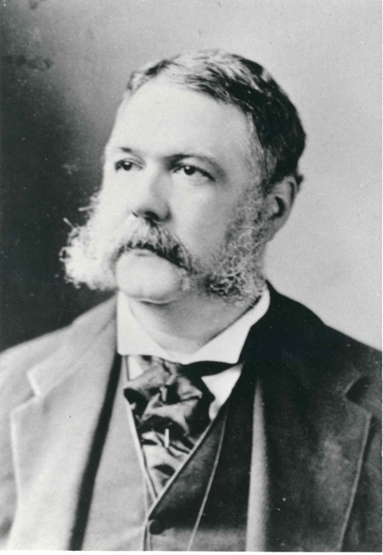
Chester A. Arthur
Civil War quartermaster
Republican ‘Stalwart’
Former chief officer of the
Customs House, Port of New York
Man of the Machine

Slide 4
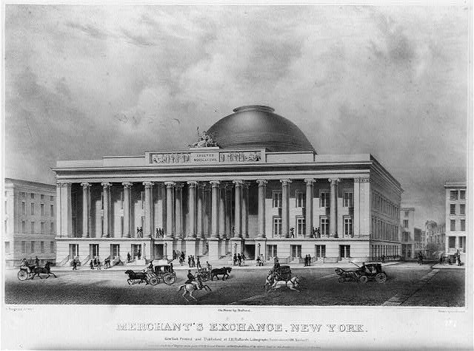

Slide 5
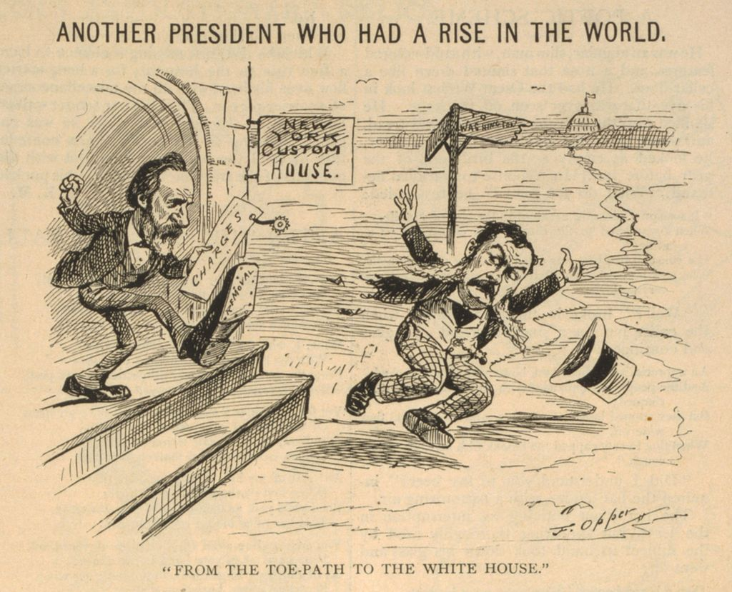

Slide 7
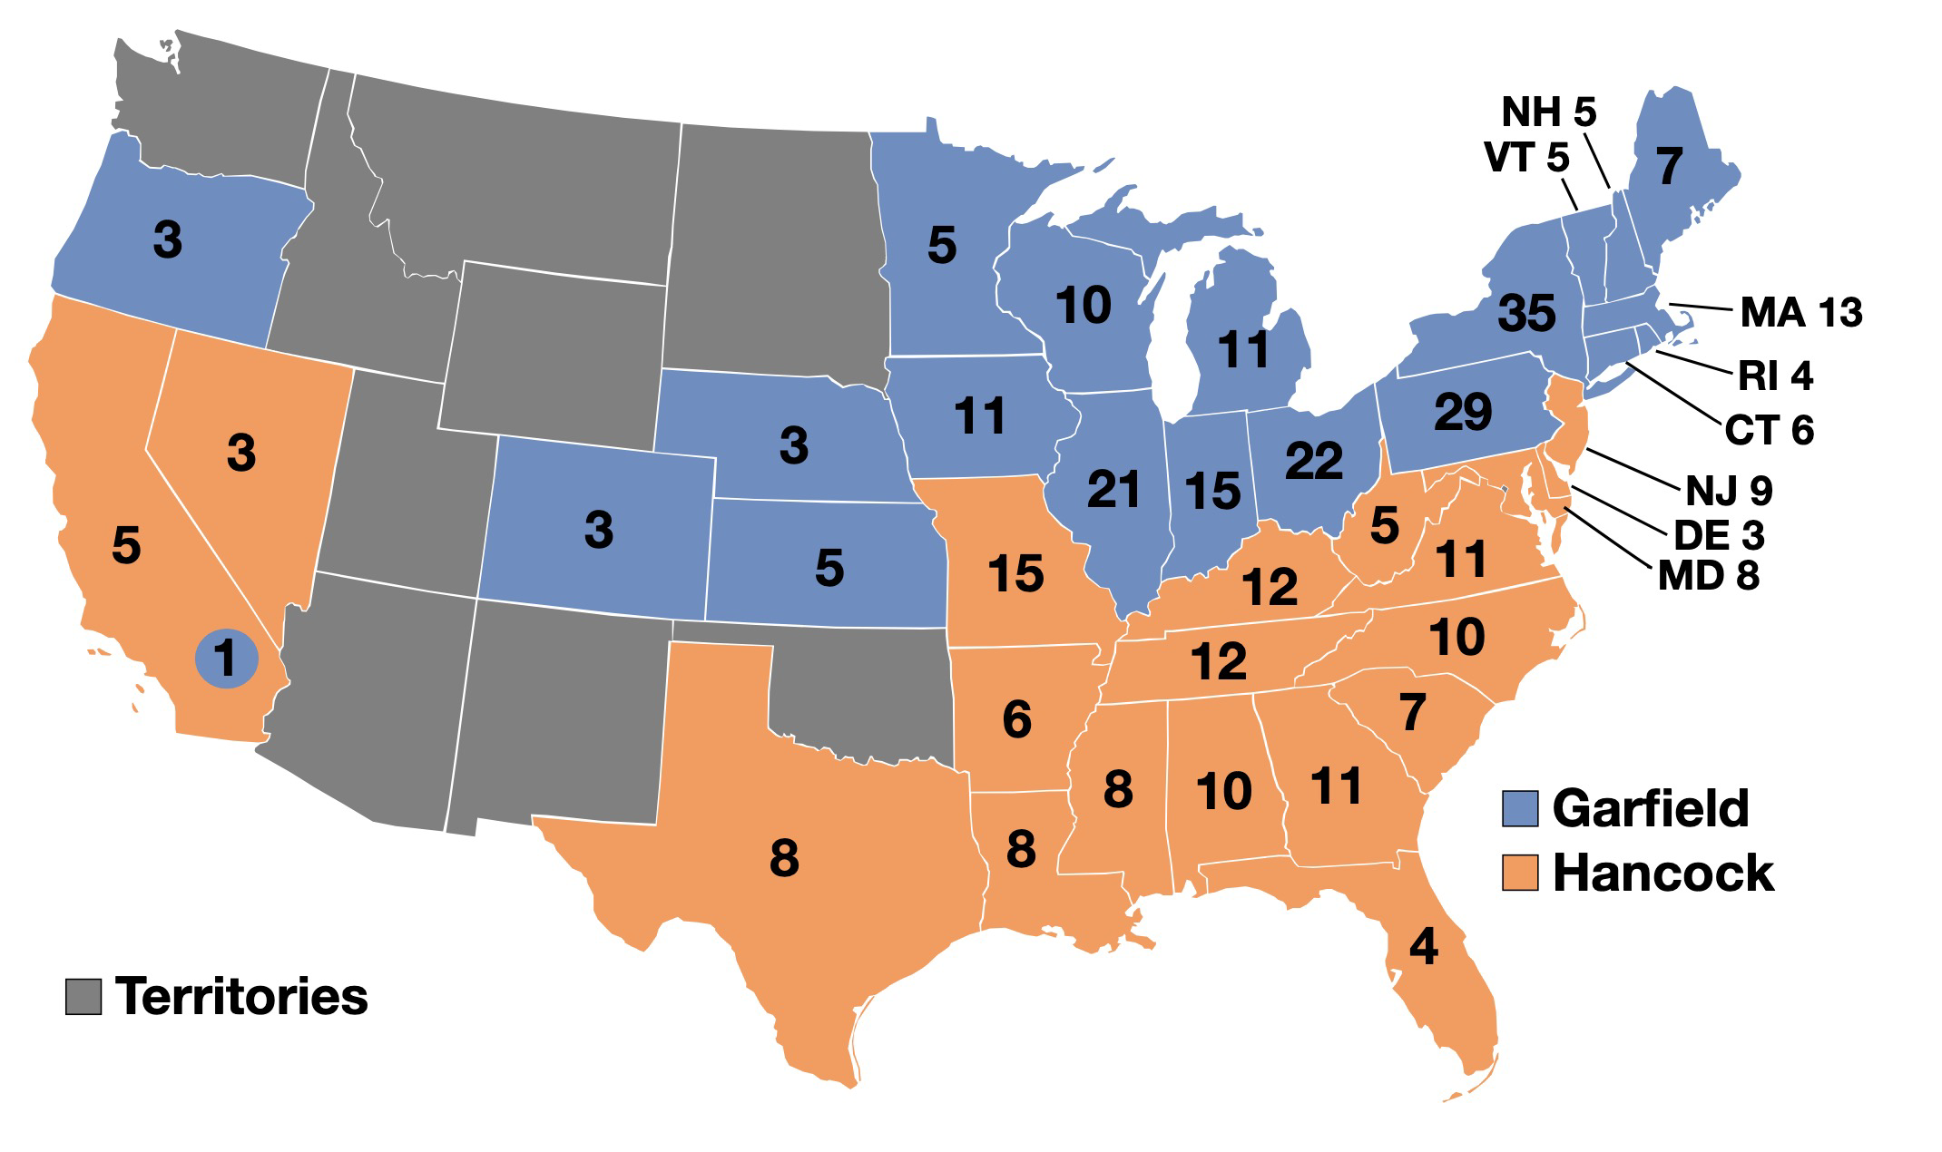
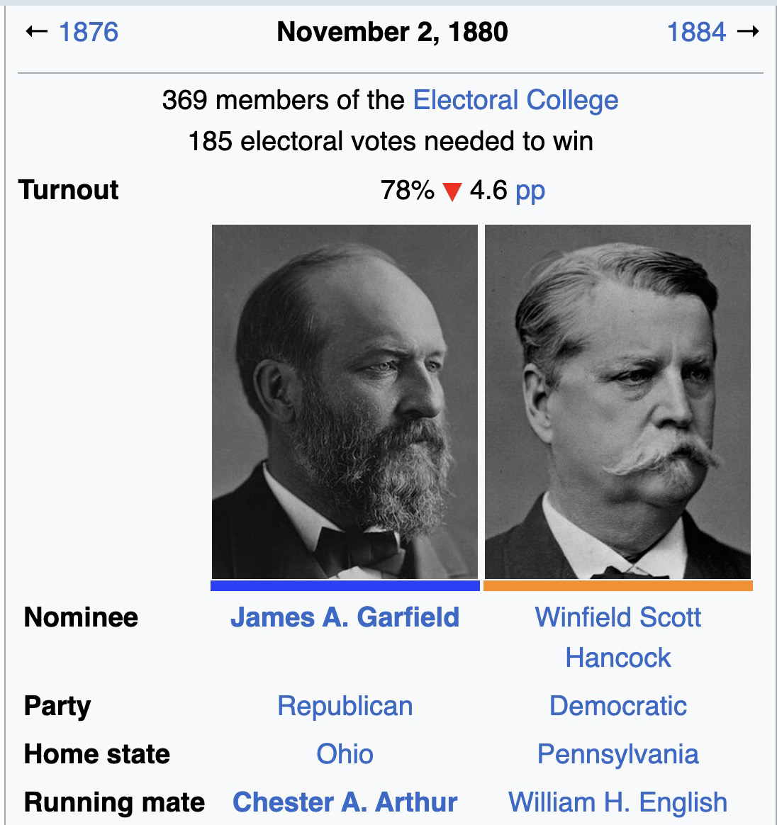
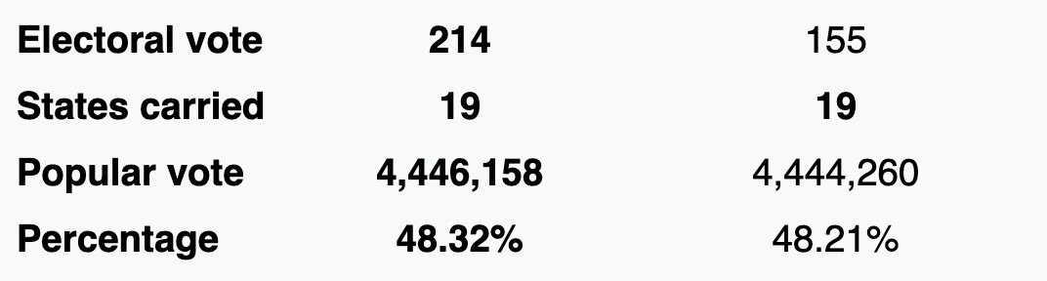
1880 Presidential Election

Slide 8
Pendleton Act (first proposed in 1881)
‘An Act to regulate and improve the civil service of the United States, January 16, 1883; Enrolled Acts and Resolutions of Congress, 1789-1996; General Records of the United States Government; Record Group 11; National Archives.’
The Pendleton Act provided that federal government jobs be awarded on the basis of merit and that government employees be selected through competitive exams. The act also made it unlawful to fire or demote for political reasons employees who were covered by the law. The law further forbade requiring employees to give political service or contributions. The Civil Service Commission was established to enforce this act.
-- United States National Archives
https://www.archives.gov/milestone-documents/pendleton-act)

Slide 9
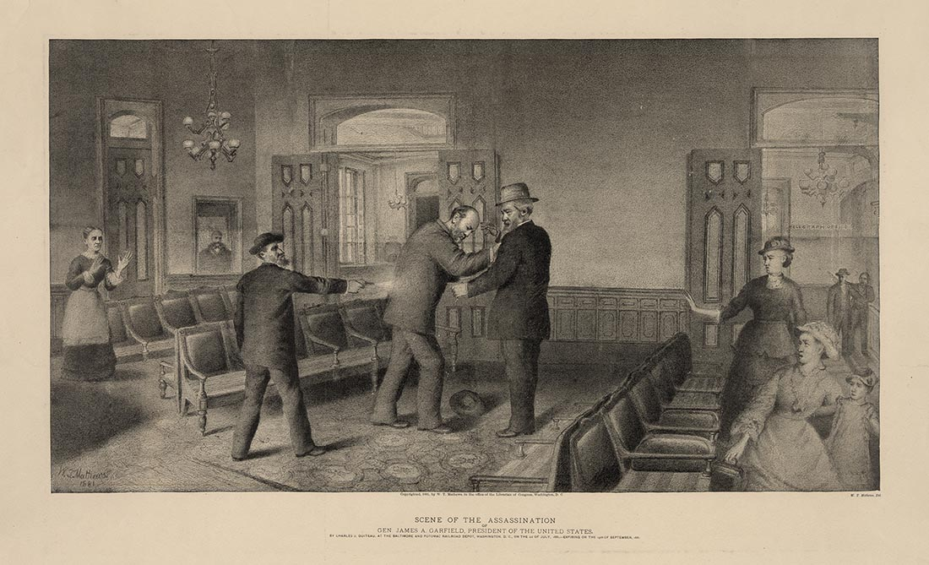

Slide 10
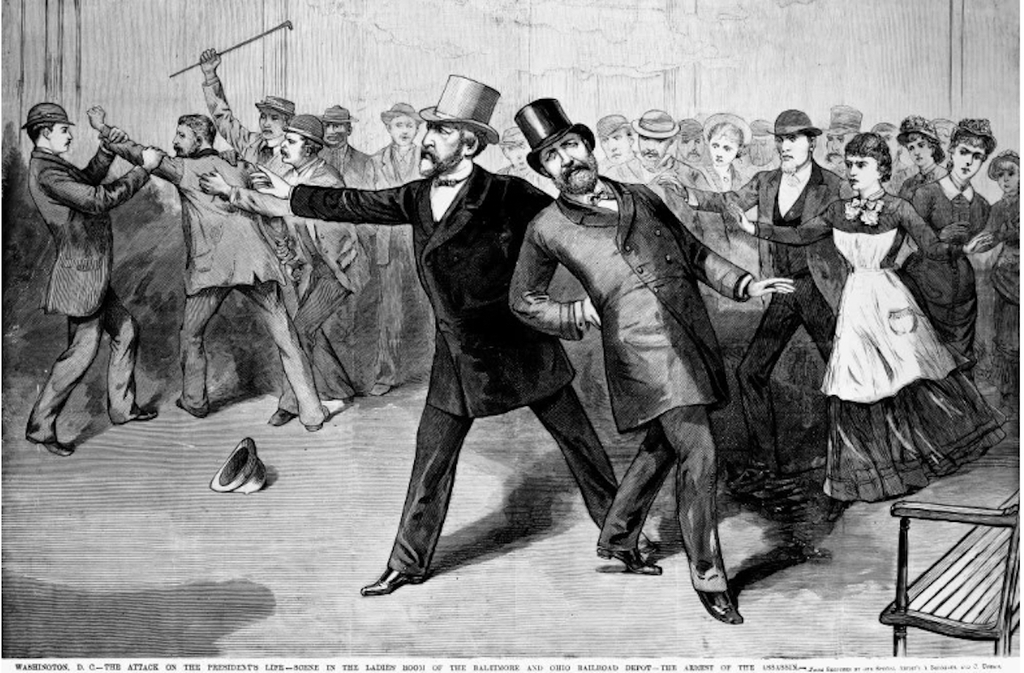
July 2, 1881, Baltimore and Potomac Railway Station, Washington DC

Slide 12
Pendleton Act (passed in 1883)
Following the assassination of President James A. Garfield by a disgruntled job seeker, Congress passed the Pendleton Act in January of 1883. The act took its name from long-time reformer Senator George Hunt Pendleton of Ohio and was signed into law by President Chester A. Arthur, who had become an ardent reformer after Garfield’s assassination.
Approved on January 16, 1883, the Pendleton Act established a merit-based system of selecting government officials and supervising their work.
-- United States National Archives
https://www.archives.gov/milestone-documents/pendleton-act)

Slide 13
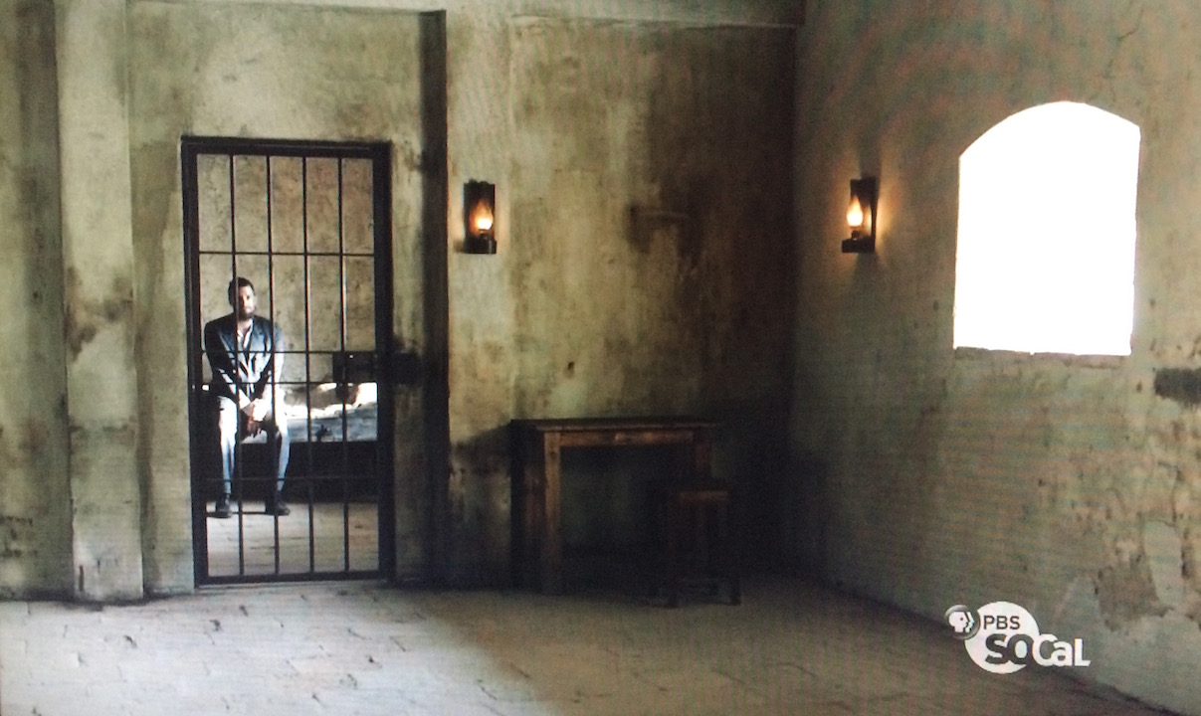

Slide 14
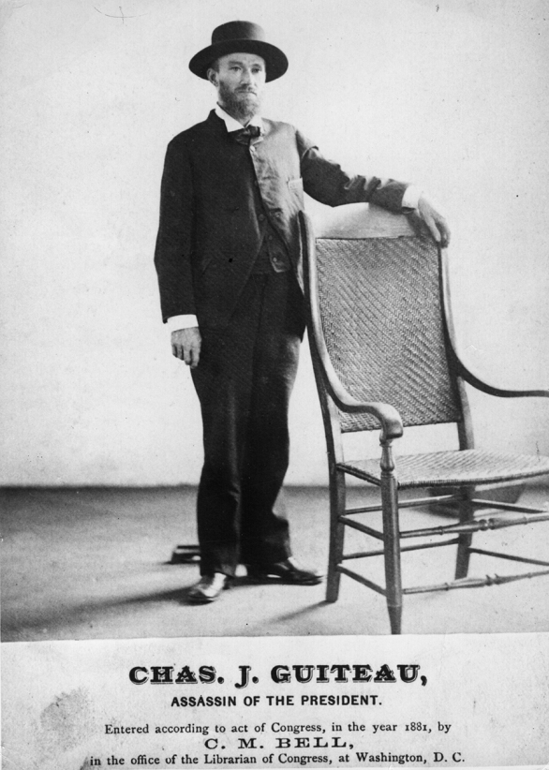
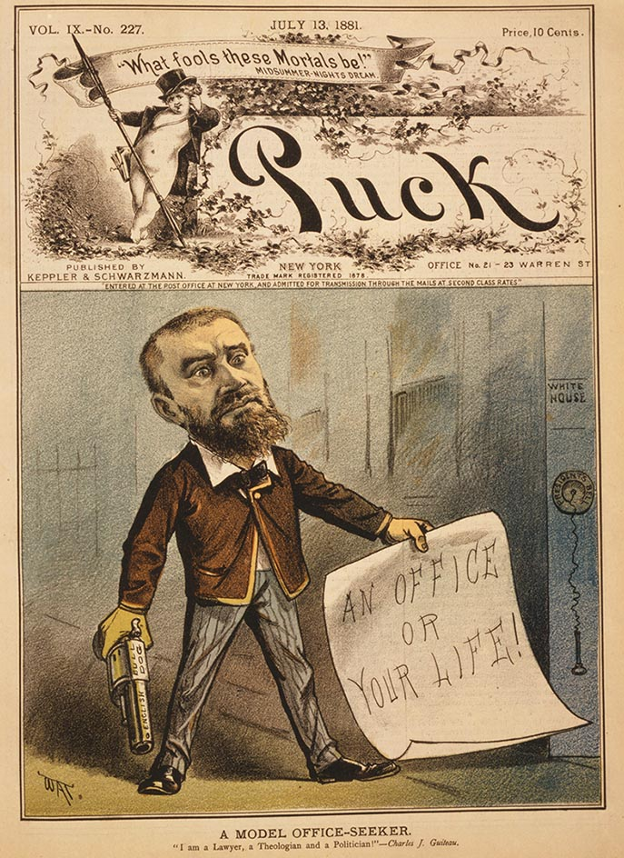
INSANITY DEFENSE

Slide 15
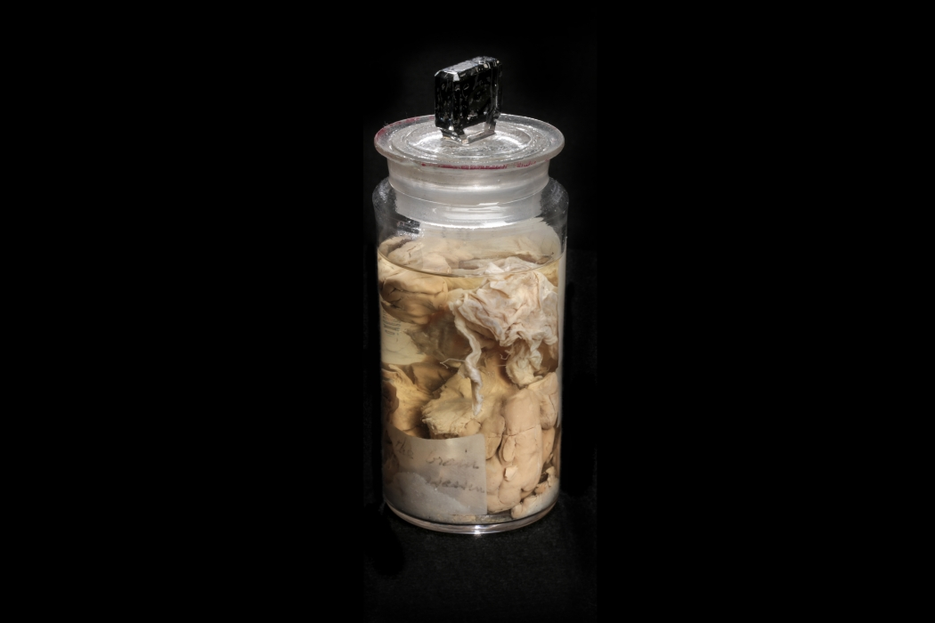

Slide 16
What does this teach us?
Political machines were adaptable to circumstance, capable of deciding to ‘run ahead’ of reform demands.
Medicine of the late 19th century had ideas we might today consider strange.
Big historic changes sometimes depend on happenstance.

