Slide 1
Any History Course
A Primer on Cartography & Geography
#ZERO
‘Universe until Recently’
Nicholas Evangelos Levis
@ City College, Fall 2026

Slide 2
Perspectives on Earth

Slide 3
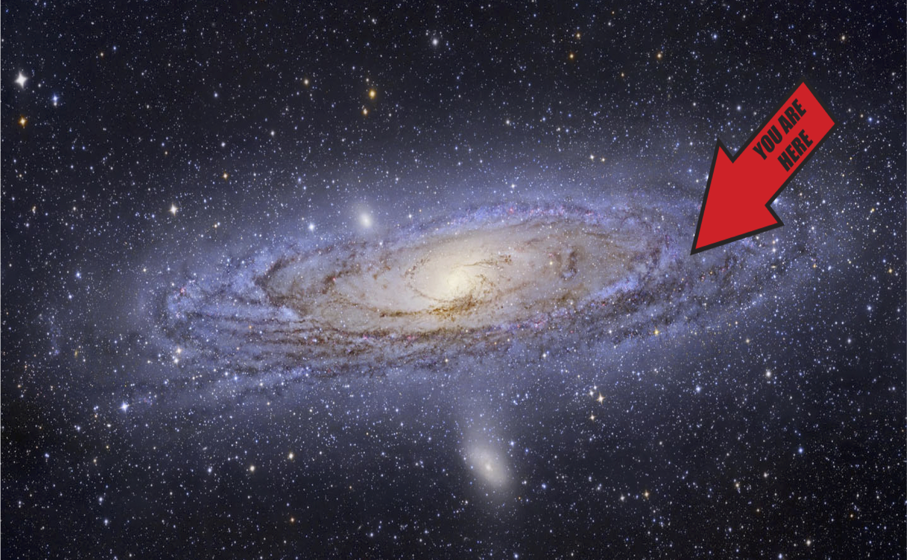

Slide 4
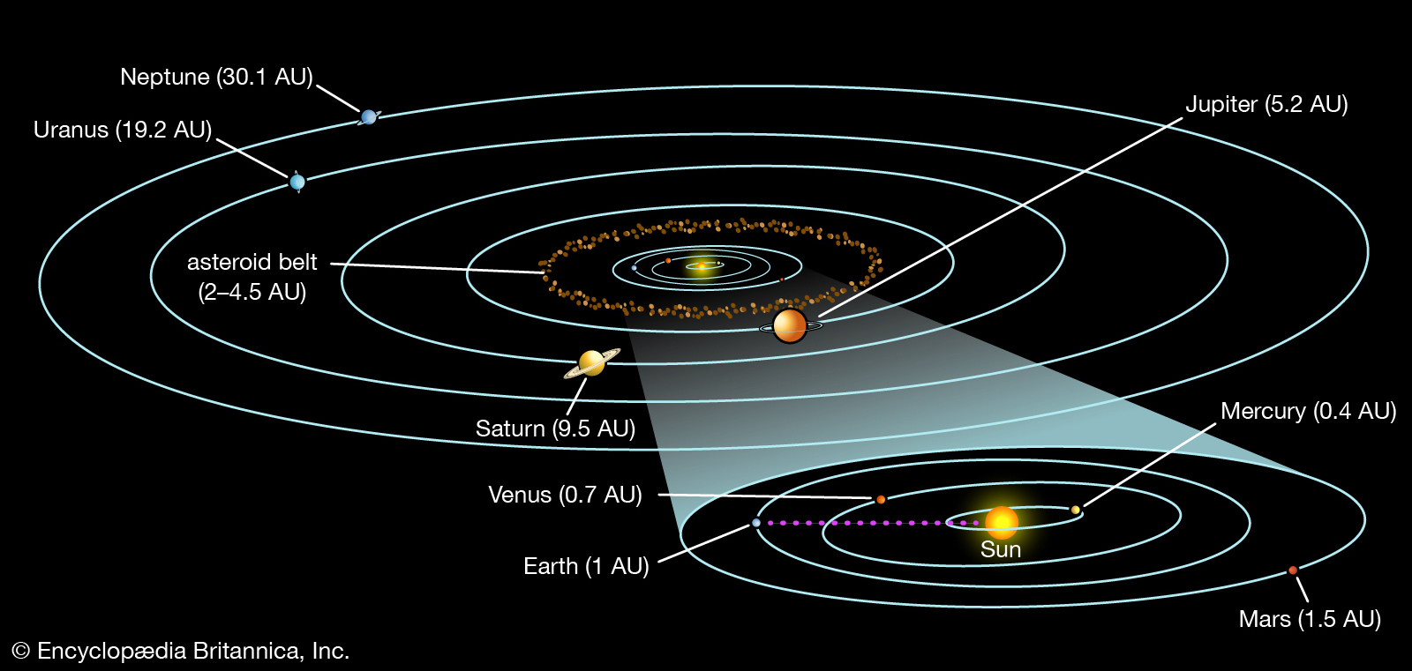

Slide 5
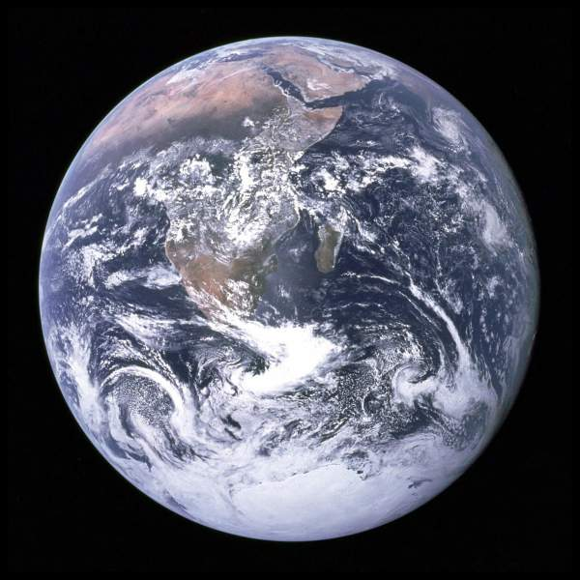
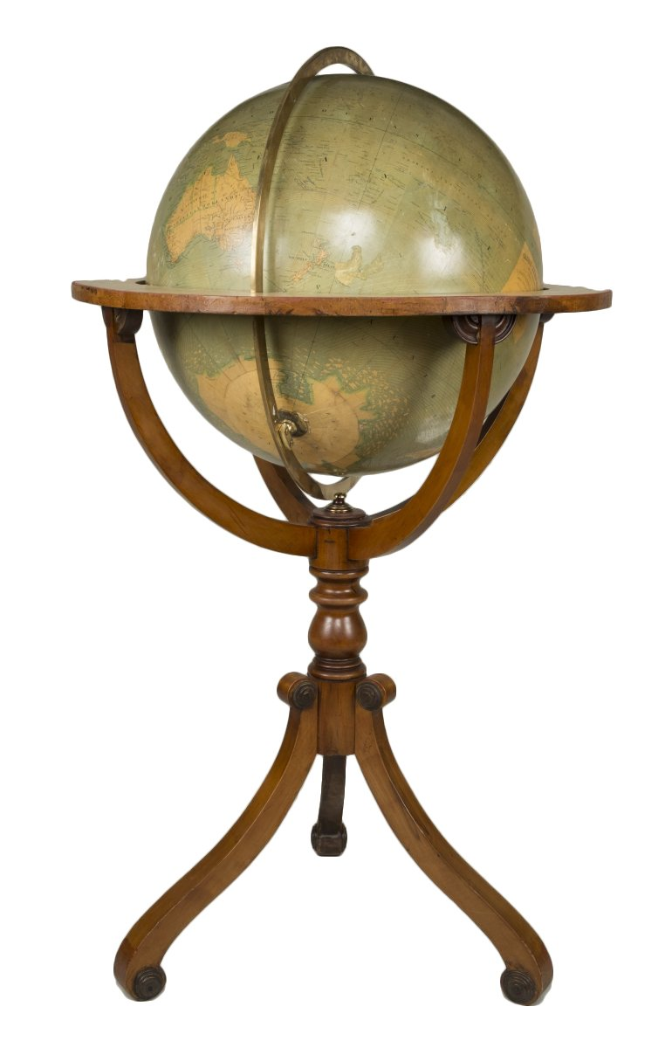

Slide 6
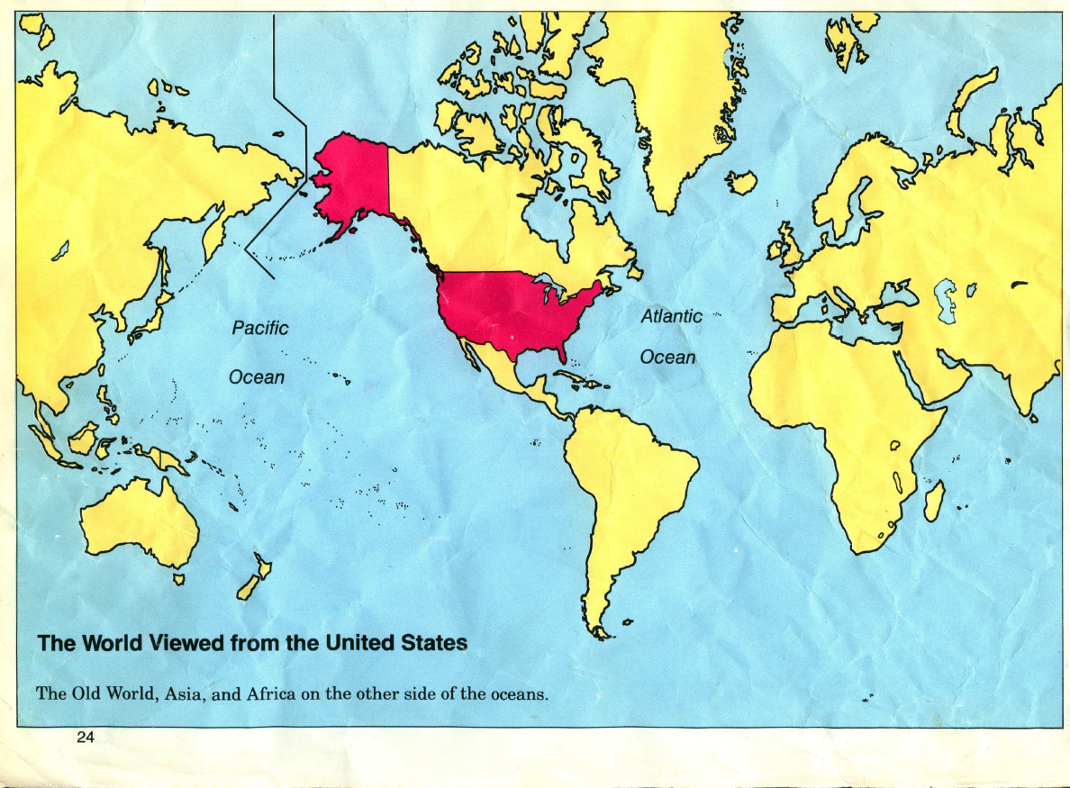

Slide 7
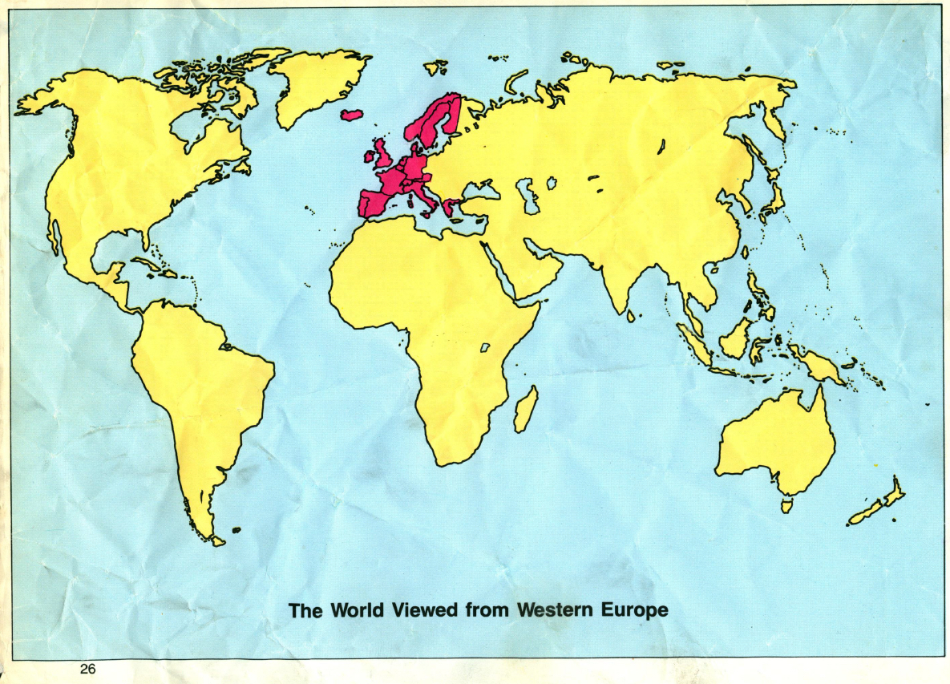

Slide 8
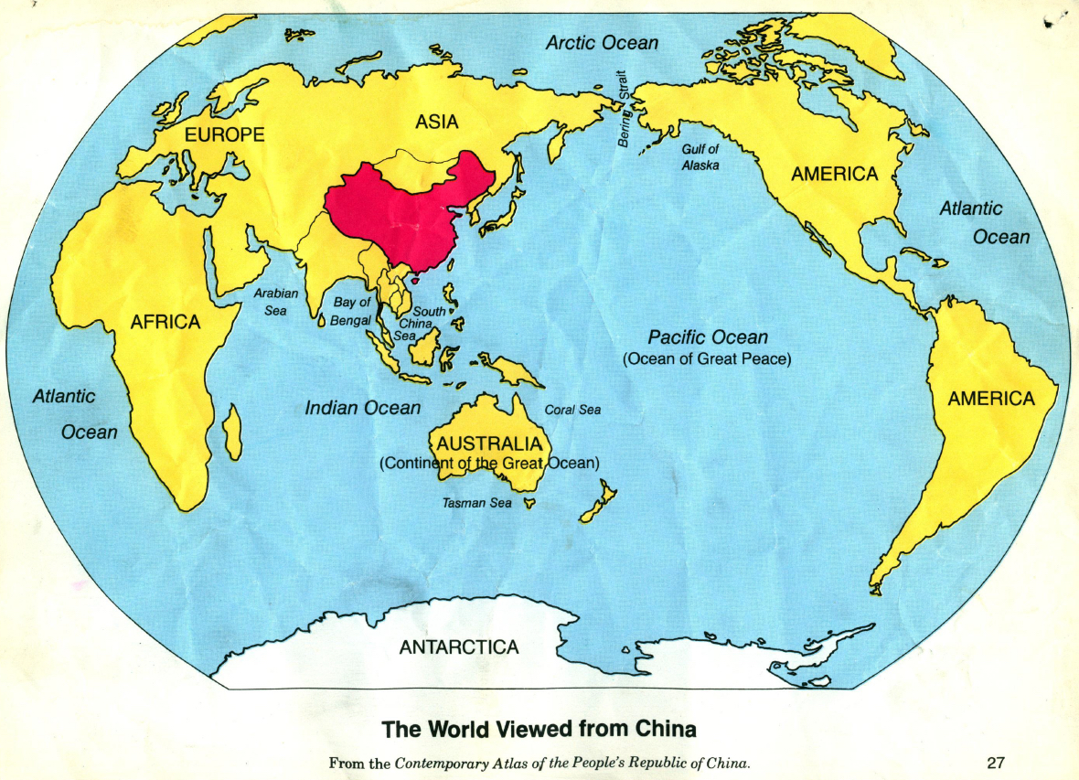

Slide 9
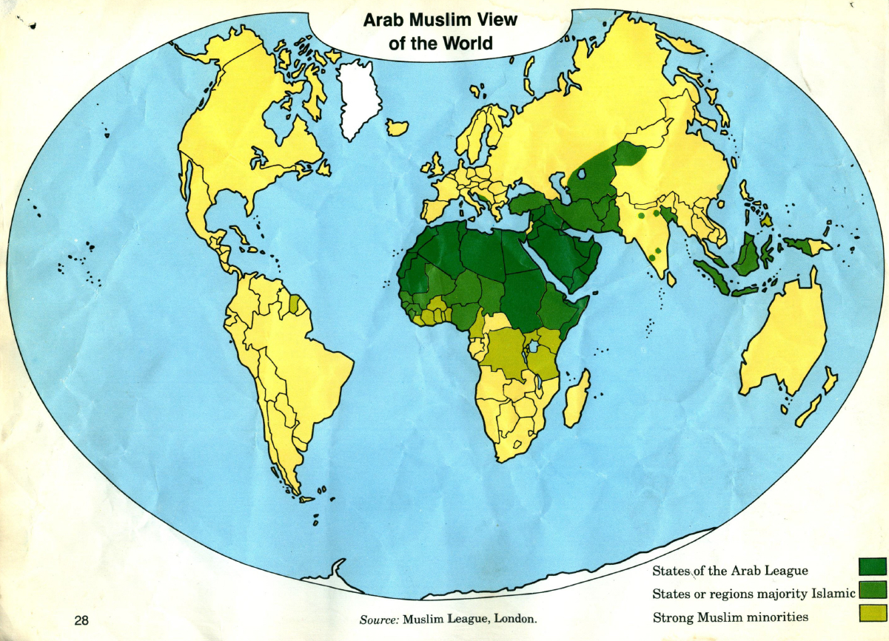

Slide 10
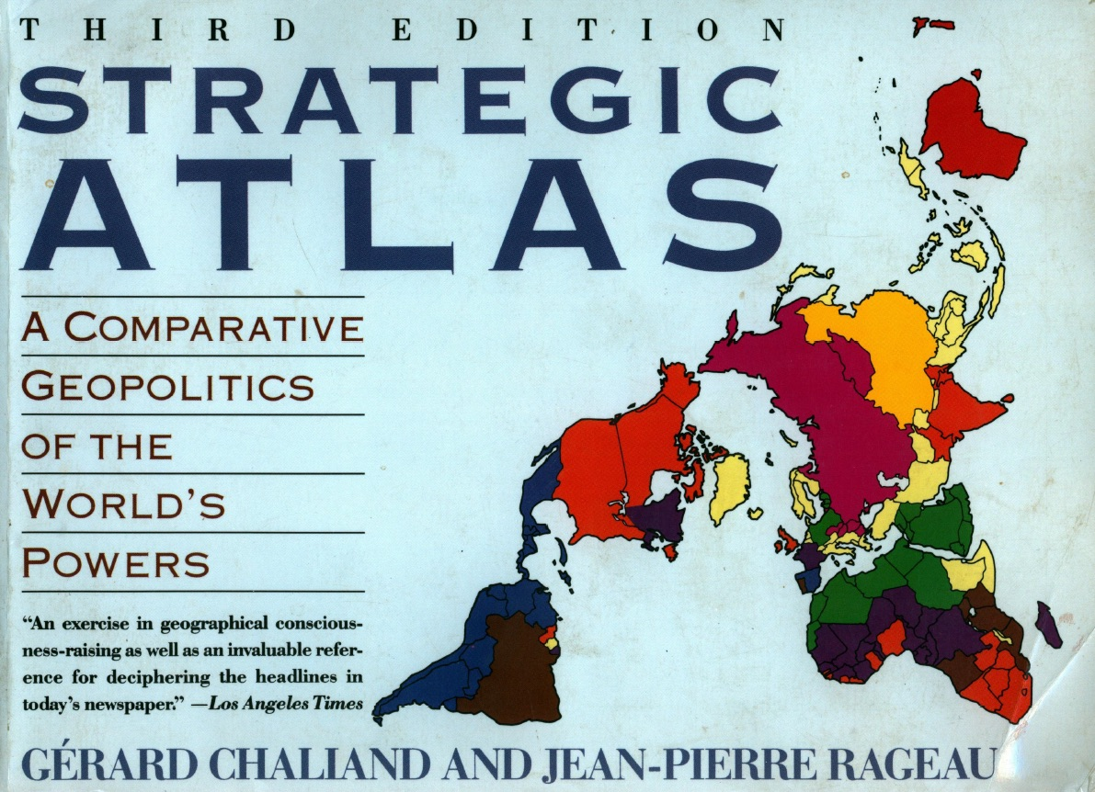

Slide 11
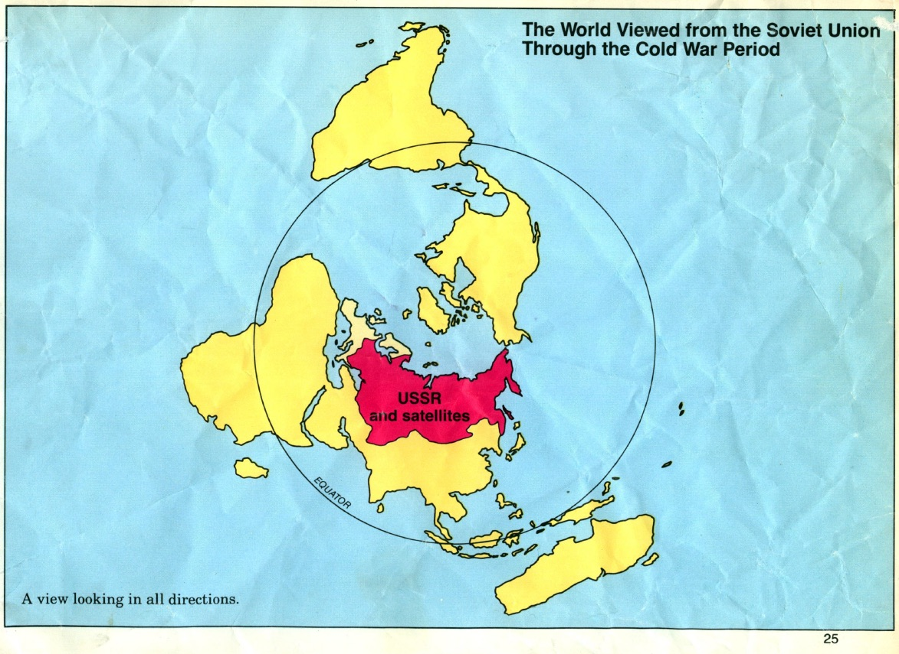

Slide 12
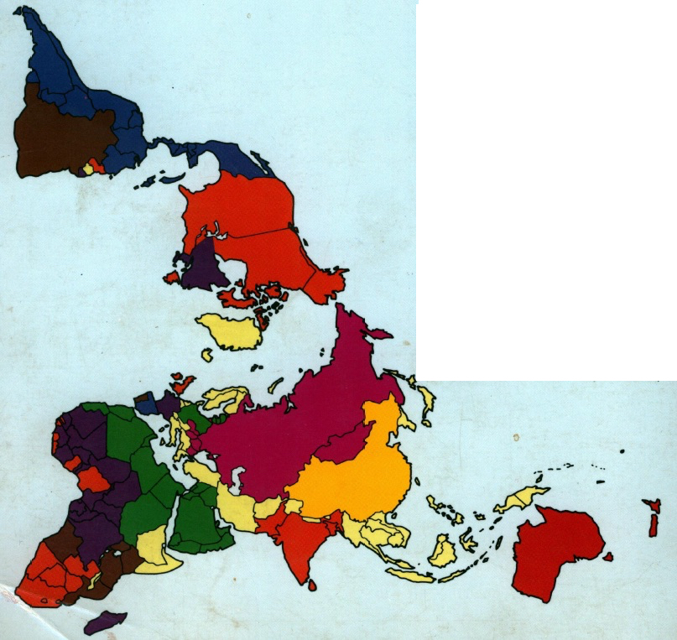

Slide 13
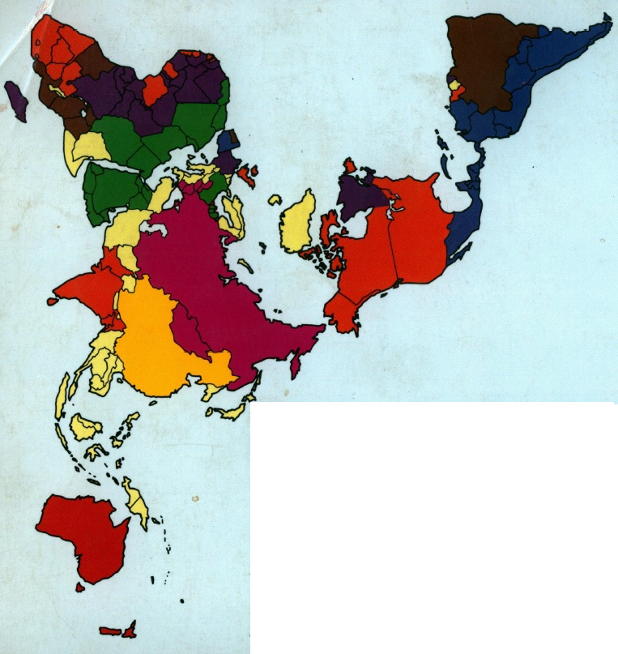

Slide 14
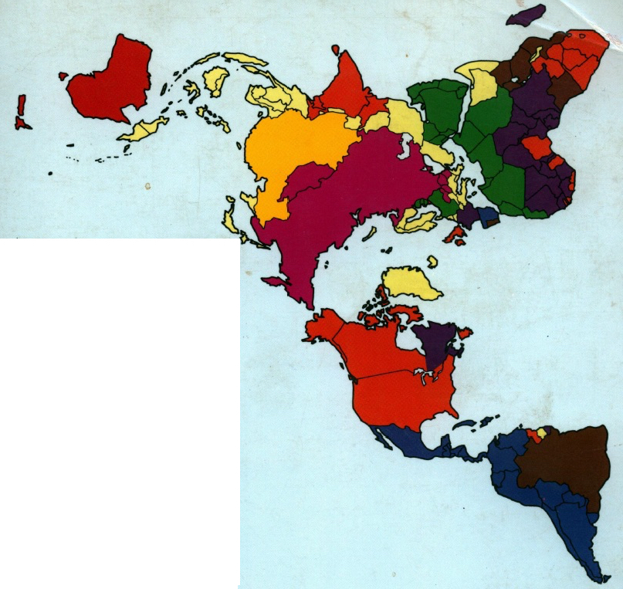

Slide 15
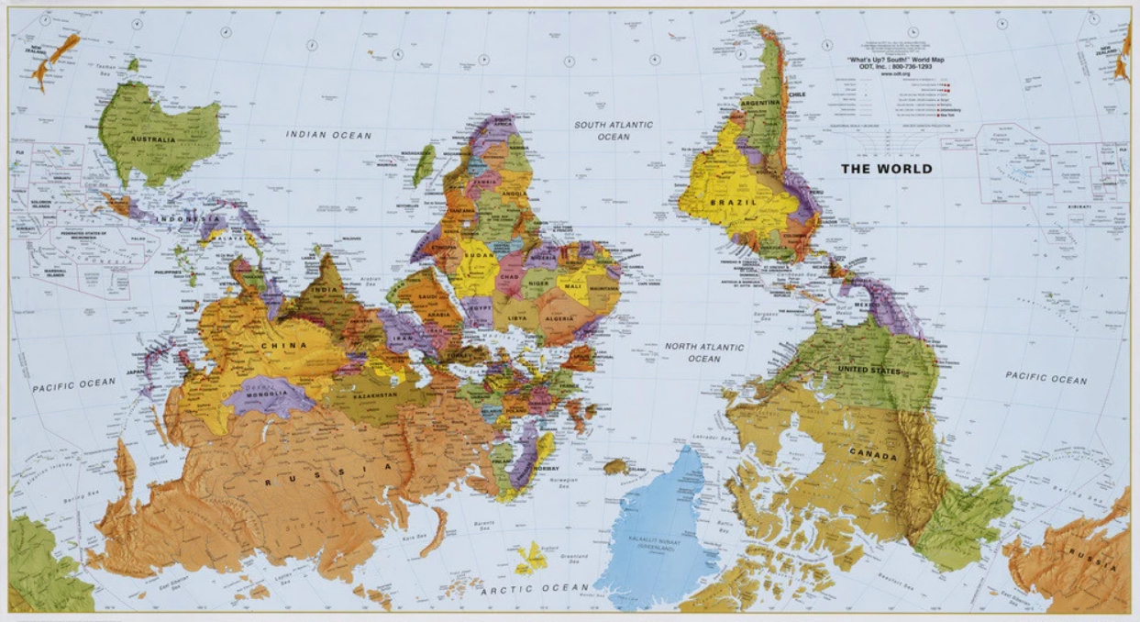

Slide 16
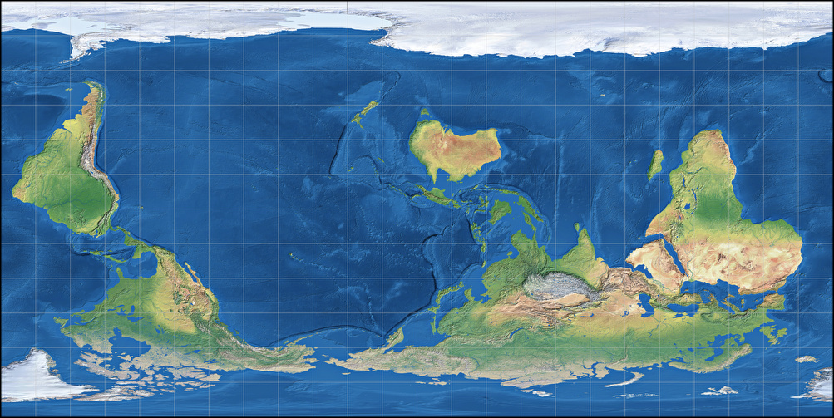

Slide 17
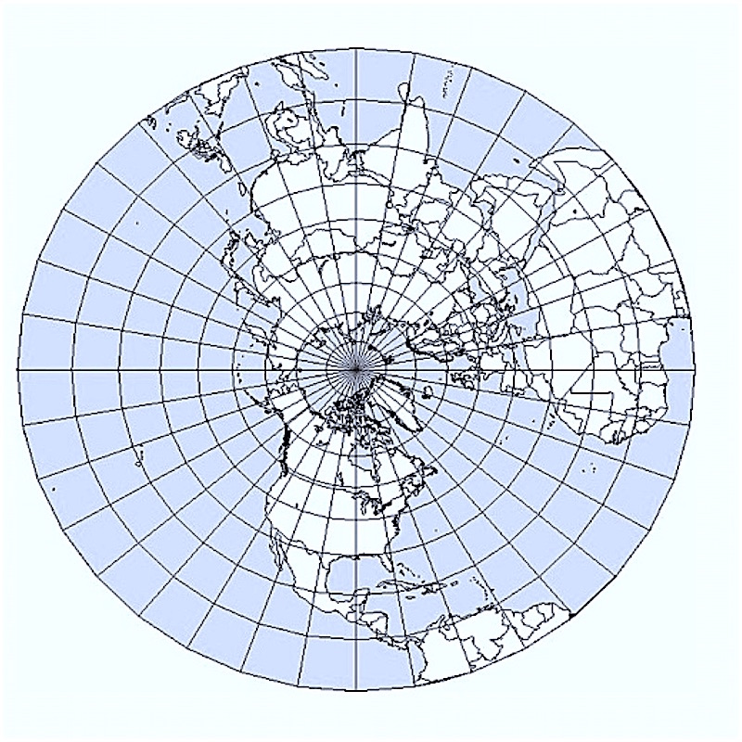

Slide 18
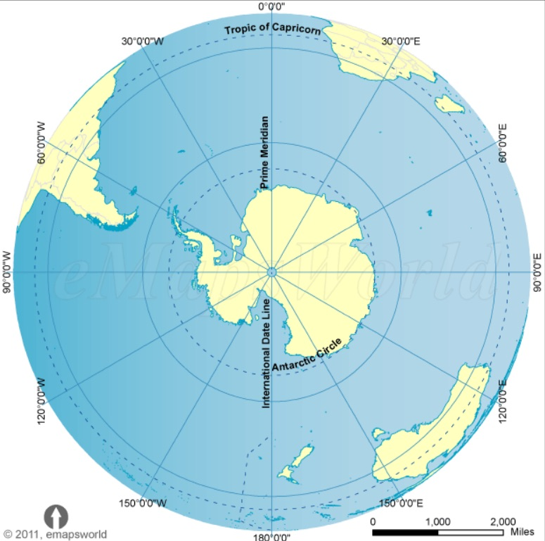

Slide 19
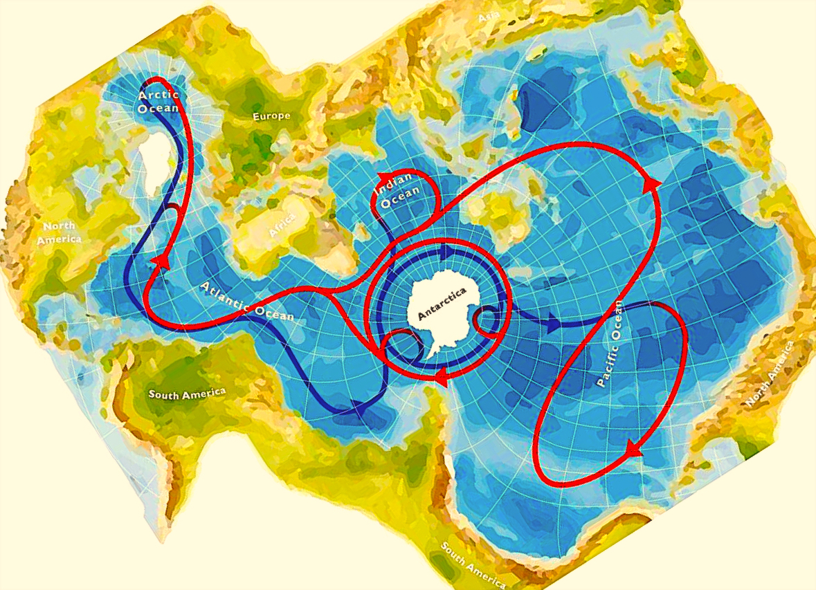

Slide 20
Preceding Page: World Ocean
The Spilhaus Projection is designed to show the true shape of the Earth’s oceans as a single body of water, a single system.
Antarctica is at center. The shores of Eurasia and the Americas run in an infinite loop around the World Ocean.
North America appears in the top left sector, with the East Coast along the Atlantic Ocean. The West Coast appears near the right edge, below center, bordering the vast Pacific.
This is as accurate and true as any other map of the Earth on a flat surface.

Slide 21
Geography
Where do people move around the globe? What ways of life are possible for them in given regions?
Much about how people will live and thus what cultures will tend to arise in a given place depends on waters, coasts, rivers, fisheries, climate, winds, rainfall, habitats and biodiversity, the kinds of species, the kinds of land, forests and grasslands, and natural barriers like mountains, deserts and ice.
But we must beware geographic determinism: Groups move around, bring their ways with them, encounter other groups, become different. In new places, people adapt but may also keep their ways. A range of cultures can arise in each region, limited by geography but also independent of it.

Slide 22
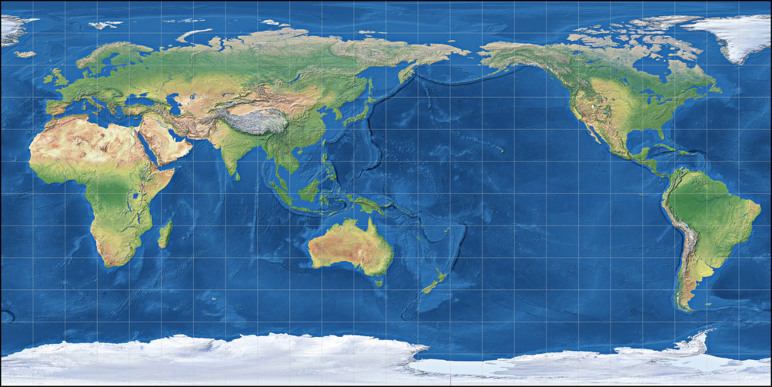

Slide 23
Choose: Europe or America?
If Europe: Stop here and go to first Readings thread in History 102 (“What is Europe?”)
If America: Proceed to the rest of this slideshow.

Slide 24
‘Turtle Island’

Slide 25
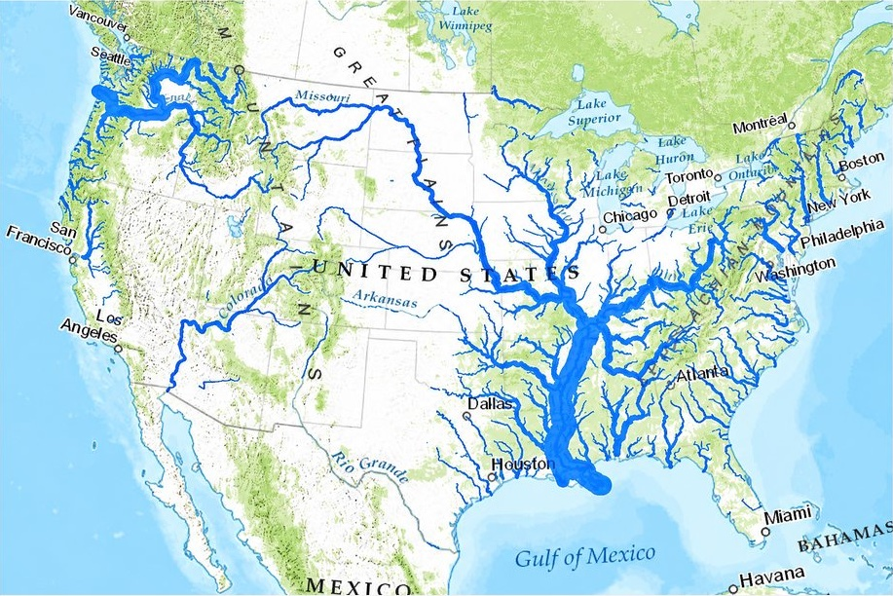

Slide 26
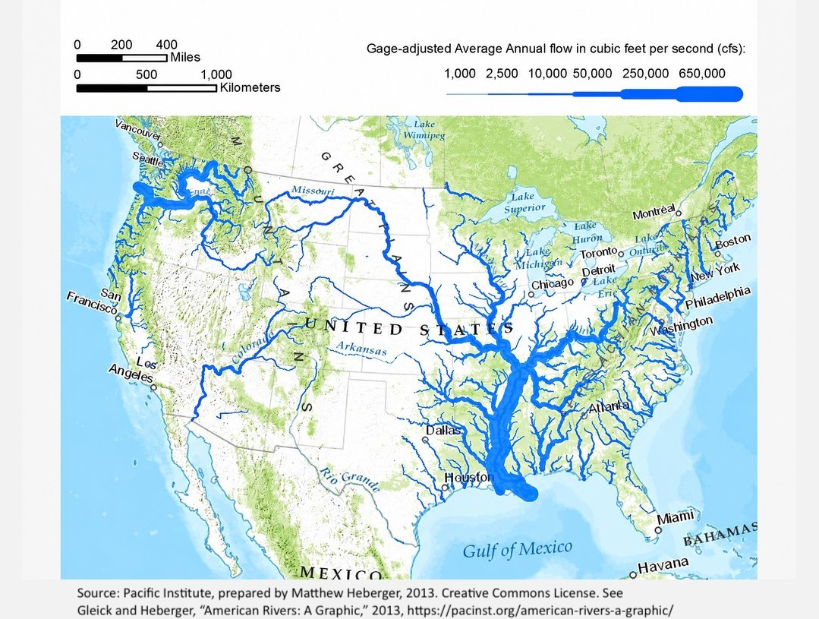

Slide 27
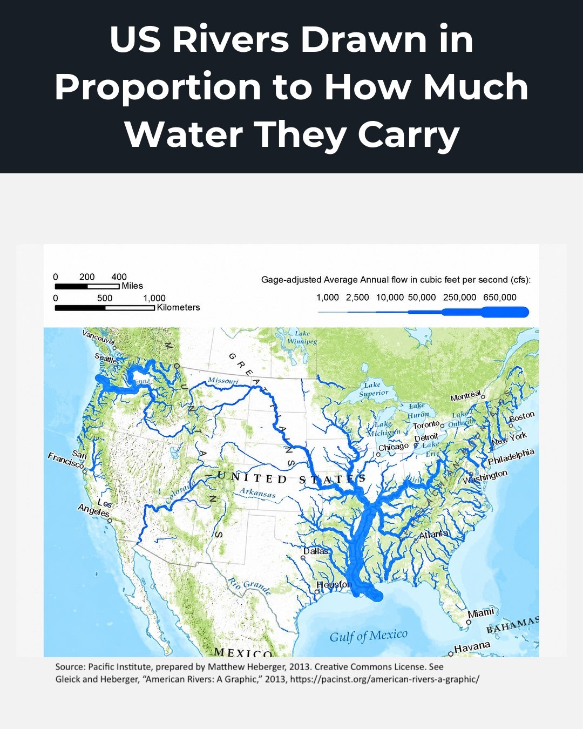

Slide 28
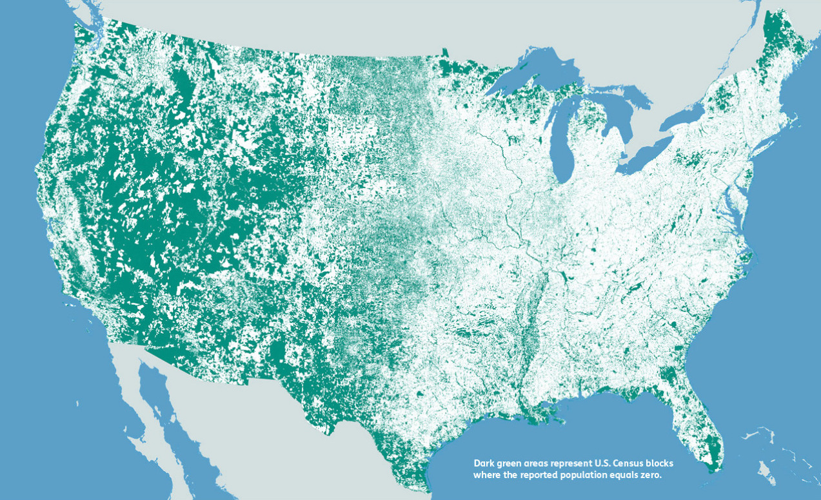
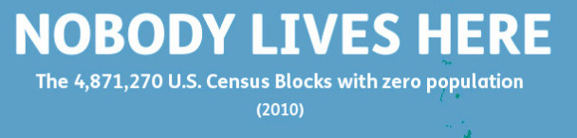

Slide 29
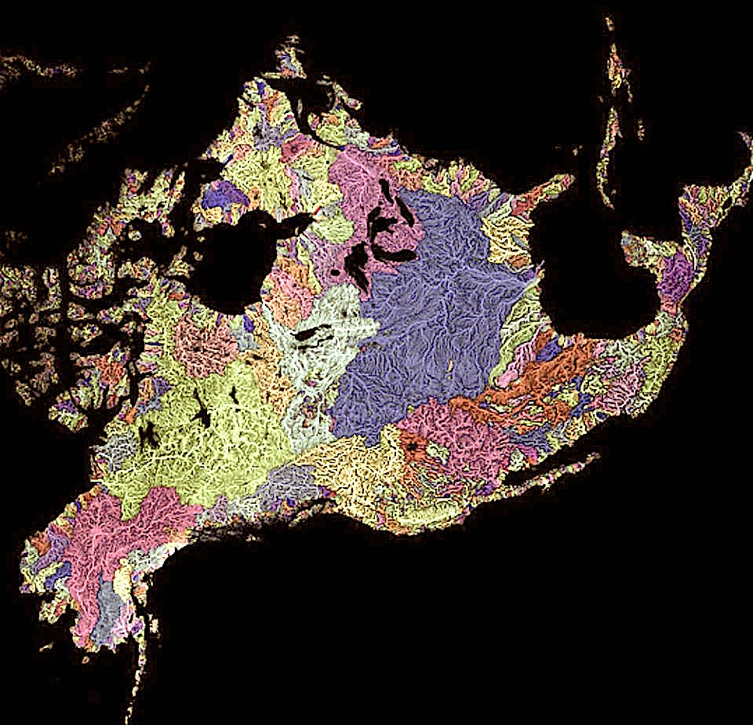
North American
Watersheds
Big purple: Mississippi
Northeast of that:
Great Lakes and the St. Lawrence River system...

Slide 30
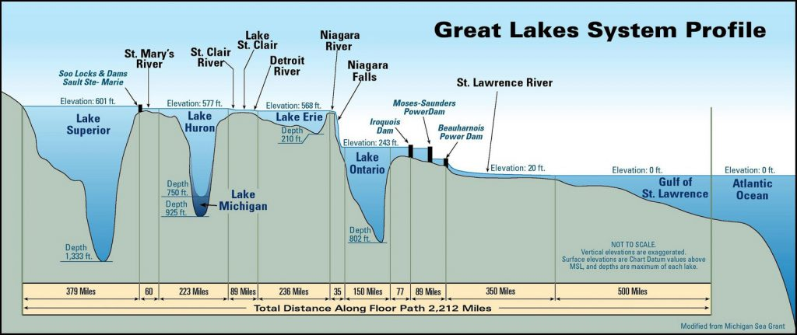

Slide 31
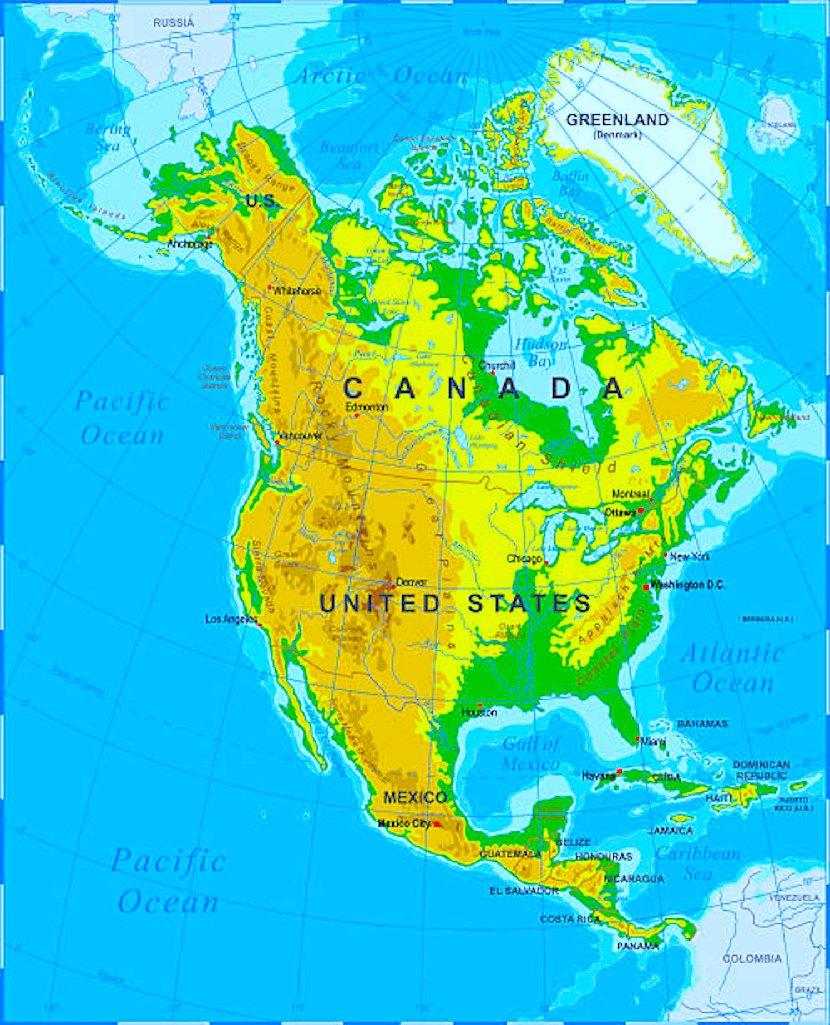

Slide 32
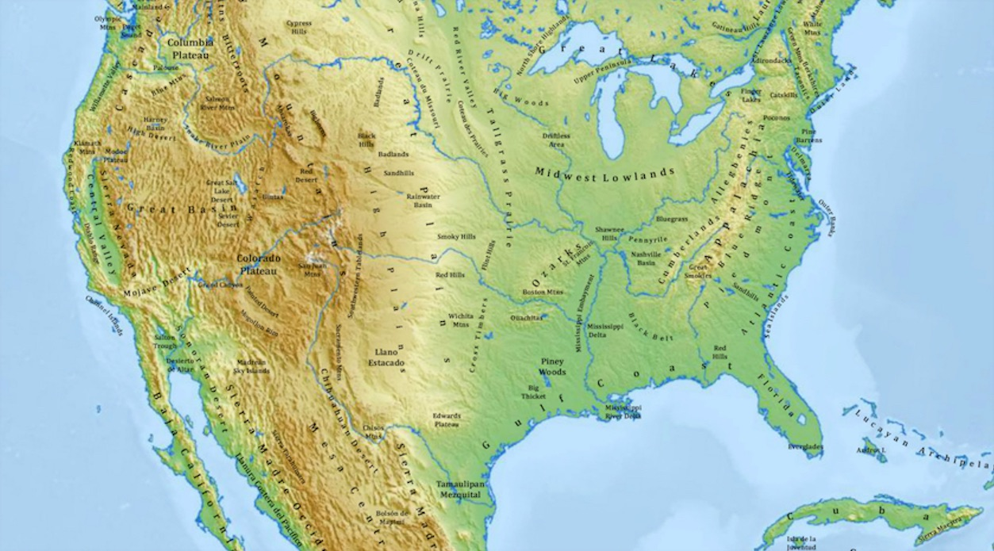

Slide 34
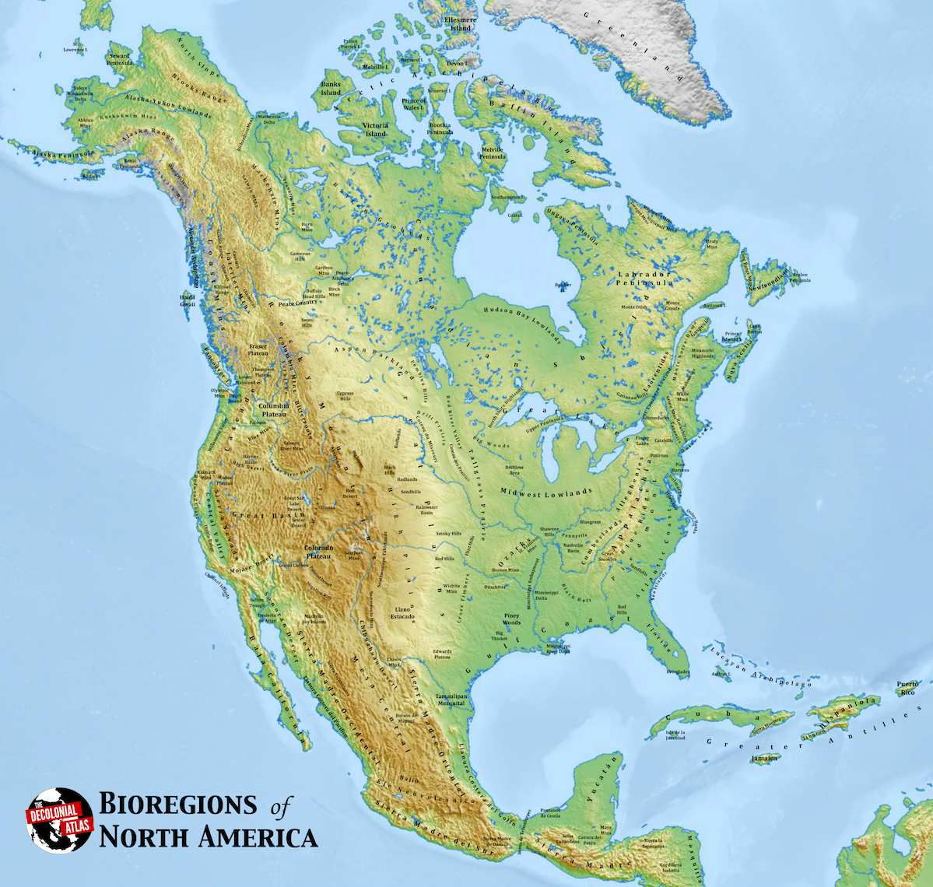
(recommended download)
‘Bioregions of North America’
The Decolonial Atlas
decolonialatlas.wordpress.com

Slide 35
‘World 2’

Slide 36
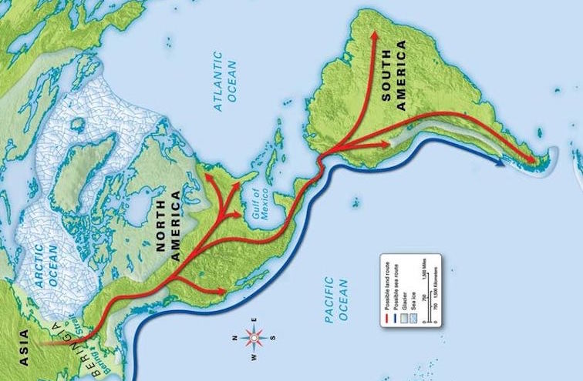

Slide 37
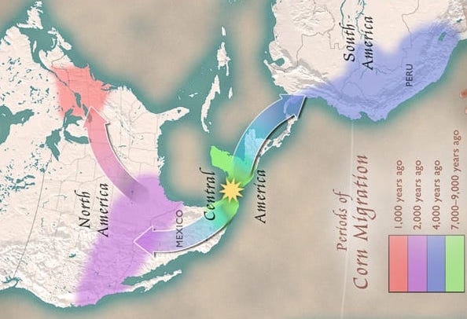

Slide 39
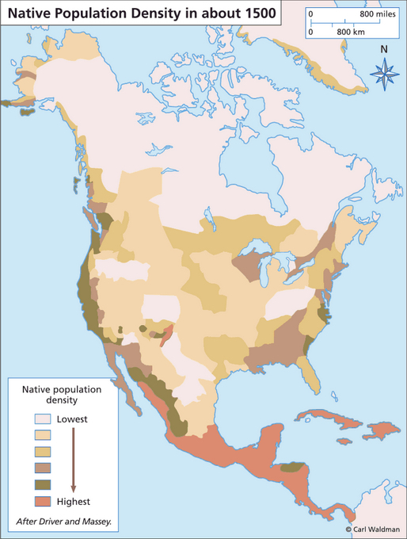

Slide 40
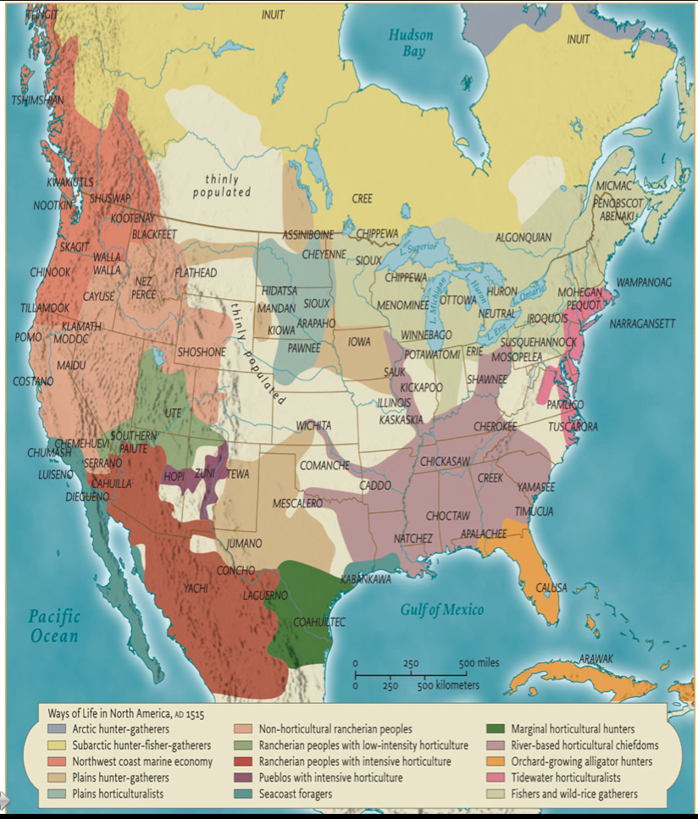

Slide 42
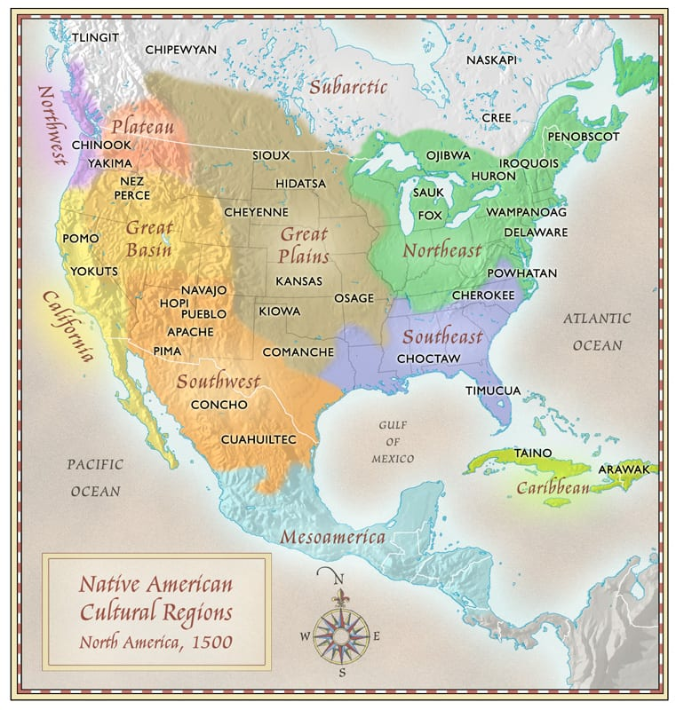

Slide 44
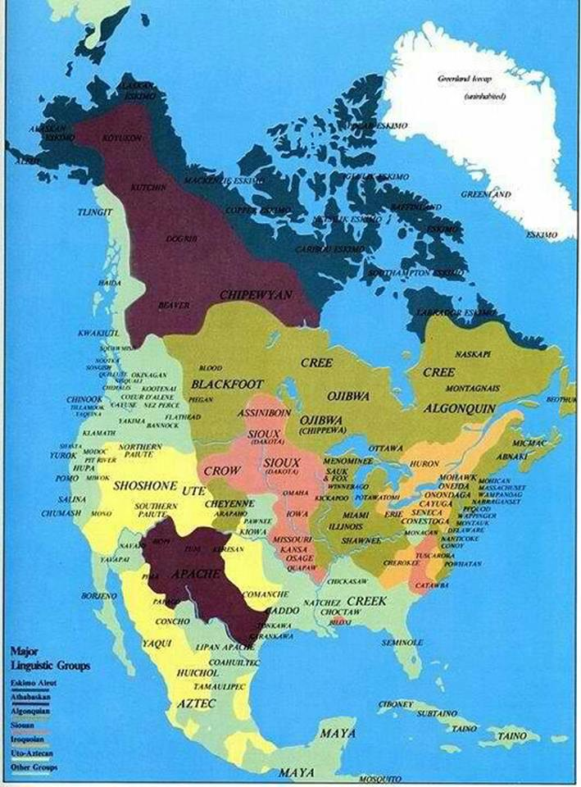

Slide 46
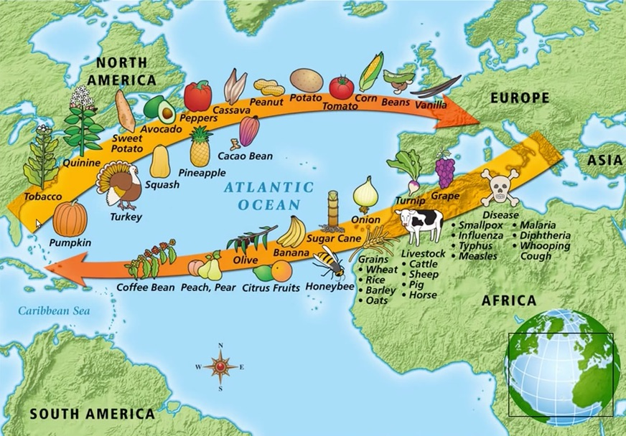

Slide 47
Population

Slide 48
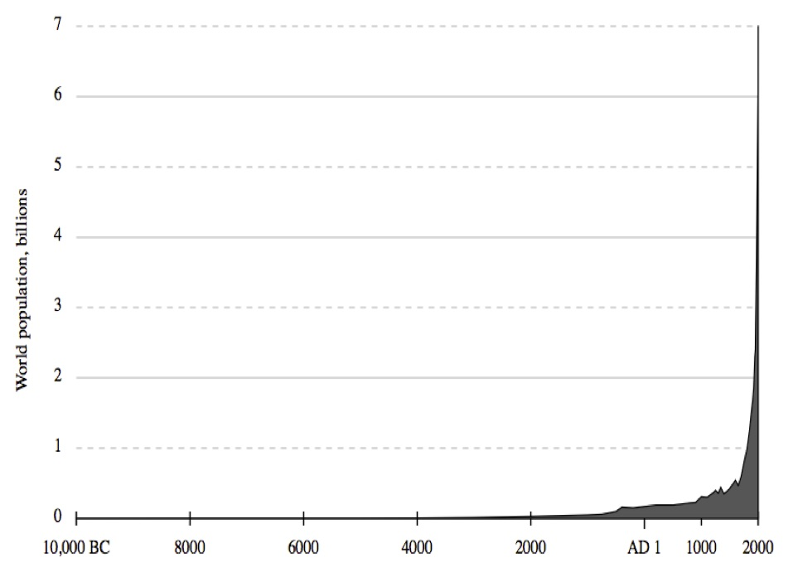
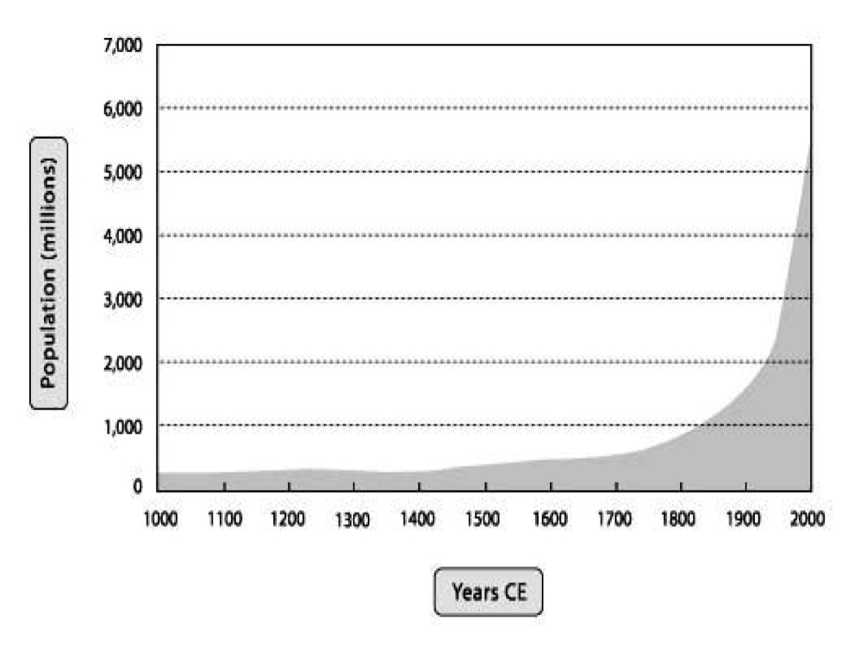
World Population – Big Picture
Last 12,000 Years
Last 1,000 Years
Source: Wikimedia, produced using lower historical estimates of U.S. Census Bureau at http://www.census.gov/population/international/data/worldpop/table_history.php
Source: Christian, David. 2004. Maps of Time an Introduction to Big History. Berk`eley: University of California Press.

Slide 49
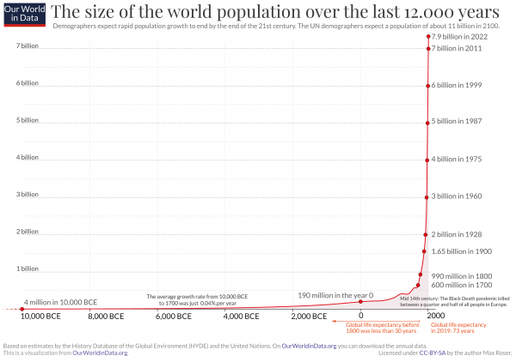

Slide 50
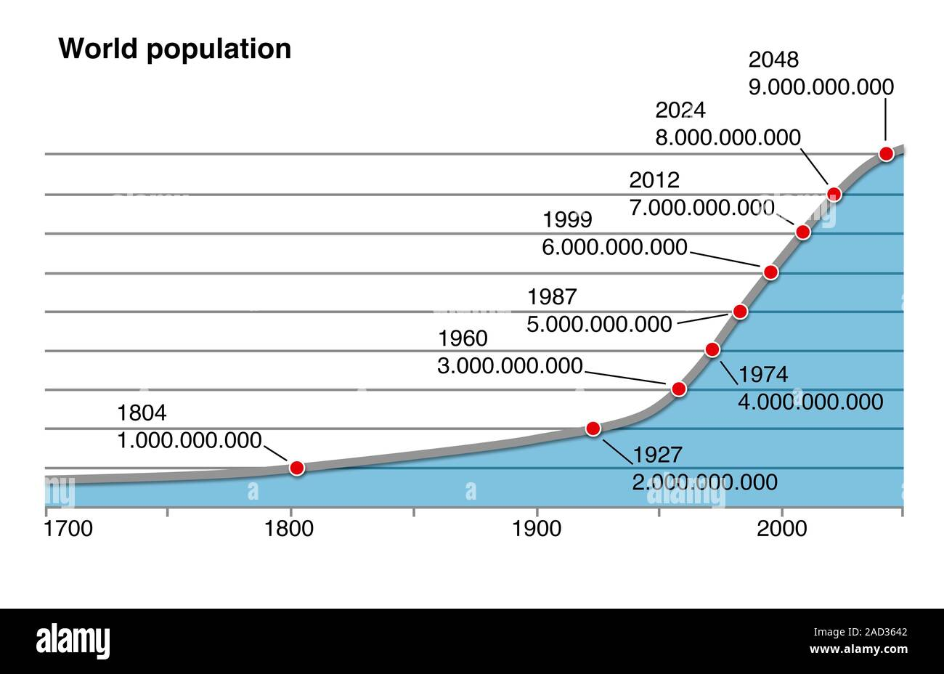

Slide 51
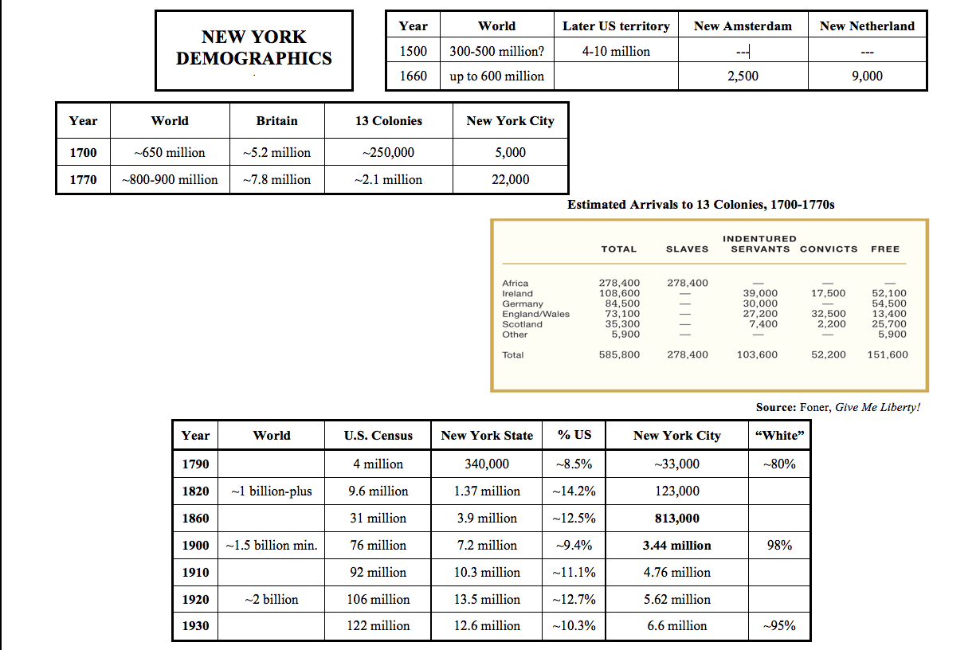

Slide 53
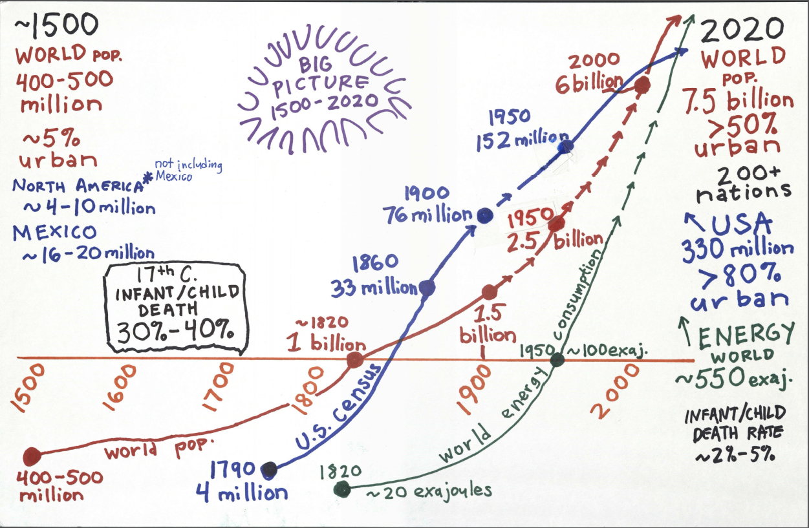

Slide 54
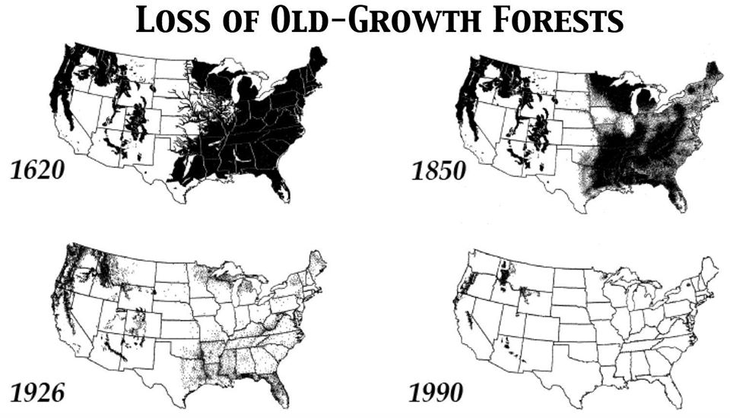

Slide 55
Population: 4 clarifications
It’s not bad, it’s not good, it is what it is.
Ecologically, the more important factor by far is consumption.
(1 average U.S. resident consumes as much as 30 people in Kenya;
1 super-rich American = 100s or 1000s of average Americans)
The key question: Can we find a way to preserve the ecological carrying capacity for civilization, humanity, and life on Earth?
Some believe current crisis is the fall in birth rates below replacement level (2.2 per female)

Slide 56
History

Slide 57
What is Historical Study?
Easy! History is the study of change over time! (Hmm, wait...)
It is the study of change and continuity over time. (Ok, mostly, but...)
The study of change & continuity over time among human beings.
Study of change and continuity over time among human beings as they understand it, and according to the purposes they pursue in seeking to understand it.

Slide 58
History is more or less bunk. It's tradition. We don't want tradition. We want to live in the present, and the only history that is worth a tinker's damn is the history that we make today.
- Henry Ford, 1916
The past is not dead. The past is not even the past.
- Wm. Faulkner

Slide 59
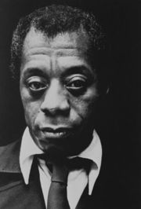
James Baldwin
“History is not the past. It is the present. We carry our history with us. We are our history. If we pretend otherwise, we are literally criminals.”
“History does not refer merely, or even principally, to the past. On the contrary, the great force of history comes from the fact that we carry it within us... history is literally present in all that we do.”
“The past is all that makes the present coherent, and further... the past will remain horrible for exactly as long as we refuse to assess it honestly.”

Slide 60
Eric Foner
History, it has been said, is what the present chooses to remember about the past. Rather than a fixed collection of facts, or a group of interpretations that cannot be challenged, our understanding of history is constantly changing. There is nothing unusual in the fact that each generation rewrites history to meet its own needs, or that scholars disagree among themselves on basic questions like the causes of the Civil War or the reasons for the Great Depression. Precisely because each generation asks different questions of the past, each generation formulates different answers. The past thirty years have witnessed a remarkable expansion of the scope of historical study. The experiences of groups neglected by earlier scholars, including women, African-Americans, working people, and others, have received unprecedented attention from historians. New subfields – social history, cultural history and family history among them – have taken their place alongside traditional political and diplomatic history. (Introduction to Foner, Give Me Liberty!)

Slide 61
Levis’s Laws of History
(joking, but true?)
Everything new is older than you think.
Everything old is newer than you think.
History does not repeat. It sticks around.
Life was different then.
History does not have an aim (telos/teleology or ‘progress’).
History is not a set of easy, general lessons.

Slide 62
Sticking Around - Legacies
Physical: buildings, layers of ruins and detritus, ecological changes, technologies.
Institutional: laws, forms of government and economics, borders, political ideals, reigning ideologies (‘hegemonies’).
In mind and soul: culture, tradition, memory, trauma, emotions, fashions, stories (myths and ‘tropes’ that seem to explain).
Examples for early 2021, after 2020: Election Day. Electoral College.

Slide 63
Sticking Around – Path Dependency
One step often turns into a journey of a thousand miles. Path dependency is a fancy social-science term for historical momentum – for how sometimes the seed of a first decision or a first outcome can turn into lasting consequences and structures.
Complex organized institutions, once established, seek to perpetuate themselves (e.g., bureaucracies, industries, states, organized religions, families).
People get used to it. “This is how it has always been done.”

Slide 64
History as Legacy
Living memory and memory culture.
Memorialization
Examples of memorialization in Fall 2022:
Columbus Day
Thanksgiving
Controversies about history
Public History
Museums, sites, archives, tourism: an industry.
Reenactment, adaptation, fictionalization, literature, film, theater.

Slide 65
Role of Historical Study in Shaping History
History as an academic profession at universities – a 19th century invention.
Historiography and Revision – responding to new presents, new ways of thinking about the past, evidentiary discoveries, reassessments of earlier versions.
Historical study provides frames through which the past is filtered, selecting the past, affecting the present.

Slide 66
Periodization
Types of periods:
- Natural: days, years, seasons, lunar months, climate
periods, etc.
Semi-natural: generations, lifetimes...
- Calendrical: “years”, decades, centuries, etc.
- Conventional: terms of office, baseball seasons, etc.
- Experienced: 1865, 1945, 1989, 9/11, 2020
- Restrospective: The historian’s specialty.
How do we periodize and why does it matter?
How can period be political?

Slide 67
Historical Study is Multi-Disciplinary
Sciences: Planet, Evolution, Archaeology, Anthropology.
Geography: Physical world; the frames of cartography.
Ways of living: Food. Agriculture. Industry. Exchange.
Peoples: Cultures. Languages. Religions. Demographics.
(Never pinned down. Always changing, re-mixing.)
Political entities: States, empires, nations, wars and peaces. Legal systems, corporations, class and Caste. Gender systems. Churches. Gangs, clubs. Clans, families.
Economics: Labor regimes. Money and markets. Production, reproduction, goods and flows. Capitalism.
Sources: A million types to discover, authenticate, evaluate, compare, incorporate into studies.

Slide 68
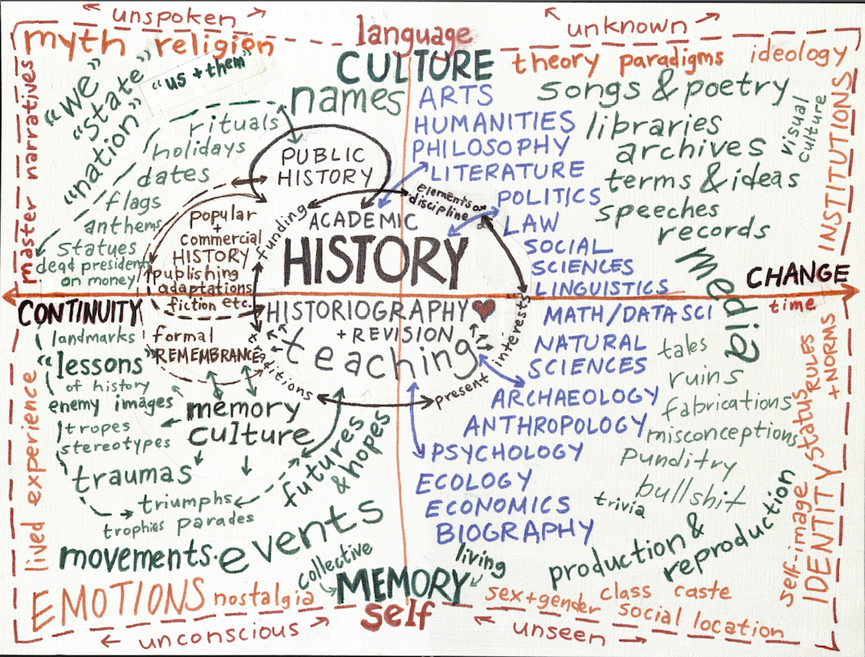

Slide 69
The End of #Zero
(c) 2022 NEL

